Slide 1
SDU International Club
OFFICIAL NEWSLETTER
No.76 – November 2013
November
Calendar
“Life starts all over again when it gets crisp in the fall”
F. Scott Fitzgerald, The Great Gatsby
November 6th @ 19.00
IC Dinner of the month
Meet new people and try new cuisine at our monthly dinner at Simoncini Restaurant, Vestergade 70, 5000 Odense. C. Simoncini's is centrally located in Odense and offers homemade Mediterranean cuisine using organic ingredients. Have dinner with your fellow internationals and make some new friends. Sign up as a soon as possible to enjoy the dinner of the month at sgg@sdu.dk
Price: 150 kr. (one course/one glass of wine)
November 16th
Studenterhuset Potluck
Come have fun with other internationals at the new Studenterhuset (Students’ House). Bring food to share ‘potluck’ style. The bar will be open. Drinks at student discount! And stay for a concert afterwards.
Sign up as soon as possible at sgg@sdu.dk
More details to come.
November 19th @ 20.00
After dinner drinks
Nelle’s Coffee & Wine,
Rosenbaek Torv 1, 5000 Odense. C.
What is there to do after dinner? Come join us for after dinner drinks at Nelle’s
where there is something for everyone. During the day, there is freshly baked bread and juice on offer. However, in the evening they serve simple dishes of great cheeses and charcuterie along with delicious wines from all over the world. Enjoy an evening of sampling in a cosy atmosphere.
by Evelina Kvartunaite
Life hits you. And when it does, it usually doesn’t hesitate.
And it hits you not once, and not even from only one direction. Perhaps that’s why it’s said, what doesn’t break you, makes you stronger. Or perhaps it’s all just your attitude. I sometimes feel that maturity is actually just a bitter disappointment and sarcasm in many ways is just a mask for a fragile soul. The question in this story is, can that be cured? Can we wake up healed and continue life as brave new people with no fear of falling over, starting again or disclosing something so well hidden just because that makes the world a happier place? Never bitter, always better.
Since when did this world became so open and closed at the same time? People don’t know open and closed snakes, as the Little Prince teaches us. You can find countless friends on social networks, but who would be the first person you would call for help? You can see the daily routines of random strangers, but you are afraid to admit you are having a bad day. It seems that the best quality to have these days is an impeccable filter for things that are good for you. And really good for you, not like an over-sized burger in a shiny ad or an overly sugared fizzy drink, but really REALLY good for you.
And it seems being different is not a problem anymore (despite the persistence of xenophobia). Yes, being different adds instant value or instant validation. I would like to aim not to be different but to be unapologetically unique. Look as if it’s a miracle (and it really is!), wake up feeling lucky to be you and share that with no fear, because in the end of the day we see things how we are and not how they are!
Page 1

Slide 2
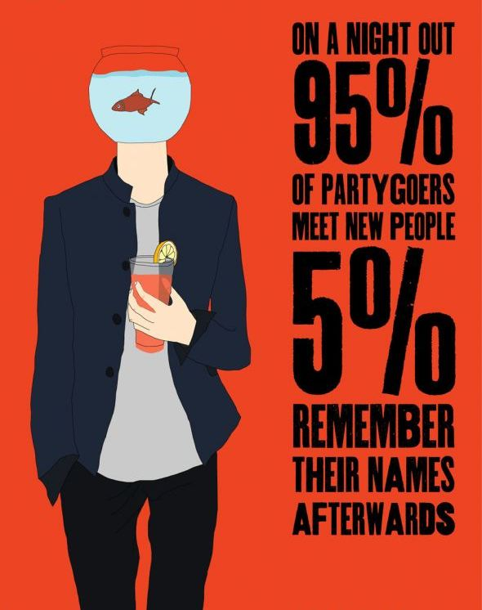
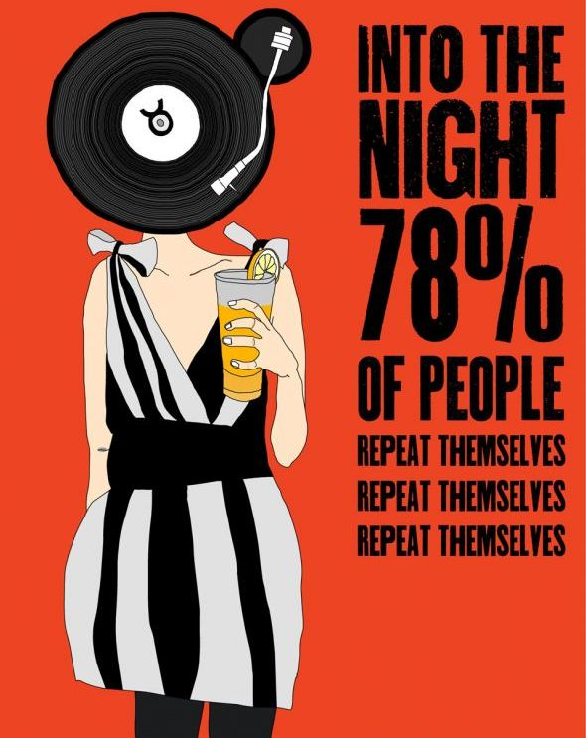
November
Yoga
Iyengar yoga is a methodology developed by B.K.S Iyengar for the practice of
Hatha Yoga. It focuses on precision in the execution of the poses. It is famous
for its therapeutic applications and for the special attention it pays to women’s
practice. It is also known for the use of props such as blocks, belts, blankets,
etc., which allow for safe and proper practice for people of any age or any
physical condition.
The class is designed for beginners. Feel free to join at any given time throughout
the span of the course.
The class is free of charge.
Mats and props will be provided.
When: Mondays 19:00-20:00 starting 21 October 2013
(No class on 11 November)
Where: Slotsvænget 1-3 & 4, 5000 Odense C (enter through the green gate and
head towards the building on the far left. Call if you get confused.)
Reka Forrai, Certified Iyengar Yoga Teacher (Intro II)
rekaforrai@yahoo.com tel. 2634 4043
November 27th @ 18.00
SDU Ladies Night Out
Vegetarian Potluck
Would you like to help create an SDU women’s network? Sandra has invited us to her house to discuss networking and work/life balance over dinner. Continuing in the scrumptious tradition of the past two vegetarian evenings, please bring a dish to share for 4 people (and your own drinks).
Hostess: Sandra
Address: Rørbækvej 5, 5230, Odense M
Sports Announcement
Football
Interested in playing football? Men’s and women’s teams will be organised soon. If you would like to put together your own team, email with a list of team members, or simply send an email if you would like to be put on a team. First come, first served. Keep in mind playing will take place on an indoor pitch.
Email Martin at MRSA@sdu.dk
More information will be forthcoming once interest has been gauged.
Page 2
Contact us
For further information to:
icnewsletter_odense@yahoo.com
IC Newsletter’s Staff: Evelina Kvartunaite, Editor and Design; Lorna Campbell, Proofreading.
Notes:
2

