Slide 1
Current State of Monitoring Open Access Output
Presentation at the OA Barometer Symposium
David J Solomon, PhD

Slide 2
Topics of this talk
Why monitor growth of Open Access?
Methodology
  Strategies, strengths and limitations
  Specific issues for Green and Gold OA
Current State of Open Access
  Green, Gold and Hybrid
  Danish Gold OA

Slide 3

Why is monitoring important
Assumptions
Open access to the research literature is a goal we should pursue
We are implementing strategies to achieve this goal
Monitoring allows you to assess:
The extent you have achieve your goals
The effectiveness of strategies promoting OA
How modify your strategies as so as to be more effective

Slide 4

How can we monitor growth in OA
Basic strategies:
Locate and obtain existing data
  Generally less expense
  Often allows much larger/more complete collection of information
  Often less than perfect fit between the needs and existing data
Gather new data
  Better fit between data and monitoring needs
  Tends to be more resource intensive
  Generally requires the need to sample
    Note: Even if you are using a sampling approach gathering your own data, you will need a sampling frame.
Is it possible to automate data collection?

Slide 5


Issues in Monitoring Green OA

Slide 6

How do you define green open access?
Freely accessible digital copies of published articles located at sites other than the official publisher website
The version or stage of publication that is archived
Where the green copies are archived
The delay between publication and archiving
Any restrictions on use/reuse etc.
How you collect data for monitoring purposes can intentionally or unintentionally impact on the definition of green OA for your project

Slide 7
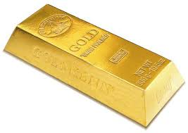
Issues in Monitoring Gold OA

Slide 8
Defining Gold OA
How to define gold OA
  Free immediate access to all content versus hybrid and/or delayed
  Licensing issues (Gratis versus Libre)
  Nonfinancial restrictions such as registration?
How do you determine if a journal is gold?
  DOAJ
  Ulrich Web
  Other?

Slide 9
Other issues in gold OA monitoring
Converted versus born
Determining article counts
Funding model
Publisher types

Slide 10
Current State of Green OA

Slide 11
State of Green Open Access (Mandates)
Gargouri et al estimates approximately 60% compliance with mandated archiving as compared with about 15% spontaneous archiving in the same journals/years.
Gargouri Y, Hajjem C, Larivière V, Gingras Y, Carr L, et al. (2010) Self-Selected or Mandated, Open Access Increases Citation Impact for Higher Quality Research. PLoS ONE 5(10): e13636. doi:10.1371/journal.pone.001363

Slide 12
State of Green Open Access (Mandates)
Compliance for the NIH mandate went from 19% to 49% the year (2008) it was made a requirement and is now at 75%¹
The UK Welcome Trust has been able to achieve a 55% compliance rate with its mandate²
Evidence suggests mandate strength impacts compliance³
¹http://poynder.blogspot.com/2012/05/open-access-mandates-ensuring.html
²Jump P. Welcome Trust Gets Tough on Open Access. Times Higher Education 29 March 2012 http://www.timeshighereducation.co.uk/story.asp?storycode=419475
³Gargouri, Y., Larivière, V., Gingras, Y., Carr, L., & Harnad, S. (2012). Green and Gold Open Access Percentages and Growth, by Discipline. In, 17th International Conference on Science and Technology Indicators (STI), Montreal, CA, 05 – 08 Sep 2012. 11pp. Available at: http://eprints.soton.ac.uk/340294

Slide 13
Bottom line on mandates
Mandates significantly increase compliance
Stronger mandates increase compliance more than weaker mandates
Mandates to date are NOT 100% effective nor anything close to it

Slide 14
State of Green OA (Location and Type)
Björk, B-C., Welling, P., Laakso, M., Majlender, P., Hedlund, T., & Gu!nason, G. (2010). Open Access to the Scientific
Journal Literature: Situation 2009. (E.Scalas, Ed.)PLoS ONE, 5(6), e11273. doi:10.1371/journal.pone.0011273.t003

Slide 15
State of Green OA by Discipline
Björk, B-C., Welling, P., Laakso, M., Majlender, P., Hedlund, T., & Gu!nason, G. (2010). Open Access to the Scientific Journal Literature: Situation 2009. (E. Scalas, Ed.)PLoS ONE, 5(6), e11273. doi:10.1371/journal.pone.0011273.t003
Gargouri, Y., Larivière, V., Gingras, Y., Carr, L., & Harnad, S. (2012). Green and Gold Open Access Percentages and Growth, by Discipline. In, 17th International Conference on Science and Technology Indicators (STI), Montreal, CA, 05 – 08 Sep 2012. 11pp. Available at: http://eprints.soton.ac.uk/340294/
Note: Figure from Björk B-C, Laakso M, Welling P, Paetau P. Anatomy of green open access. JASIST in press.
Available at http://www.openaccesspublishing.org

Slide 16
State of Green Open Access (Uptake)
Best current overall estimate of the literature available via green archiving is about 12%¹(Copies available at other than the publisher site)
Varies significantly by discipline^{2,3}
Commonly on author/departmental website²
A significant portion, perhaps a third of green OA appears to constitute unauthorized OA. Much as formatted PDFs from the publisher¹
¹Björk B-C, Laakso M, Welling P, Paetau P. Anatomy of green open access. JASIST in press.
Available at http://www.openaccesspublishing.org
²Björk, B-C., Welling, P., Laakso, M., Majlender, P., Hedlund, T., & Gu!nason, G. (2010). Open Access to the
Scientific Journal Literature: Situation 2009. (E. Scalas, Ed.)PLoS ONE, 5(6), e11273.
doi:10.1371/journal.pone.0011273.t003
³Gargouri, Y., Larivière, V., Gingras, Y., Carr, L., & Harnad, S. (2012). Green and Gold Open Access
Percentages and Growth, by Discipline. In, 17th International Conference on Science and Technology
Indicators (STI), Montreal, CA, 05 – 08 Sep 2012. 11pp. Available at: http://eprints.soton.ac.uk/340294/

Slide 17
Current State of Gold Open Access

Slide 18
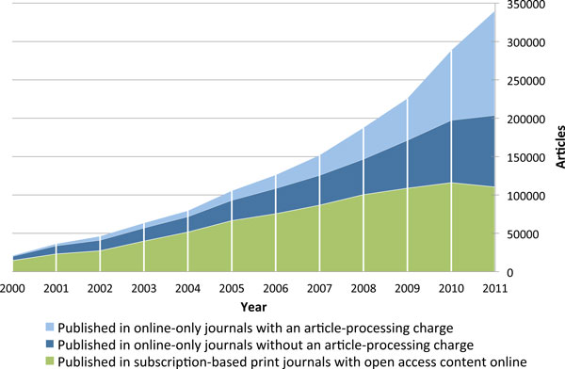
State of Gold Open Access (Growth)
Annual volumes of articles in full immediate open access journals, split by type of open access journal.
Laakso and Björk BMC Medicine 2012 10:124 doi:10.1186/1741-7015-10-124

Slide 19
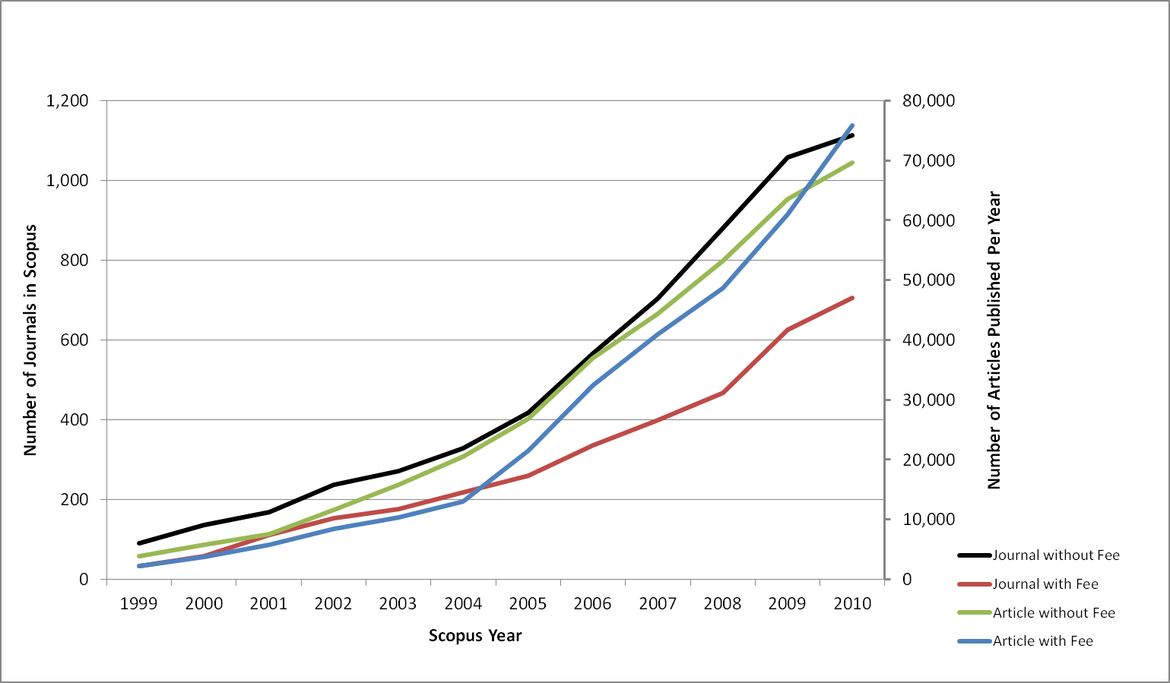
Growth in Gold OA (Journals in Scopus)
Growth of OA journals and articles in Scopus over 12 year period
Solomon DJ, Laakso M, Björk B-C. A longitudinal comparison of citation rates and growth among open access journals. Journal of Informetrics 7 (2013) 642– 650. doi:10.1016/j.joi.2013.03.008

Slide 20
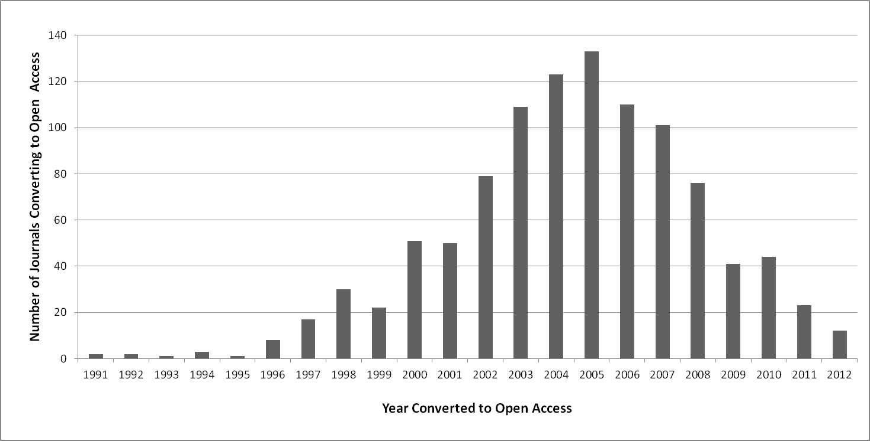
Journal conversions to OA in Scopus
Solomon DJ, Laakso M, Björk B-C. A longitudinal comparison of citation rates and growth among open access journals. Journal of Informetrics 7 (2013) 642– 650. doi:10.1016/j.joi.2013.03.008

Slide 21
Publisher Type Journals and Articles
Solomon DJ. Types of Open Access Publishers in Scopus. Publications 2013,
1, 16-26; doi:10.3390/publications1010016

Slide 22
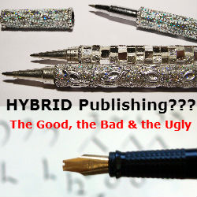

Slide 23
History of the hybrid model
First proposed in 1996 as a transition from paper to electronic reprints by Thomas Walker¹
Implemented in 2000 by the Entomological Society of America for 4 journals @ ~ 100 USD with high uptake.²
Proposed as a mechanism for transitioning to OA in 2003 by David Prosser³
A variety of publishers implemented hybrid models during 2002 – 2004 at steadily rising prices with lower uptake^{3,4}
In 2004 Springer launched “Open Choice” @ 3000 USD the expected price point for a transition to author pay OA⁴
Walker, T. (1996). Electronic reprints -- segueing into electronic publication of biological journals, BioScience 45, 171. Retrieved from http://www.fcla.edu/FlaEnt/bioscivp.htm
Walker, T. (2004). Open access by the article: an idea whose time has come? discussion item, Nature web site, etrieved from www.nature.com/nature/focus/accessdebate/13.html
Prosser, D. (2003). From here to there: a proposed mechanism for transforming journals from closed to open access. Learned Publishing, 16(3), 163-166.
Björk B-C. The Hybrid Model for Open Access Publication of Scholarly Articles – a Failed Experiment? Journal of the American Society for Information Science and Technology, in press available in accepted form at https://helda.helsinki.fi/handle/10138/23717 and http://www.openaccesspublishing.org/

Slide 24
Relationship between price and uptake¹
Prices and uptake percentages are approximations.
Oxford Press charged ~ 3’000 USD but gave 50% discounts when the author’s institution had a subscription.
Björk B-C. The Hybrid Model for Open Access Publication of Scholarly Articles – a Failed Experiment? Journal of the American Society for Information Science and Technology, in press available in accepted form at ttps://helda.helsinki.fi/handle/10138/23717 and http://www.openaccesspublishing.org

Slide 25
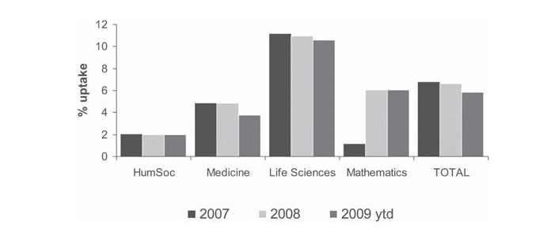
Hybrid uptake by discipline (one publisher*)
Oxford Press: Reflects a 50% discount from ~ 3000 USD price for authors at
subscribing institutions
Bird, C. (2010). Continued adventures in open access: 2009 perspective, Learned Publishing, 23(2), 107-116.

Slide 26
Bottom Line
Hybrid uptake by authors appears heavily influenced by cost
Uptake also varies by discipline but differences appear minor as compared with cost
Charges at levels that off that offset subscription fees appear to lower uptake to 1 or 2 percent
Hybrid OA appears a failure as a mode of transitioning subscription journals to OA*
*Björk B-C. The Hybrid Model for Open Access Publication of Scholarly Articles – a Failed Experiment? Journal of the American Society for Information Science and Technology, in press available in accepted form at https://helda.helsinki.fi/handle/10138/23717 and http://www.openaccesspublishing.org/

Slide 27


Gold OA in Denmark

Slide 28
Danish Gold OA
Based on country coding in the DOAJ as of 2013-Mar-26
  39 journals listing Denmark as the country in which they were published.
  34 (87%) did not charge author fees, 4 listed no information and one indicated their charges were conditional

Slide 29
Danish Gold OA
Language
  16 (41%) Danish and other languages
  16 (41%) English (only)
  5 (13%) Danish (only)
  2 (5%) Other languages

Slide 30
Danish Gold OA

Slide 31
Thank You !

