Slide 1



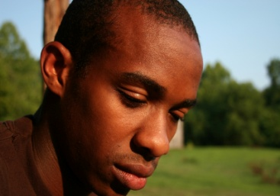


Is community collaboration associated with
reduced barriers and increased use of
evidence-based trauma treatments with children?
Benjamin E. Saunders, PhD
Rochelle F. Hanson, PhD
National Crime Victims Research and Treatment Center
Department of Psychiatry and Behavioral Sciences
Medical University of South Carolina
Charleston, SC USA
Presentation at the XV Conference of the European Society for Traumatic Stress Studies, Odense, Denmark, June 4, 2017.

Slide 2
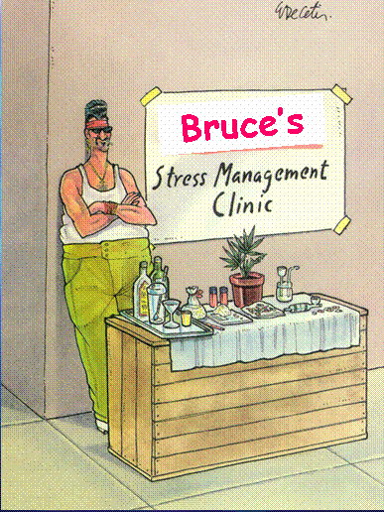
Goals for
Evidence-Based Treatments
Widespread, universal availability
High reach
Adequate fidelity
Good outcomes
Sustained use over time
Evidence-based
“Standard practice in our town.”

Slide 3
Common EBT Training and
Implementation Approaches
Training Only
Training + Coaching*
Learning Collaborative
Readings
Online courses
In-person training
Readings
Online courses
In-person training
Training cases
Expert coaching
Readings
Online courses
Multiple in-person training events
Training cases
Expert coaching
Senior Leaders
Supervisors
Org support & change
Barrier solving
Metrics
*Beidas et al., 2012
*Markiewicz et al., 2006
Focus on clinical providers and agency implementation only.
Notes:
Comment about intent/goals of CBLC in terms of collaboration (i.e., bringing all professionals across roles together; activities emphasize increasing communication, convos across professionals about cases, such as contacting about referral, assessment and treatment, overall case monitoring)
Highlight activities during CBLC that emphasize collaboration – community development, broker involvement, types of activities in LS; senior leaders

Slide 4
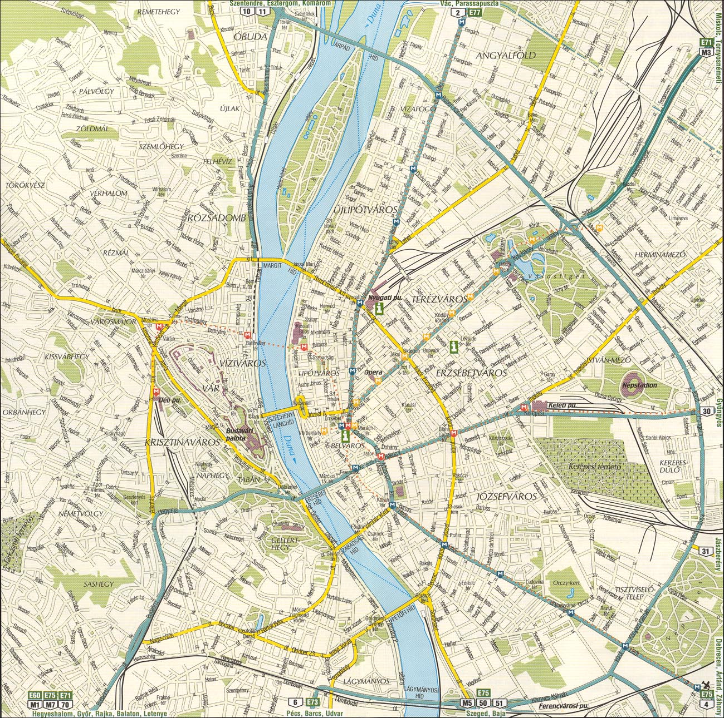
Probation
Sex Offender
Treatment
Law
Enforcement
Domestic
Violence
Medical
CACs
Group
Homes
MCOs
Rape
Crisis
Medicaid
Mentor
Programs
Juvenile
Justice
Victim’s
Compensation
No one agency can make it happen.
Parenting
Programs
Alternative
Care
Schools
Drug &
Alcohol
pRTFs
Family
Court
Mental
Health
Private
Practitioners
Child
Welfare
Victim
Advocates
Drug &
Alcohol
Criminal
Court
GALs
In-Home
Services
Bmod
Services
Foster
Homes

Slide 5



Bringing Evidence Supported Treatments to South Carolina Children and Families
Coordinating Centers
The Dee Norton Children’s Advocacy Center
Charleston, SC
National Crime Victims Research and
Treatment Center
Medical University of South Carolina
www.musc.edu/projectbest
Project BEST is funded by The Duke Endowment and participating agencies.

Slide 6
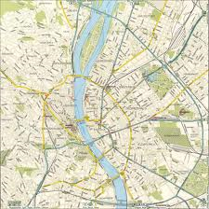
Relevant Service Systems
Juvenile Justice
Nonprofit
MH
Services
Rape Crisis Center
Medical
Public
Mental
Health
Referral
MH Providers
Child Welfare
Brokers
Private Practitioners
Schools
Victim
Advocates
MCO Providers
Guardian
Ad Litem
Notes:
6

Slide 7
Community as the Target
Community-Based
Learning Collaborative
Saunders & Hanson (2014)

Slide 8
Community-Based Learning Collaborative
Community Change Team
Clinical
Senior
Leaders
Broker
Senior
Leaders
Clinical
Supervisors
Families
Broker
Supervisors
Therapists
Brokers

Slide 9
National Survey of Child and Adolescent Well-Being
Coordination Improves Outcomes
N=1,613 children within 75 child welfare agencies over 36 months
Examined Interorganizational Relationships (IORs)
  Number of coordination approaches between each child welfare agency and mental health service providers
  Tested relationships between IORs, Service Use, and Outcomes
Greater intensity of IORs → more service use for children → greater mental health improvement.
Conclusion:
  Encourage organizational ties between child welfare and mental health service systems.
Bai, Y., Wells, R., Hillemeier, M.M. (2009). Coordination between child welfare agencies and mental health service providers, children’s service use, and outcomes. Child Abuse & Neglect, 33, 372-381.
Notes:
9

Slide 10

Hypotheses
Community Collaboration
Treatment
Barriers
More Children
Get EBTs
More Children Improve

Slide 11

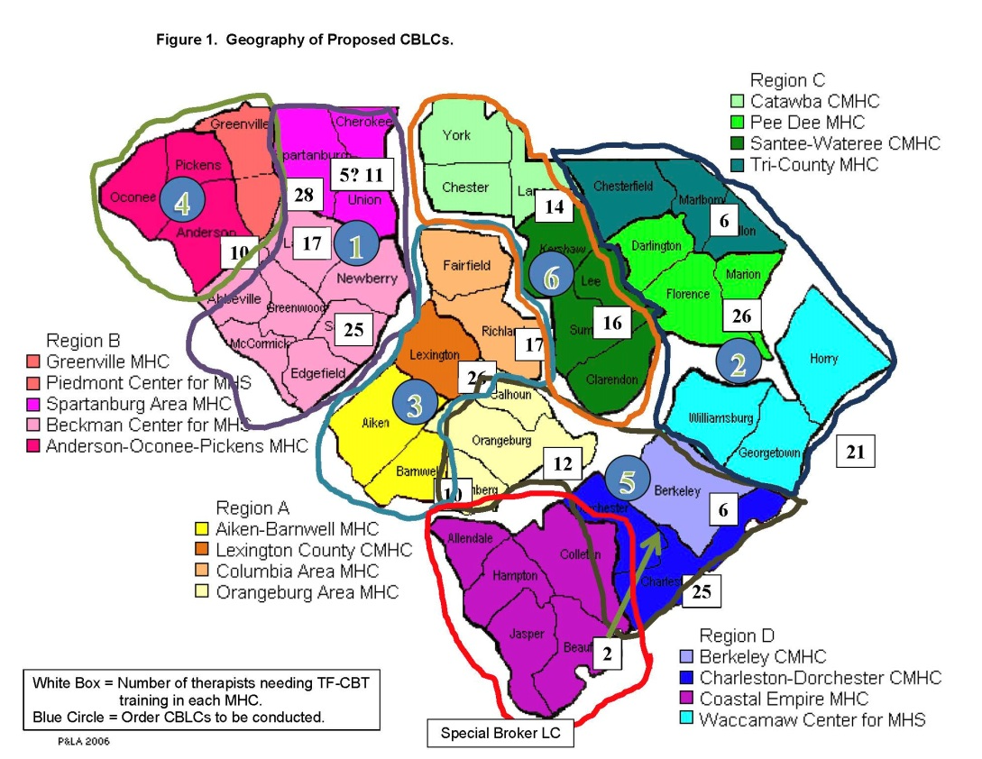
2014-15
SC Dept. of Mental Health
SC Dept. of Social Services
The South Carolina Trauma Practice Initiative was supported primarily by grant appropriation No. 1877-SP from The Duke Endowment.

Slide 12

SCTPI Completion Results
6 Community-Based Learning Collaboratives on TF-CBT
640 child abuse professionals participated
433 completed all requirements (68%)
    224 of 338 therapists completed all requirements (66%)
    112 of 175 brokers completed all requirements (64%)
    97 of 127 senior leaders completed all requirements (76%)
308 professionals completed pre- and post-assessments*
1027 clinical training cases began TF-CBT
566 cases completed treatment (55%)
d_{pre-post} = 1.36; 85.5% improved
*Pre-CBLC community collaboration items were in only 5 of the 6 CBLC’s.

Slide 13
Community Collaboration
Table 1. Community collaboration Pre- and Post-CBLC assessments – All participant roles
Item (1-5) | Pre CBLC M (SD) | %³ | Post CBLC M (SD) | %³ | t (273)
Overall quality of collaboration | 3.13 (0.88) | 34.7 | 3.39 (0.90) | 49.3 | 4.93***
Frequency sharing assessment info | 2.99 (0.93) | 30.3 | 3.17 (0.96) | 41.2 | 2.87**
Frequency sharing tx progress info | 2.97 (0.91) | 28.8 | 3.15 (0.97) | 40.2 | 2.89**
Frequency that agencies meet | 2.76 (1.04) | 25.7 | 3.02 (0.99) | 37.5 | 3.80***
Work together to overcome barriers | 2.80 (0.94) | 26.7 | 3.11 (0.97) | 38.2 | 5.03***
Work to insure clients complete tx | 2.77 (0.90) | 23.3 | 3.11 (0.94) | 37.7 | 5.91***
Make sure clients don’t fall thru cracks | 2.61 (0.86) | 16.1 | 3.00 (0.93) | 31.6 | 6.49***
Coordinate services, not overwhelmed | 2.58 (0.90) | 15.8 | 2.88 (1.00) | 29.0 | 4.70***
Comm. Collaboration Scale (0-32)¹ | 14.6 (6.1) | 25.2⁴ | 16.9 (6.4)² | 38.1⁴ | 6.07***
N=274; **p<.01; ***p<.001. ¹α= 0.93; ²d=0.37; ³Good-Excellent or Frequently-Nearly Always. ⁴Average across items.

Slide 14
Community Collaboration by Track
Table 2. Community Collaboration Scale pre- and post-CBLC by track.
Role | Pre CBLC | Post CBLC | t | d | n
Clinicians | 14.19 (6.41) | 15.74 (6.21) | 3.04** | 0.24 | 154
Brokers | 13.74 (5.95) | 16.77 (6.59) | 3.62** | 0.51 | 53
Senior Leaders | 16.38 (4.93) | 19.53 (6.07) | 4.88*** | 0.64 | 67
**p<.01; ***p<.001.

Slide 15
Barriers to Treatment
Table 3. Barriers to treatment Pre- and Post-CBLC assessments – All participant roles.
Barrier to Treatment | Pre-CBLC M(SD) | %¹ | Pre-CBLC M(SD) | %¹ | t(278)
Not enough trained therapists | 3.09 (1.03) | 32.7 | 2.52 (1.03) | 16.5 | 7.58***
Brokers unaware of appropriate EBTs | 2.94 (1.02) | 28.9 | 2.33 (0.89) | 8.0 | 8.89***
Families unable to attend office-based treatment | 3.21 (0.92) | 41.4 | 3.05 (0.94) | 32.9 | 2.31*
EBTs not included in service plans | 2.61 (1.07) | 20.2 | 2.04 (0.98) | 8.7 | 8.29***
EBTs not offered in locations near clients | 2.81 (1.13) | 28.2 | 2.25 (1.08) | 14.0 | 7.57***
Insurance will not pay for EBTs | 2.08 (1.10) | 13.0 | 1.68 (0.99) | 6.1 | 5.49***
Few agencies deliver EBTs with fidelity | 2.79 (1.09) | 26.2 | 2.26 (0.99) | 11.9 | 7.26***
Brokers unaware of agencies that deliver EBTs | 2.80 (1.05) | 26.2 | 2.29 (1.01) | 12.0 | 7.01***
Clinicians cannot see clients weekly | 2.62 (1.07) | 21.0 | 2.42 (1.08) | 17.4 | 2.71**
Poor communication between brokers and therapists | 2.86 (1.02) | 29.5 | 2.57 (0.96) | 16.2 | 4.77***
Long wait lists for EBTs | 2.55 (1.11) | 21.5 | 2.05 (1.04) | 10.5 | 7.28***
Lack of monitoring EBTs by brokers | 2.68 (1.05) | 21.7 | 2.37 (1.01) | 13.5 | 4.35***
Low demand for EBTs | 2.01 (1.06) | 9.1 | 1.70 (0.88) | 4.3 | 5.05***
Barriers Scale² (0-52) | 22.1 (9.3) | 24.6⁴ | 16.5 (8.4)³ | 13.2⁴ | 10.24***
N=279; *p<.05; **p<.01; ***p<.001. ¹Percent answering “Very frequently” or “Nearly always a barrier.” ²α= 0.89. ³d=0.61. ⁴Average across items.

Slide 16
Barriers by Track
Table 4. Barriers Scale pre- and post-CBLC by role.
Role | Pre CBLC | Post CBLC | t | d | n
Clinicians | 20.6 (9.1) | 15.1 (7.5) | 7.87*** | 0.60 | 155
Brokers | 25.3 (8.7) | 20.4 (9.9) | 3.29** | 0.56 | 55
Senior Leaders | 23.1 (9.4) | 16.4 (8.0) | 6.24*** | 0.71 | 69
**p<.01; ***p<.001.

Slide 17
Estimates of
Children Completing Treatment
Table 5. Percent of abused children completing trauma treatment estimates, pre- and post-CBLC by role.
 | Clinicians |  | Brokers |  | Senior Leaders |  | All Respondents
 | Pre-CBLC % | Post-CBLC % | Pre-CBLC % | Post-CBLC % | Pre-CBLC % | Post- CBLC % | Pre- CBLC % | Post- CBLC %
Mean | 31.3 | 45.9 | 34.7 | 40.1 | 34.8 | 48.3 | 32.8 | 45.3
SD | 22.2 | 24.4 | 17.9 | 24.7 | 23.2 | 21.5 | 21.7 | 23.9
Median | 25.0 | 50.0 | 35.0 | 40.0 | 30.0 | 50.0 | 30.0 | 50.0
Range | 0-85 | 0-97 | 0-75 | 0-90 | 0-90 | 3-100 | 0-90 | 0-100
N |  | 151 |  | 53 |  | 66 |  | 270
t |  | 7.02*** |  | ns |  | 3.94*** |  | 7.64***
**p<.01; ***p<.001.
“Thinking about all the abused and traumatized children in your community, what is your best estimate of the percentage of those children that engage in, receive, and successfully COMPLETE evidence-based trauma treatment?”

Slide 18
Correlation Matrix
Table 6. Associations between pre- and post-CBLC collaboration, barriers, and treatment completion estimates.
Variable | Collabor. Pre | Collabor. Post | Barriers Pre | Barriers Post | % Compl. Tx Pre
Collaboration-Post | .52*** | 1.00
Barriers-Pre | -.33*** | -.23*** | 1.00
Barriers-Post | -.19** | -.25*** | .45*** | 1.00
% Complete Tx-Pre | .53*** | .30*** | -.31*** | -.12^{T} | 1.00
% Complete Tx-Post | .30*** | .41*** | -.22*** | -.31*** | .30***
N=270. **p<.01; ***p<.001.

Slide 19
Mediational Analyses
Table 7. Mediation analysis for barriers to treatment -- initial assessment.
Model | B |  | Beta |  | R |  | R² |  | ΔR² |  | F |  | t
Collab. -> %Tx | 1.74 |  | 0.50 |  | 0.50 |  | 0.25 |  | 0.25 |  | 181.3*** |  | 13.47***
Collab. -> Barr. | -0.46 |  | -0.31 |  | -0.31 |  | 0.10 |  | 0.10 |  | 58.0*** |  | -7.61***
Barr. -> %Tx | -0.67 |  | -0.28 |  | -0.28 |  | 0.08 |  | 0.08 |  | 47.6*** |  | -6.90***
Collab. + Barr. -> %Tx
Collaboration | 1.58 |  | 0.46 |  | 0.50 |  | 0.25 |  | 0.25 |  | 181.3*** |  | 11.81***
Barriers | -0.34 |  | -0.14 |  | -0.52 |  | 0.27 |  | 0.02 |  | 13.6*** |  | -3.69***
N=550. ***p<.001.
Table 8. Mediation analysis for barriers to treatment -- final assessment.
Model |  | B |  | Beta |  | R |  | R² |  | ΔR² |  | F | t
Collab. -> %Tx |  | 1.54 |  | 0.42 |  | 0.42 |  | 0.17 |  | .17 |  | 62.0*** | 7.88***
Collab. -> Barr. |  | -0.33 |  | -0.25 |  | -0.25 |  | 0.07 |  | 0.07 |  | 20.4*** | -4.52***
Barr. -> %Tx |  | -0.88 |  | -0.31 |  | -0.31 |  | 0.10 |  | 0.10 |  | 31.2*** | -5.59***
Collab. + Barr. -> %Tx
Collaboration |  | 1.34 |  | 0.36 |  | 0.42 |  | 0.17 |  | 0.17 |  | 62.0*** | 6.78***
Barriers |  | -0.62 |  | -0.22 |  | -0.47 |  | 0.22 |  | 0.04 |  | 16.6*** | -4.08***
N=297. ***p<.001.

Slide 20

Treatment
Barriers
Community Collaboration
More Children
Get EBTs
More Children Improve

Slide 21
Conclusions
Perceived community collaboration improved significantly.
  Different roles had different perceptions of collaboration improvement.
  Clinicians reported the least improvement, senior leaders the most.
Barriers to treatment were reported to be significantly reduced.
  Brokers described less reduction than clinicians or senior leaders.
Estimates percentage of children completing treatment varied by role.
  Clinicians and Senior Leaders reported significant increases.
  Brokers saw no significant change.
Greater collaboration related to reduced barriers to treatment.
Reduced barriers related to increased treatment completion estimates.
Barriers partially mediated relationship between collaboration and treatment completion estimates.
Supports the place of increasing community collaboration as part of community implementation of an EBT.

Slide 22
Colleagues
Michael de Arellano, PhD
Daniel Smith, PhD
Heidi Resnick, PhD
Angela Moreland, PhD
Jan Koenig, MEd
Faraday Davies, MA
Emily Fanguy
Sara delMas
Carrie Jackson
Raelle Saulson
Medical University of South Carolina
Monica Fitzgerald, PhD
University of Colorado
Elizabeth Ralston, PhD
Elizabeth Hinson, MSW
Carole Swiecicki, PhD
Rachael Garrett, MSW
Lizabee Ciesar, MSW
Kathy Quinones, PhD
Kim Reese, MSW
Aliza MacClellan, MSW
Polly Sosnowski, MSW
Dee Norton
Child Advocacy Center
The Duke Endowment
SC Dept. of Mental Health SC Dept. of Social Services
SC Network of Children’s Advocacy Centers

Slide 23
Contact Information
saunders@musc.edu

