Slide 1
The political economy of energy transitions
Espen Moe, Department of sociology and political science, NTNU
Notes:
Is it all about markets? Is it all about getting the price right? Is it all about resource endowments? NOPE!
Nothing is more political than energy these days. And everything is connected… Tech-economics-politics triangle. Industrial ecology story

Slide 2
How do we know when/if an energy transition has begun?
Many dimensions and many challenges
Lower energy consumption
«Higher» energy production (= phasing in of new energy production)
Onto electricity as fast as possible
Electricity renewable as fast as possible
My angle
We know that it has begun when renewable energy doesn’t just complement the existing energy system, but when it actually replaces/transforms it.
Instead of, not in addition to…!

Slide 3
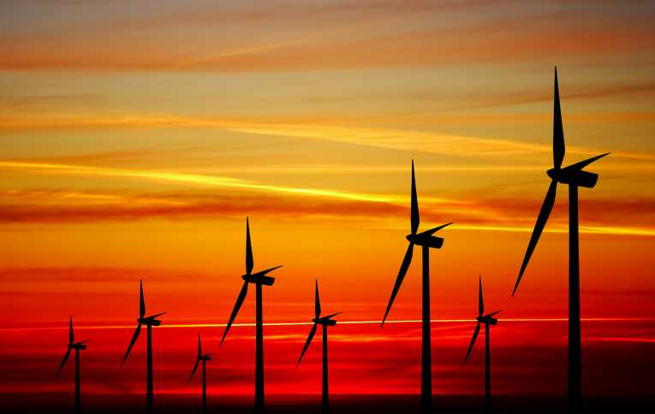
Has it begun?
Strong growth (20-40% per year)
Solar PV 100-fold growth since 2004 (401GW)
Wind 30-fold growth since 2000 (542GW)
Investments 6-fold growth since 2004
Costs rapidly falling
Wind and solar now competitive on price in many markets
Offshore wind still not, but suddenly realistic in the foreseeable future
Renewable installations > fossil fuel installations
But still, compared to oil…
≈87mb/d → 97mb/d
Hydro 4* as much electricity as wind and solar together
Fossil 5* as much electricity as hydro
Notes:
Costs. But also to do with Chinese oversupply. Not all of this is because of technological progress. More so in wind than in solar.
Fracking: In the US brought the price of shale gas down from $13 per million thermic unit to 2$. USA nå verdens største gassprodusent, etter at shale gas-prod firedoblet 2007-10. USA now self-sufficient in gas, and it’s cheap! A third of the German price.
Shale oil/tight oil også. Har økt USAs oljeproduksjon med en tredel siden 2009.
IEA, innen 2020, USA større oljeprodusent en Saudi Arabia!
Vind en mer moden teknologi, så svakere vekst.
Investeringer opp fra $40 mrd til rundt $250
PRC
Til tross for at ingen land ekspanderer fortere på kull, in 2012, for the first time, wind power generation increased more than generation from coal, and that total wind power output, at more than 100TWh (and considerably up since 2011) for the first time actually exceeded nuclear power output. At approximately $65 billion, China in 2012 spent nearly twice as much as the US ($35.6 billion) on clean energy projects.
Særlig i Europa nå typisk slik at kapasitetsøkningen fra fornybar pr år er større enn kapasitetsøkningen fra noen andre energikilder, og til og med nå slik I USA for utvalgte år.
China: Now installing more REN than nuclear.

Slide 4
Solar PV vs. wind, cumulative and annual installations

Slide 5
Clean energy investments, billion $, 2004-17
Notes:
Financial crisis, dip. (Would have been a big dip without China.) But then pick up again. 2011 not a good year.
But worth noting that net investments in REN now $40b higher than in fossil fuel capacity.
5-6 times 2004 (depending on dataset)
US invm increased by 57%. BUT: Mainly to take advantage of support policies coming to an end. Which means: KNOW YOUR DATA!

Slide 6
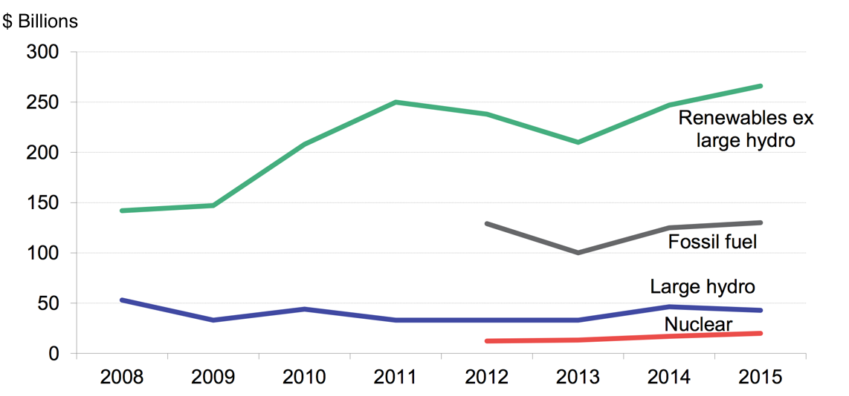
Notes:
https://www.bloomberg.com/news/articles/2015-04-14/fossil-fuels-just-lost-the-race-against-renewables
https://www.bloomberg.com/news/articles/2016-04-06/wind-and-solar-are-crushing-fossil-fuels

Slide 7
Japan: Fukushima triggers solar growth
Notes:
Some info on JP: Some of the strongest vested interests in the world. Very strong electric utility companies. Obsession with nuclear power.
Does politics matter? YES! 2009 FIT, but only for solar. 2011, new FIT for both solar and wind, but more for solar. But also shows that not necessarily only about the FIT, but also about other types of politics. Wind not respond as well as solar because lacking in other respects. Priority access? Nope. Maybe. Can still shut wind power out of the(ir) grid.
Also, about imports. Stimulating Japanese industry, but more than 50% is imports.
Solar, straight to the house. Customers of the utility company, grid already strong. Utility company having a hard time refusing this. Wind power, independent power producers in areas with weak grid lines.

Slide 8
China: Strong growth in wind

Slide 9
Germany: Strong growth, solar and wind

Slide 10
Renewable share of electricity production

Slide 11
Has the energy transition begun?
Strong growth (20-40% per year)
Solar PV 100-fold growth since 2004 (401GW)
Wind 30-fold growth since 2000 (542GW)
Investments 6-fold growth since 2004
Costs rapidly falling
Wind and solar now competitive on price in many markets
Offshore wind still not, but suddenly realistic in the foreseeable future
Renewable installations > fossil fuel installations
But still, compared to oil…
≈87mb/d → 97mb/d
Hydro 4* as much electricity as wind and solar together
Fossil 5* as much electricity as hydro
Notes:
Costs. But also to do with Chinese oversupply. Not all of this is because of technological progress. More so in wind than in solar.
Fracking: In the US brought the price of shale gas down from $13 per million thermic unit to 2$. USA nå verdens største gassprodusent, etter at shale gas-prod firedoblet 2007-10. USA now self-sufficient in gas, and it’s cheap! A third of the German price.
Shale oil/tight oil også. Har økt USAs oljeproduksjon med en tredel siden 2009.
IEA, innen 2020, USA større oljeprodusent en Saudi Arabia!
Vind en mer moden teknologi, så svakere vekst.
Investeringer opp fra $40 mrd til rundt $250
PRC
Til tross for at ingen land ekspanderer fortere på kull, in 2012, for the first time, wind power generation increased more than generation from coal, and that total wind power output, at more than 100TWh (and considerably up since 2011) for the first time actually exceeded nuclear power output. At approximately $65 billion, China in 2012 spent nearly twice as much as the US ($35.6 billion) on clean energy projects.
Særlig i Europa nå typisk slik at kapasitetsøkningen fra fornybar pr år er større enn kapasitetsøkningen fra noen andre energikilder, og til og med nå slik I USA for utvalgte år.
China: Now installing more REN than nuclear.

Slide 12
Is there a transition yet?
So far; renewable has been a supplement, not a replacement
Old and established energy structures still there
5.5% of electricity, 1.6% of total energy consumption
Fossil fuels + nuclear: 75-80%
Renewable energy has not led to any structural change in the energy system
But there are places where the limits of the old system are challenged
Where change is necessary, but it is hard to predict what kind of change
Not obvious that renewable energy wins!
Germany, PV as disruptive technology, «prosumer» revolution
No energy transition yet, but we may be getting close(r)…!
Notes:
7.9 if include biomass, geothermal and ocean/tide
Denmark 42%, Germany 13+6 (+ biomass = 8) = 27%
Norway: 96-98% = hydro
China only 3%+, USA only 6%
Hvordan vet vi at/om det grønne skiftet har begynt?
Noen steder hvor det grønne skiftet kanskje er iferd med å begynne. Hvor systemet knaker i sammenføyningene. Hvor umulig å gå videre med det gamle (ok, kanskje i Norge…), men hvor vanskelig å spå om veien videre. Reform eller backlash. Mektige interesser som utfordres, og det er ikke sikkert at det er det nye som vinner.

Slide 13
Renewable energy share of electricity production (2016)
Notes:
Wind + solar = 4 (3.1+0.9) → [4.9% [3.7 + 1.2] → 5.5 (4+1,5)
Fossil fuels still at roughly 75%, down from about 80.
Wind way bigger than solar? About technology. Efficiencies. So, difference between generation and installation. 1GW wind more electricity than 1GW solar. 1GW coal more electricity than 1GW wind.

Slide 14
Share of electricity production

Slide 15
Share of global final energy consumption
Notes:
Fossil 80.4 → 78.3
Hydro 3.2 → 3.9
Nuclear 2.8 → 2.5
REN 0.7 → 1.4 → 1.6

Slide 16
Is there a transition yet?
So far; renewable has been a supplement, not a replacement
Old and established energy structures still there
5.5% of electricity, 1.6% of total energy consumption
Fossil fuels + nuclear: 75-80%
Renewable energy has not led to any structural change in the energy system
But there are places where the limits of the old system are challenged
Where change is necessary, but it is hard to predict what kind of change
Not obvious that renewable energy wins!
Germany, PV as disruptive technology, «prosumer» revolution
No energy transition yet, but we may be getting close(r)…!
Notes:
7.9 if include biomass, geothermal and ocean/tide
Denmark 42%, Germany 13+6 (+ biomass = 8) = 27%
Norway: 96-98% = hydro
China only 3%+, USA only 6%
Hvordan vet vi at/om det grønne skiftet har begynt?
Noen steder hvor det grønne skiftet kanskje er iferd med å begynne. Hvor systemet knaker i sammenføyningene. Hvor umulig å gå videre med det gamle (ok, kanskje i Norge…), men hvor vanskelig å spå om veien videre. Reform eller backlash. Mektige interesser som utfordres, og det er ikke sikkert at det er det nye som vinner.

Slide 17
Energy transition: Is politics important?
Economists: All about getting the prices right
Engineers: All about getting the technologies right
Geographers (and others): All about resource endowments
Instead: Why structural change is difficult = vested interests. Very strong interests in preserving the status quo.
Joseph Schumpeter, Mancur Olson
Major structural change always fought by the losers = existing vested interests
Few changes are bigger than a transition from fossil fuels to renewables.
Oil, gass, coal, nuclear had decades to build political influence, to get beneficial regulations and shaping the institutional framework.
But renewables usually need different institutions and regulations!
Industrial giants: Organized, access to politicians, allies within institutions, media, politics.
Politically easier for the state to support old and ”safe” industries than new and ”risky” ones.
Old industries effectively blocking the rise of new industries.
Renewable energy has no level playing field, but has to rise in the shadow of some of the largest industrial giants the world has ever seen.
Notes:
Slipper ikke unna.
Vested interests som kjernebegrep. Påstand; at bare om man analyserer vested interest-strukturen at man skjønner hvorfor politikken har blitt som den har blitt. Det som forklarer hvorfor noen gjør det godt og andre mindre godt.
11/12 biggest companies on the planet. Resource extraction in some kind of way.
*Vested interests accumulate economic and political power and influence. Securing regulations and institutional arrangements that fit their own interests.
*Arrangements in the favor of old and established industry often not in the interest of new and vulnerable industries.
*Economies that do not prevent their vested interests from controlling economic policy-making doomed to long-term stagnation and decline.
*Easier for the state to support old and ”safe” industries than new and promising, but ultimately ”risky” industries.
*Old industries effectively blocking new industries.
*A system that ”sows the seeds of its own destruction”.

Slide 18
Energy, resource extraction and vested interests
Every reason to believe that vested interests a problem with respect to energy
Some of the biggest industrial giants ever
Oil companies, electricity companies
Costly infrastructure, sunk cost
Major political connections
Potentially the biggest process of structural change in the past 100 years!
Switching from one energy paradigm to the next not something that happens overnight!
(Even if it may be good for the economy…)
Notes:
11 of the 12 biggest industrial giants.
Supporting oil and gas once a wise policy. Is it still so today? Might seem so. Sector in which Norway already a big player, with a major comparative advantage. And while Norway hit peak oil a few years ago, gas is still very much an expanding economic activity. Stupid not to exploit those resources that Norway as a country has been blessed with from mother nature, would it not?
No doubt that oil and gas will remain among the most important Norwegian economic activities for years to come. Anything else would defy both political and economic rationale. However, there is more to the story, or maybe rather; if there was more to the story, this would be very desirable for Norway. This has to do with the prospects for growth in other industries than oil and gas, more specifically within renewable industries (in this paper for practical purposes limited to wind and solar). Hence, the crucial question; is Norway’s economic future going to be all about oil and gas (as before), or will it be linked to growth in new industries, like renewables (wind, solar)? And equally crucial, but maybe less obvious; is the existence of a huge oil and gas industry a benefit or a problem for the growth of renewables? Could it be that the oil and gas industry effectively prevents Norway from structurally changing? That it instead locks the country into an industrial status quo, one that is doomed to fail as the remaining fossile resources inevitably deplete, and as climate change makes it ever less acceptable to rely on fossil fuels?
Main point: importance of Norwegian success within the field of renewable technologies and industries. This is important from an environmental perspective, from an energy perspective and from an economic and industrial perspective. Hence, one of the main point of this paper is also that renewable energy, renewable technologies or renewable industries should not be thought of either as a way of meeting present and future CO2-emission standards, or as a way of boosting Norwegian energy supply, or as a future industrial goldmine. It is potentially all of the above. It is because it is all of the above – not just one out of three. Finally, another main point of this paper is that this may not happen at all in Norway, for reasons that have to do with the existing industrial structure and the power and influence wielded by the existing actors of the system.

Slide 19
Will it lead to economic growth?
As in a new wave of growth?
Could lead to growth industries
Very likely that both solar and wind will keep growing fast for several decades still to come.
Cluster of growth industries
Investments will keep increasing
Constraints on future growth through for instance carbon taxes benefit renewables
Peak oil?
New Green Growth?
Europe instead subsidizing Chinese growth?!
Industrial growth = economic growth?
Not necessarily
Still based on subsidies (but maybe not much longer) → success is expensive!
Expensive infrastructure that needs to be built.
Notes:
Petrol subsidies still far higher: $523b vs $88b [although figures biased by the Arab spring]
Without subsidies no growth.
Denmark. Negative investment
Fuinhas: Led to reduced growth
Estimated jobs worldwide, 5m; 0.8m in PV, 0.67m in wind. Total in EU 1.1m, PRC 1.6m. Doesn’t matter if it steals jobs from other sectors!
But could also be that will eventually become competitive. Schilling and Esmundo article on how REN actually doing pretty well in terms of becoming competitive. Could happen. But probably not right now. Then again, that has been the case with other waves as well. Just that they weren’t contingent on subsidies in order to survive.
But then again, fossil fuel subsidies as well, and externalities. China, externalities from air quality amount to 8% of GDP a year. Huge! Japan, possible that nuclear subsidies and side-payments so big that wind power no more expensive.
So, will it lead to economic growth? In the short term not. But it’s complicated. And maybe to some extent the reason why it does not lead to growth is because our economic indicators are biased.

Slide 20
Is an energy transition compatible with economic growth? Is growth bad?
We always seek economic growth.
Economically dynamic societies as important as ever
But probably more restrictive constraints on growth than before
Do we need to change our way of life?
Yes: Can’t consume more and emit less. Economic growth → increased emissions
No: Unless the old energy system is replaced by a new one!
Problems that have to be solved
Energy production (here ≈we know what works and what the problems are)
«Recycling» (here we have come considerably shorter)
Circular economy
Area usage: Bioservices, habitat loss, BECCS (short here as well…)
Negative emissions (really short…)
Notes:
Vs. økonomisk vekst i Østblokk o.l.?
Så, hva er økonomisk vekst? Football result version of economic growth. Know the result, may know the goal scorers, don’t know a damn thing about the game!
China. Elizabeth Economy: Environmental degradations equalling 8-10%/year!
Zero growth economists
Robert Gordon. Growth will never return to old levels.
Need to do what we can to keep the political economy dynamic. Growth ends when that dynamic ends, but without this having any beneficial effects on the environment. The green shift IS a dynamic political economy.
Compatible with capitalism? Completely depends on what we mean by capitalism. Unrestricted capitalism, definitely not…!
But zero growth in itself says absolutely nothing about the environment. What IS true, is that economic activity brings emissions with it. When we consume more, we also emit more. This is a problem…!

Slide 21
Neoclassical solution: Market mechanisms will solve the problem
Industrial neutrality and cost effectiveness
The green shift happens once renewable energy becomes competitive?
Polluter pays principle?
Finding the «right» price for externalities
But if all the apples need to picked, is there such a thing as a «right» price?
Market mechanisms → phasing in of REN, but no system change
Carbon taxes: Must be so high that politically impossible
ETS: Carbon quota markets need a strong regulator (otherwise carbon price ≈ 0)
Market mechanisms rarely build infrastructure
The problem is structural: We need system change, not tinkering and incremental change. But this is politically very difficult!
Notes:
When is renewable electricity as cheap as «regular» electricity?
Not yet, but not that far away
Retail vs. wholesale
2014, 19 countries reached retail solar grid parity
Wind power, some countries 2010
Depends on the electricity price!
Eksempel med røyking og skatt på nikotin.
El-biler viktige, ikke fordi noen el-biler i Norge fører til stor nedgang i klimautslipp, men fordi vi bidrar til å fremme noe som kan gi en strukturendring. Er ikke slik at det er en transportfri verden vi etterstreber. Målet er forurensningsfri transport.
Apples on the tree.

Slide 22
Lack of state/institutions
Notes:
EPA, Scott Pruitt, another example of what may happen if all the top assignments are political.

Slide 23
Lack of market mechanisms
Notes:
Grid line problems anywhere. But especially bad in China. Probably relevant for Poland as well?
Curtailment problems.
Easy for politicians to allow a subsidy. Leaving it up to the industrial actors and to the markets. But if not coordinated with grid expansion, then get curtailment problems.
20% for wind, 9% for PV. And off-grid capacity.
China, installations been more important than generation. First, energy-security, then industrial, then climate.

Slide 24
Wind power in Scandinavia (MW)

Slide 25
Notes:
CCS: 14%
REN: 33%
Energy eff: 36% End-use fuel and electricity efficiency
Fossil fuel switching: 10%
Nuclear: 6%
På sektor:
Power sector: 39%
Industry: 21%
Transport 19%
Residential: 7%
Services: 6%
Other: 6%
Agriculture: 0%

Slide 26
Neoclassical solution: Energy efficiency?
IEAs 2C projections: 35-40% = largest singular component
Often the most cost effective solution
Politically easy
(May even increase your exports…!)
Does it have system changing effects?
Rebound effect
Or does it just reduce the pressure on the already existing energy system?
End-of-pipe
Reducing the electicity consumption
(Which is already renewable in Norway…)
Makes it easier for us to continue as before?
Could end up as false security [sovepute]?
Notes:
Byggsektoren helt opplagt viktig

Slide 27
Is Norwegian wind power a good idea?
Depends on the system boundaries…
Norway as a system: Nope.
Regional politics/economics
Probably have enough electricity without extra wind power
Also if electrifying the transportation sector and the continental shelf
Jens Stoltenberg and green certificates
Europe as the system: Yes/it depends…
Phasing out fossil fuels requires fast and massive phasing in of renewables
Norway has the best renewable resources in Europe
Norway as a green battery (and continued energy exporter)
Carbon-free energy will become a competitive advantage for Norwegian industry(?)
Norway needs to be compensated for its energy exports
Subsea cables to foreign countries
Interest battles, power companies vs. energy intensive industry + households, ACER
Notes:
Kabling er grønt skift

Slide 28
How about petrol taxes, toll roads and car-free downtown areas?
Goal is carbon free transportation, not a transport free society!
Fight over petrol taxes a year and a half ago purely symbolic!
Effect that completely on the margin
Part of a larger debate on green taxes and fees
Behavioral change by changing incentives (Grønn skattekommisjon)
Side-track! Will NEVER lead to a shift
Green shift (in the transport sector)?
Phasing in electric cars as fast as possible on as large a scale as possible
(Driven by renewable electricity)
Not cost effective (at all!), but potentially lead to a system change.
(And public transportation)
Notes:
Fokus på etterspørselssiden, ikke på tilbudssiden. Fokus på folks etterspørsel etter fossile løsninger. Vs. fokus på tilbudet av alternative løsninger.
Hvordan få et strukturelt skift, et kvalitativt skift, av inkrementelle, kvantitative endringer?!

Slide 29
Conclusions: Markets and state
So far we’ve done the easy part of the green shift
FITs or green certificates
State: Framework conditions (costs money, but little action).
Industrial actors in the market place doing the actual work.
Renewable energy in addition to fossil fuels
Result: Rapid phase-in of renewable energy – up to a certain level
Expensive and maybe not scaleable?
What remains: The difficult part…!
Renewable energy instead of fossil fuels
Upgrading gridlines
Expensive! Utility companies struggling in many countries.
Cross-country connections, subsea cables
Energy policy from national to supranational
Europe-wide markets
MUCH MORE POLITICS (and less economics), more coordination, more interest battles, more negotiating and bargaining, more active state required, national and international
Notes:
Biggest economic, political, technological change of the last 50 years. And the mechanisms are not neoclassical and not Keynesian. More complicated. Involves more actors, involves institution-building, involves international cooperation and coordination, involves lots and lots of politics and political in-fighting. Interest battles, as with the building of subsea cables.

Slide 30
Where should we put in the effort?
Efforts that have system changing effects rather than changes on the margin
Not always cost effective
Changes on the margin (for instance through the tax system) often cost effective
Anthony Patt (Transforming Energy: Solving Climate with Technology Policy (2015))
Every single apple on the apple tree needs to be picked (vs. low-hanging fruits)
There must be alternatives. The fight is won on the «supply side», not the «demand side».
Too much of the climate struggle perceived as punishment.
The fight can only be won by creating a new, carbon-free energy system. Everything else is details and a postponement of necessary changes.

Slide 31
Are we doomed…?
If we keep thinking economy and ecology the same way that we have for the past 20 years, probably…!
Cost effectiveness as blessing and curse
Keep going for the low-hanging fruits and end-of-pipe solutions.
Keep looking for our keys where the light is the brightest rather than where we think we lost them
NOT primarily a right vs. left type of thing
Neoclassicals and Keynesians flip sides of the same coin
Need system change → what kind of political economy creates system change?
Transport sector: Electrification
Redefine the system boundaries
Energy sector:
Exploiting renewable resources: Need MORE (renewable) energy! (R&D and support systems)
Building infrastructure (grid lines)
Energy storage
CCS

