Slide 1
Department of Molecular Medicine
Neurobiology research unit
https://www.sdu.dk/da/immed/nb

Slide 2
Neurobiology Research
Neurobiology research is directed toward:

Slide 3
Neurobiology Research
Neurobiology research is directed toward:
Improving the understanding of the central nervous system’s response to injury and disease

Slide 4
Neurobiology Research
Neurobiology research is directed toward:
Improving the understanding of the central nervous system’s response to injury and disease:
Multiple sclerosis
Neuromyelitis optica spectrum disorders
Alzheimer’s disease
Parkinson’s disease
Stroke and spinal cord injury
Psychiatric disorders

Slide 5
Neurobiology Research
Neurobiology research is directed toward:
Improving the understanding of the central nervous system’s response to injury and disease:
Multiple sclerosis
Neuromyelitis optica spectrum disorders
Alzheimer’s disease
Parkinson’s disease
Stroke and spinal cord injury
Psychiatric disorders
Using :
molecular, cellular and histologic methods in studies of clinical material, animal models and tissue culture.

Slide 6
We use:
Clinical material from patients: Autopsy – fresh, formalin-fixed, plastinated, Patient-derived (Biomarkers), blood, CSF
Cell culture: “Induced pluripotent stem cells” (a skin cell can become a neuron, or a glial cell), primary cell cultures, cell lines
Animal models: Transgenic mice- Mice with modified disease related genes
Analytical methods: Proteomics, Genomics, cellular and molecular methods

Slide 7
Neurobiology
8 research groups + 2 recently recruited
+ 7 clinical affiliates
Student projects ongoing (estimates)
PhD 9
Master 10
Pregraduate 0
Bachelor, ISA 15
Find us at
WP21 st and 1.sal
WP25 2.sal
https://www.sdu.dk/da/immed/nb

Slide 8
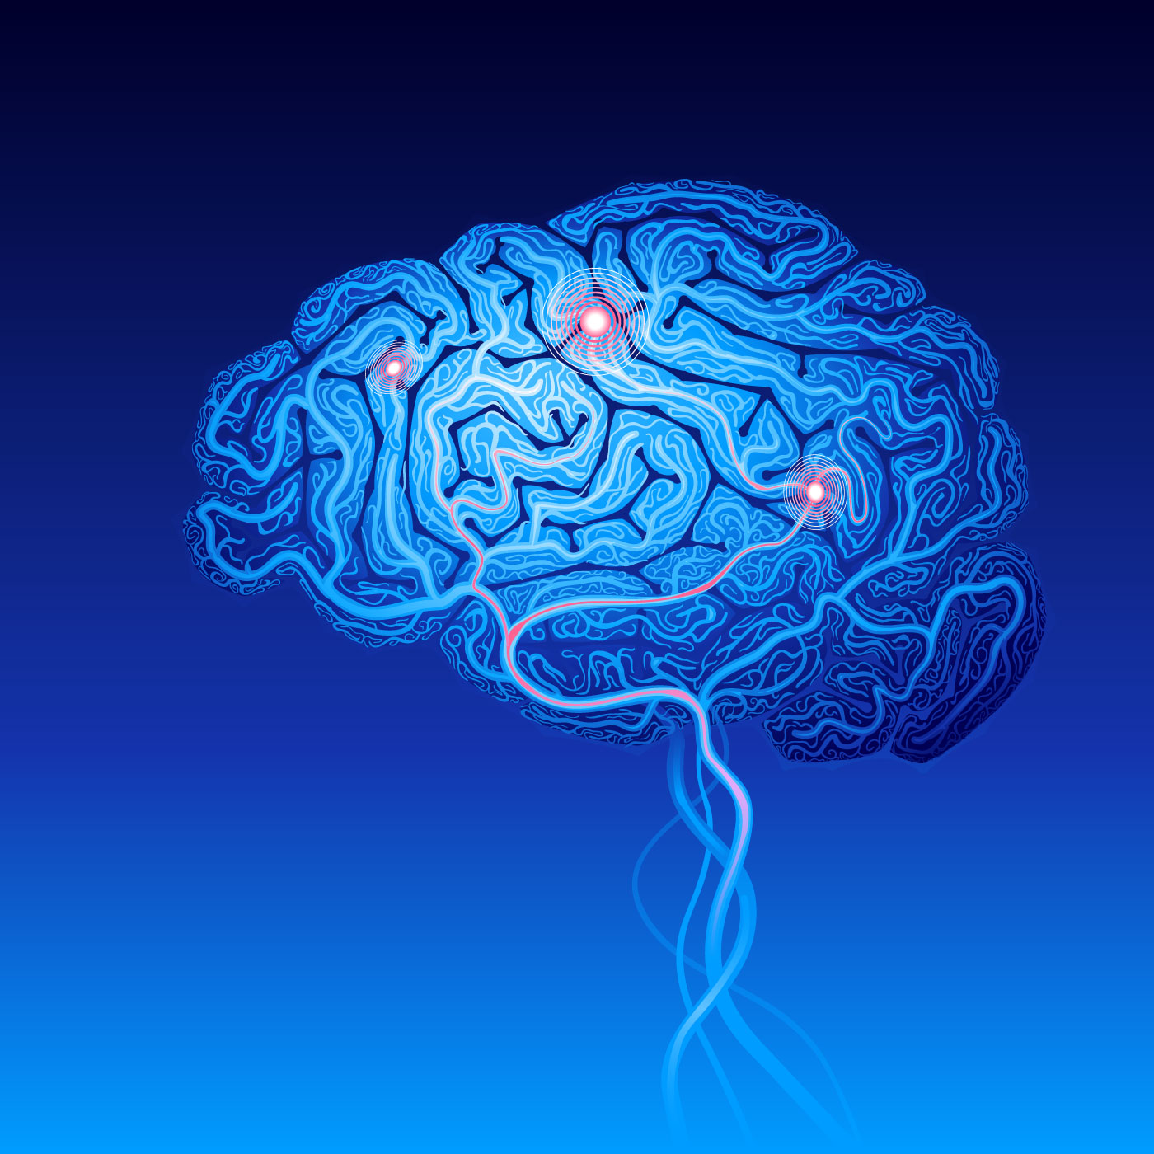
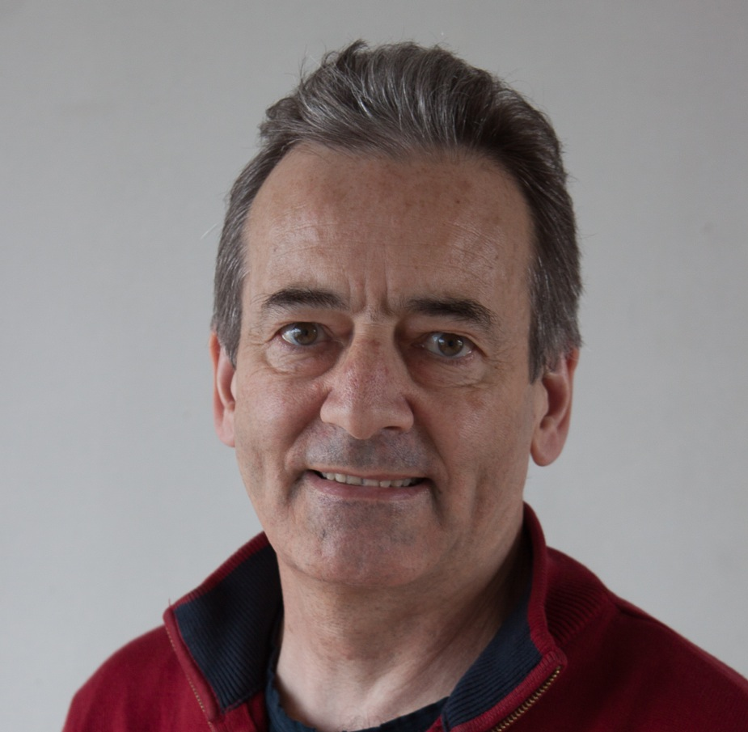
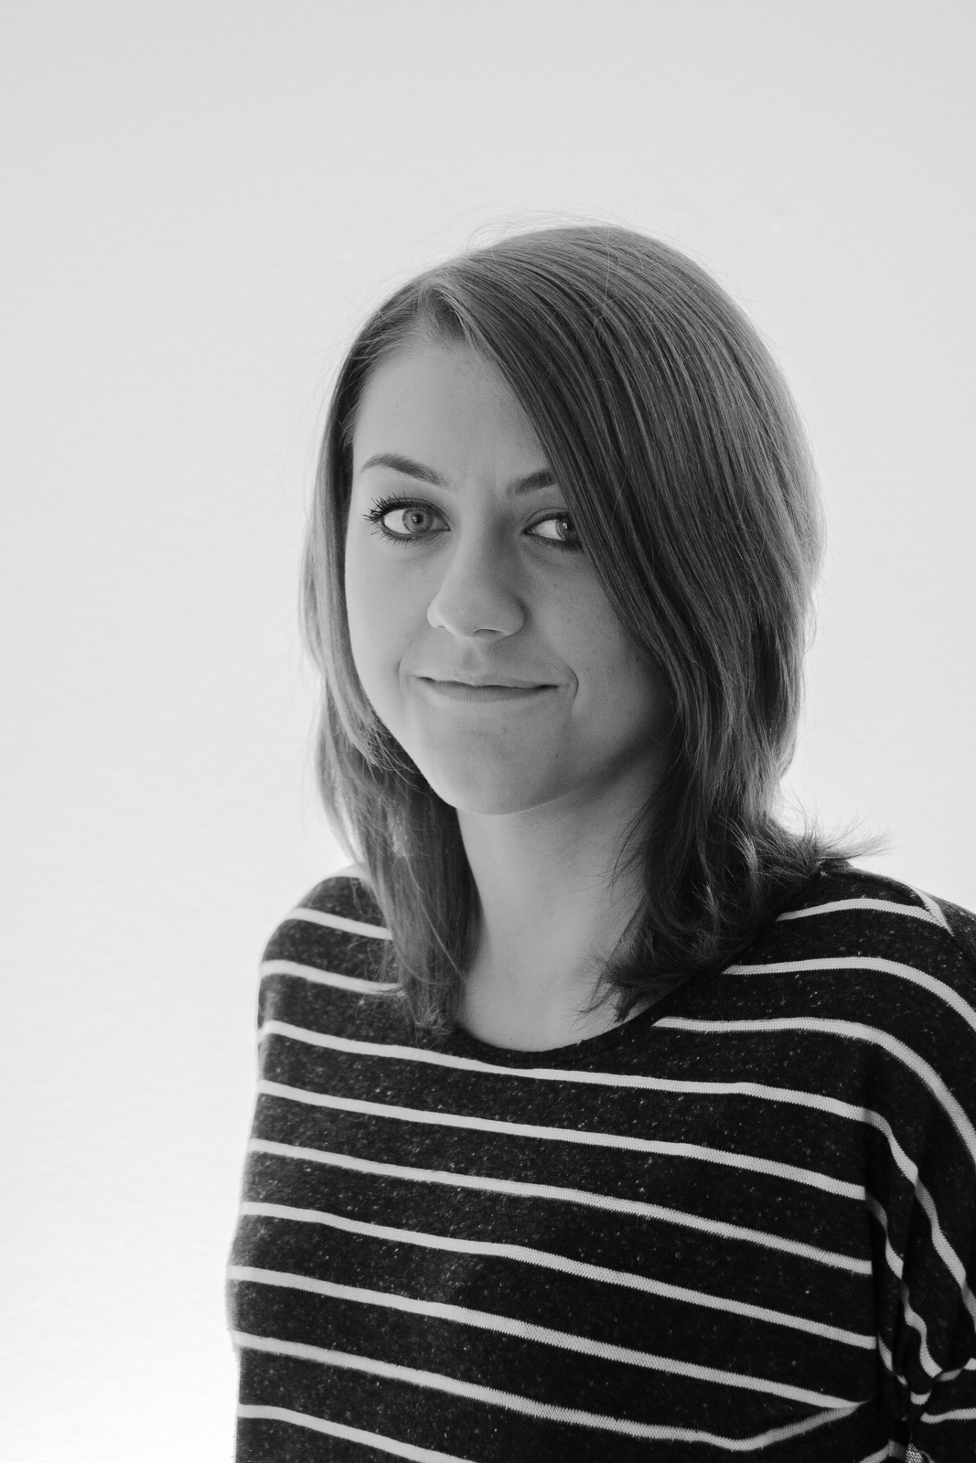
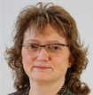
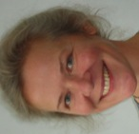
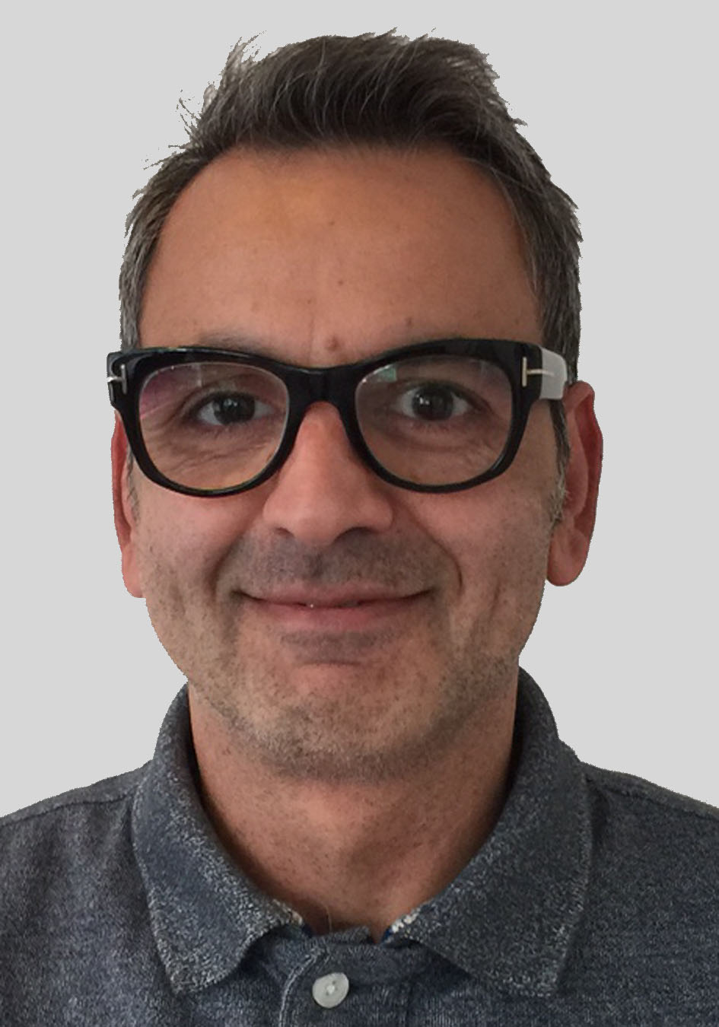
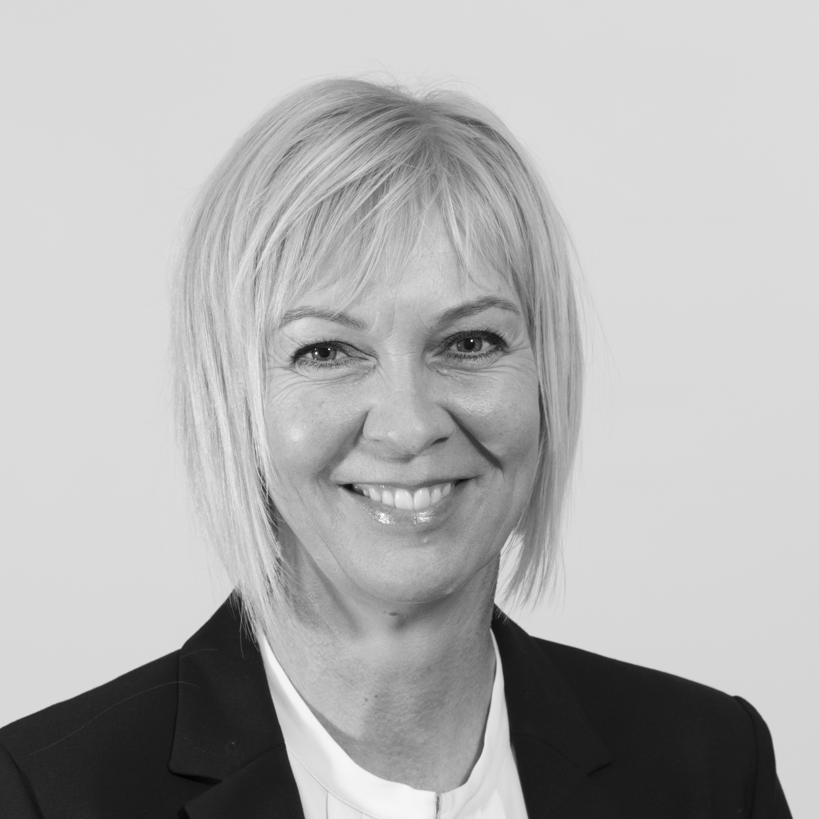
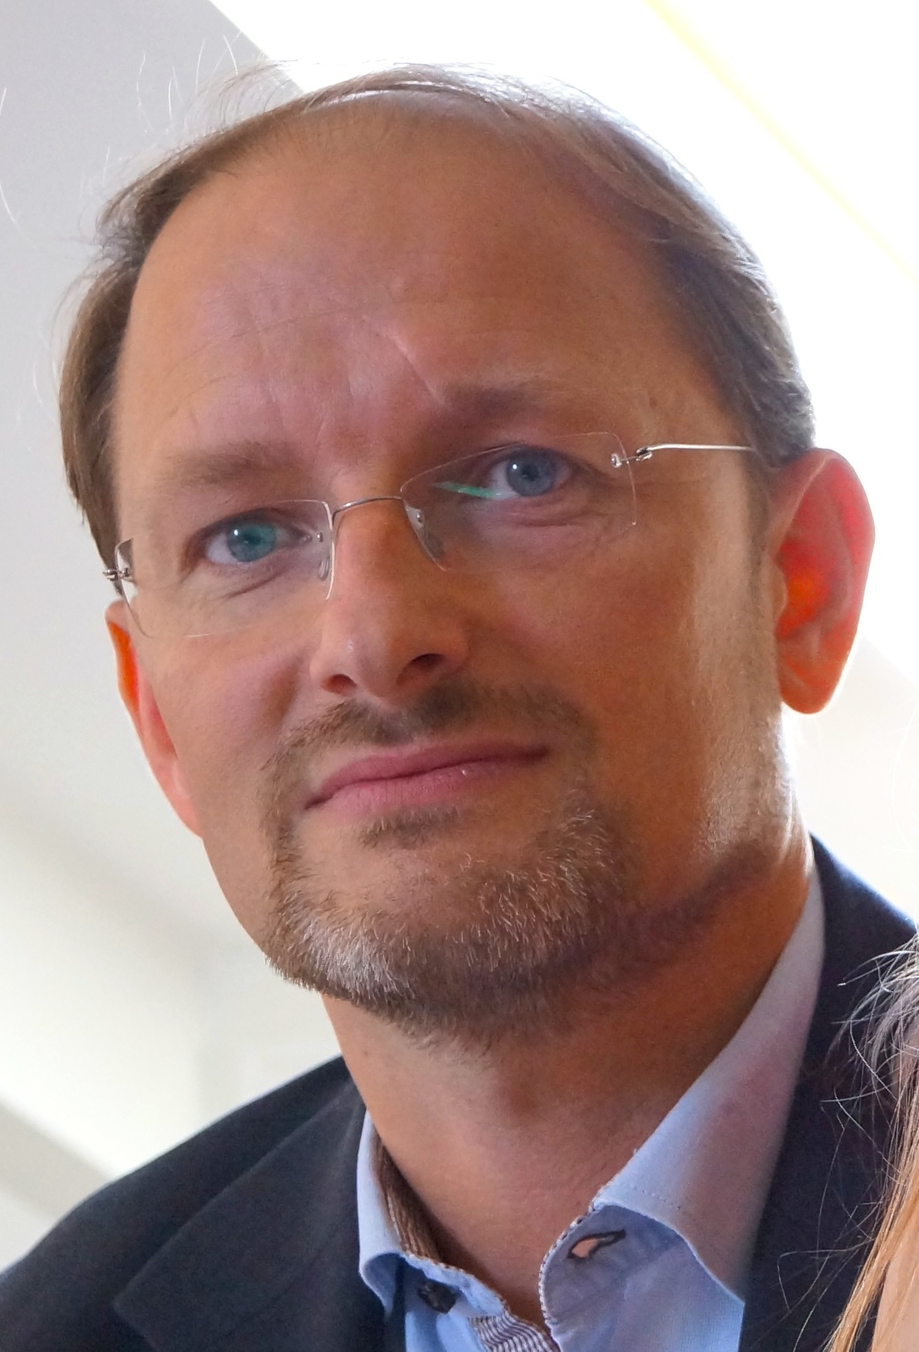
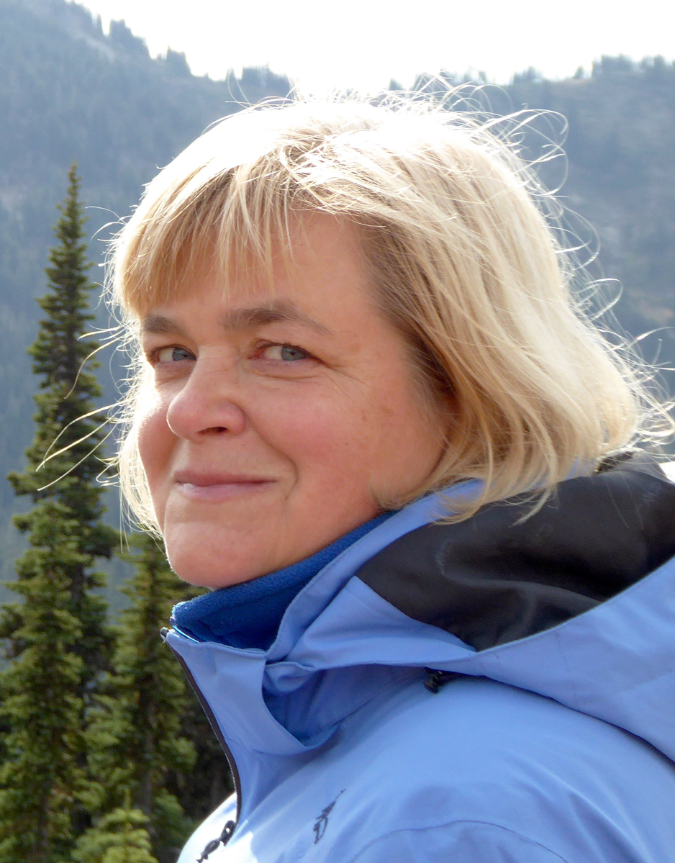
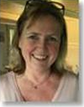
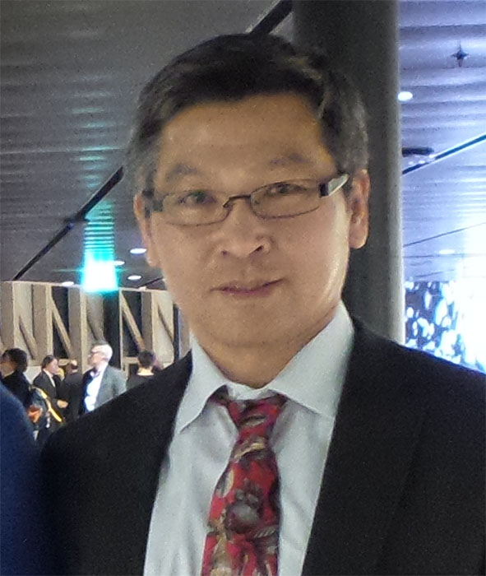
Neurobiology Research
Neurological disease
Parkinson’s
disease
Brain
development
T Owens
Genetic control
of neurodevelopment
J Chemnitz
Stem cell
differentiation
Neuron-glial
Biology
Clinical material
Research
Animal models
Neuromyelitis
optica
A Wlodarczyk
Stroke
A Dahl
Neurodegeneration/
protection
Neuroinflammation/
immunology
Spinal cord
injury
Multiple
sclerosis
B Finsen
Alzheimer’s
disease
R Khorooshi
Clinical Affiliates
Nasrin Asgari
Helle Hvilsted Nielsen
Zsolt Illes
Mikael Palner
Morten Blaabjerg
Lars Henrik Frich
Tanja Sheldrick-Michel
KL Lambertsen
M Meyer
ÅF Svenningsen
B Clausen
M Zhang
Mengliang Zhang

Slide 9
Neurobiology Research
Basic Research
Clinical Research
and treatment
Education
and
Training
Kate Lambertsen
Åsa Fex Svenningsen
Neurodegeneration and
inflammation in stroke and spinal cord injury.
Neurodegeneration
and regeneration in
development and disease

Slide 10
Neurobiology Research
Basic Research
Clinical Research
and treatment
Education
and
Training
Morten Meyer
Bettina Clausen
Development and Stem Cells
Parkinson’s disease
Stroke, Inflammation, Cell therapy

Slide 11
Neurobiology Research
Basic Research
Clinical Research
and treatment
Education
and
Training
Trevor Owens
Bente Finsen
Neuroimmunology
Multiple sclerosis
Alzheimer’s disease,
Stroke and
Multiple sclerosis

Slide 12
Neurobiology Research
Basic Research
Clinical Research
and treatment
Education
and
Training
Agnieszka Wlodarczyk
Reza Khorooshi
Microglial subsets in developing and adult CNS
CNS-innate immunoregulation in neuroinflammation

Slide 13
Neurobiology
Find us at
WP21 st and 1.sal
WP25 2.sal
https://www.sdu.dk/da/immed/nb

Slide 14
Neurobiology Research
Thank you for your attention!

Slide 15
Available now!!
ISA/Masters project
The group of Trevor Owens have funding through 2023 from Scleroseforeningen, to study the induction of cortical brain lesions in mice using laser irradiation, and the impact of aging on this.
The project is directly supervised by Assoc prof Reza Khorooshi and PhD student Bhavya Ojha.
This would be a suitable project for an ISA or Masters student with interest in neuroimmunology.
You should have taken or be willing to take a course in animal experimentation and be prepared for a collaborative and challenging lab environment. You will learn a variety of techniques including small animal stereotactic surgery, confocal microscopy, histological methods such as immunohistochemistry and fluorescence microscopy, RT-PCR and flow cytometry.
The project is up and running and you can start right away, once course formalities are complete.
Apply by email to towens@health.sdu.dk or to rkhorooshi@health.sdu.dk.

