Slide 1
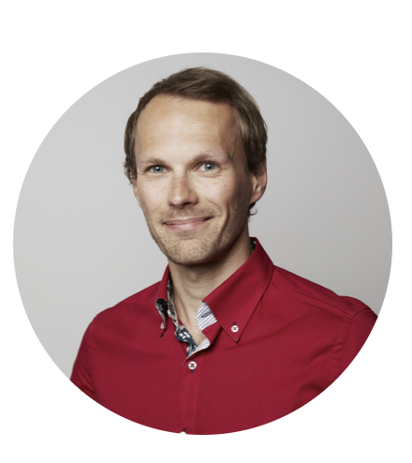
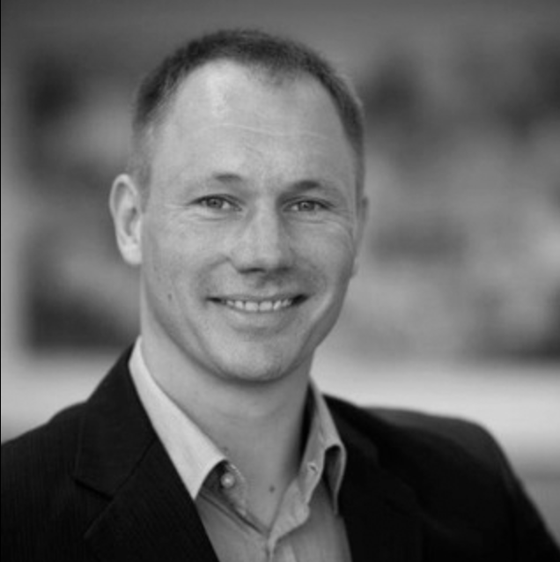
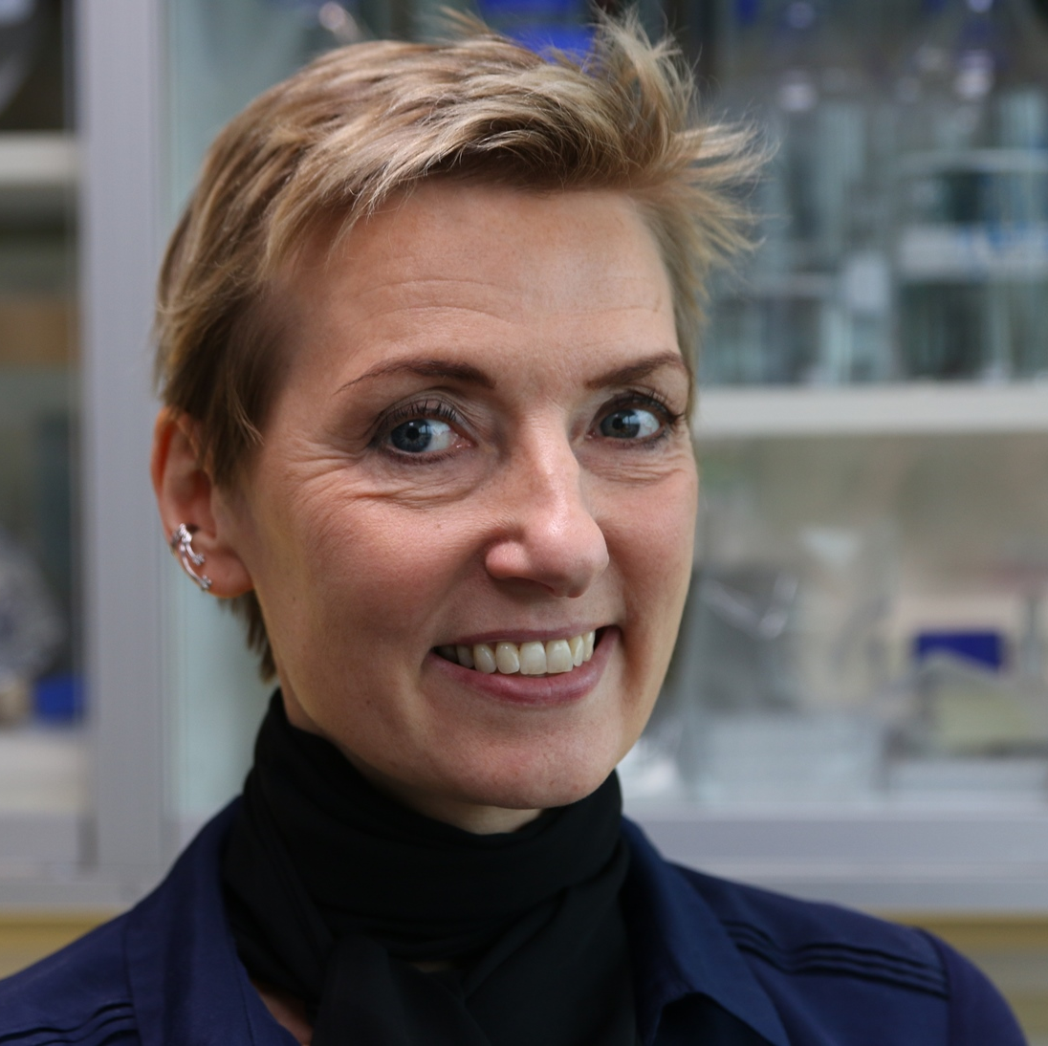
Inflammation research WP25.3
Jesper Bonnet Møller
jbmoeller@health.sdu.dk
Mucosal immunity
Intestinal parasites
Intestinal inflammation and Cancer
Grith Lykke Sørensen
glsorensen@health.sdu.dk
    Extracellular matrix factors in disease
    Blindness
    Cancer
    Cardiovascular disease
Bartosz Pilecki
bpilecki@health.sdu.dk
Contact:
Interests:
You are always welcome to contact us for an informal discussion about projects in our labs.

Slide 2

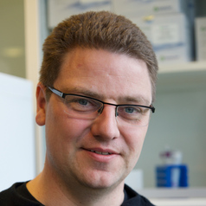

Inflammation research WP25.2 and WP25.1
Contact:
Interests:
Yaseelan Palarasah
ypalarasah@health.sdu.dk
Complements system
Hybridoma technology
Cross-talk between inflammation and coagulation
Immunothrombosis
Biomarker research
Jonas H. Graversen
jgraversen@health.sdu.dk
Receptor characterization
Protein engineering
Therapeutic antibodies
Inflammatory cells in cancer
Inflammation in relation to obesity
Biomarkers
Søren w. Hansen
shansen@health.sdu.dk
Innate immunity
Complement system regulation
Inflammatory diseases
You are always welcome to contact us for an informal discussion about projects in our labs.

Slide 3
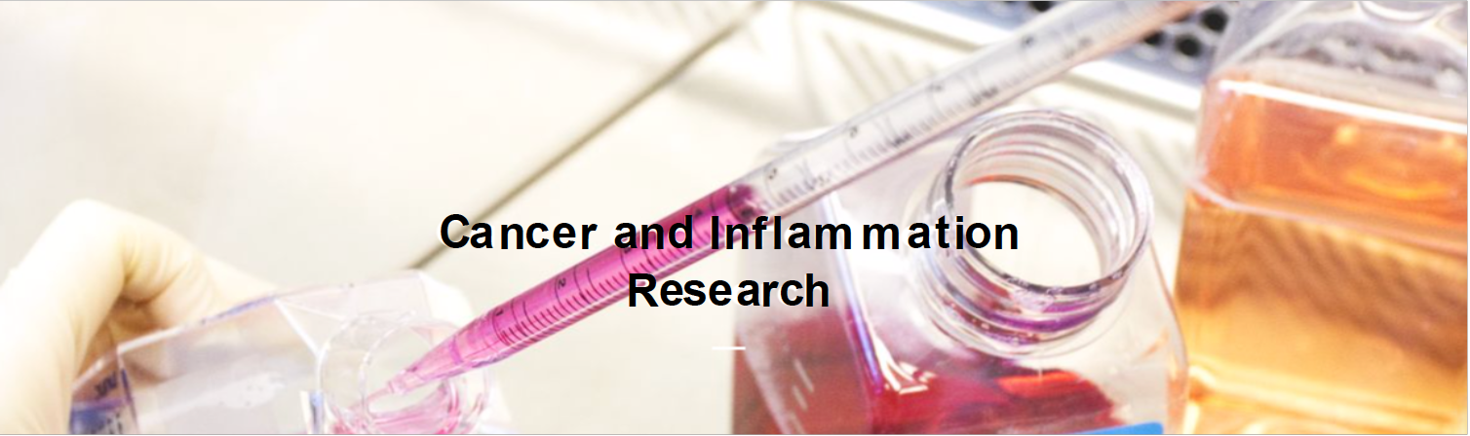

Department of Cancer and Inflammation Research
Institute of Molecular Medicine
WP25.3
Group leaders: Grith Sorensen, Jesper Bonnet Moeller, Bartosz Pilecki

Slide 4
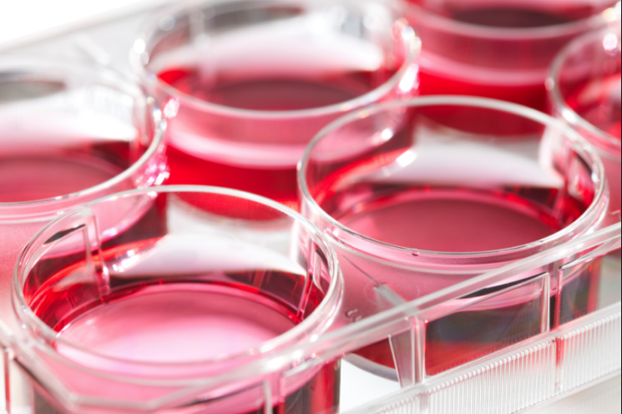
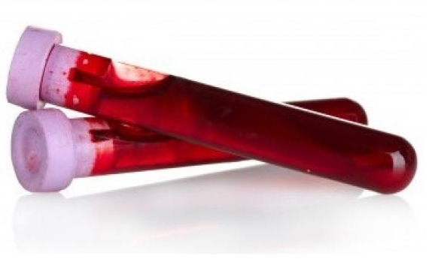
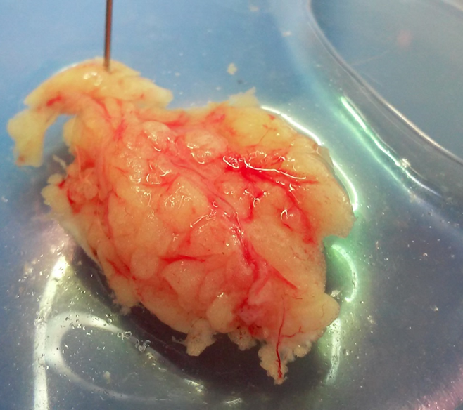
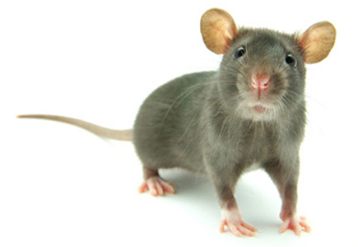
Our research strategy
Basic research
Translational research
Molecular biology
Biochemistry
Cell cultures
Animal experiments
Biomarker research
Patient tissue samples
Patient-derived cells
Genetic polymorphisms
Understanding of molecular mechanisms
Identification and development of new treatments
Improvement in disease monitoring

Slide 5
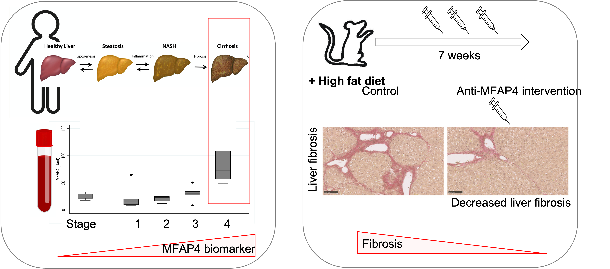
Prof. Grith Lykke Sorensen, glsorensen@health.sdu.dk
Developing novel therapeutic strategies for treatment of pathological fibrosis
To characterize novel therapeutic strategies aimed at targeting organ fibrosis
To identify biomarkers for early fibrosis detection
Research Tools and Methods
Animal intervention models (pig anastomosis surgery, liver fibrosis, kidney fibrosis)
Screening for biomarker potential in human samples
In vitro validation of the treatments’ mechanisms-of-action

Slide 6
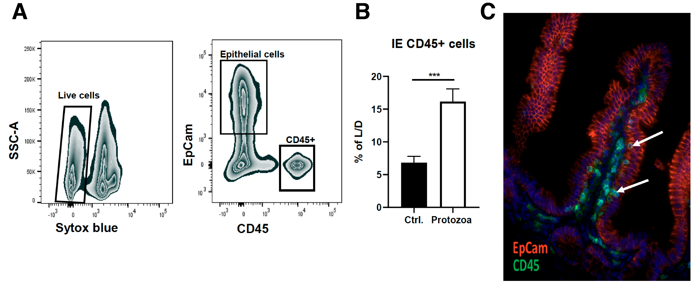
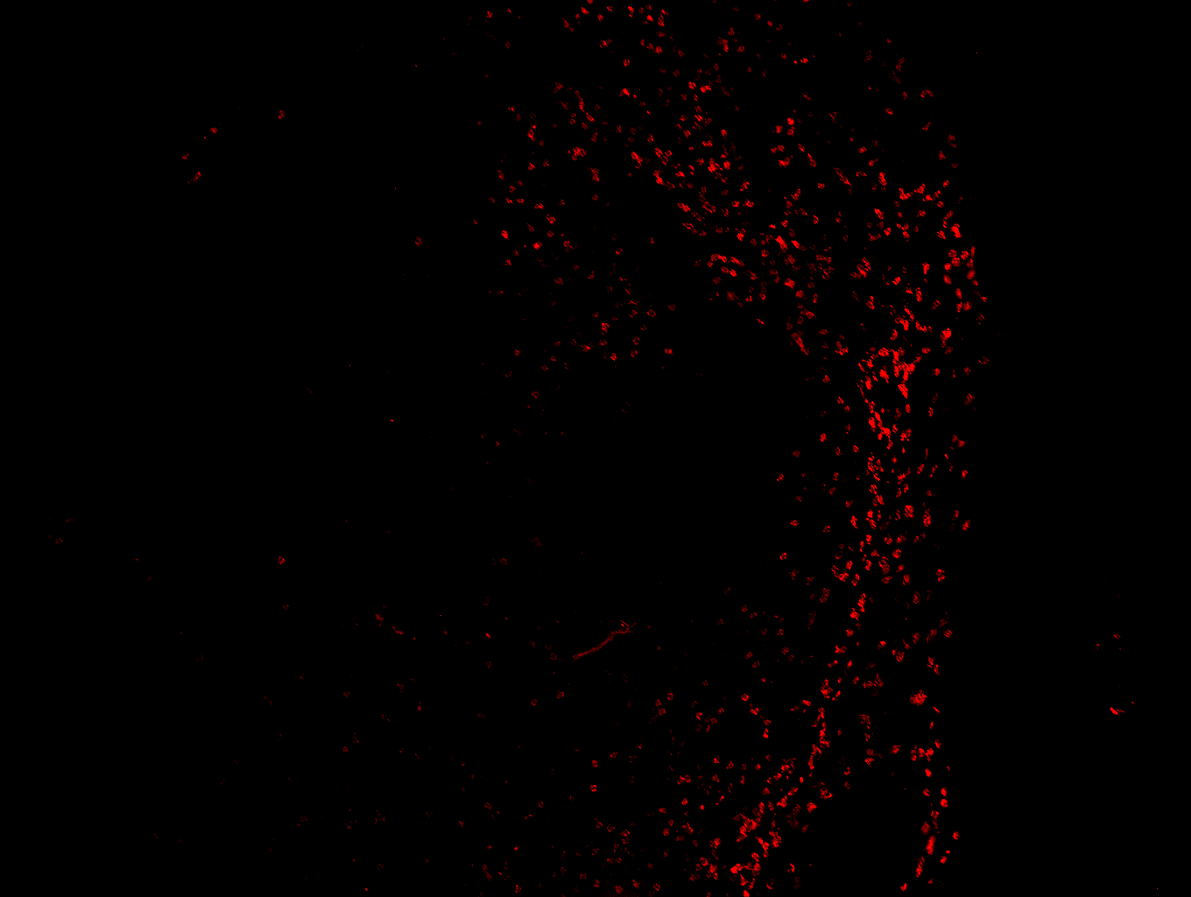
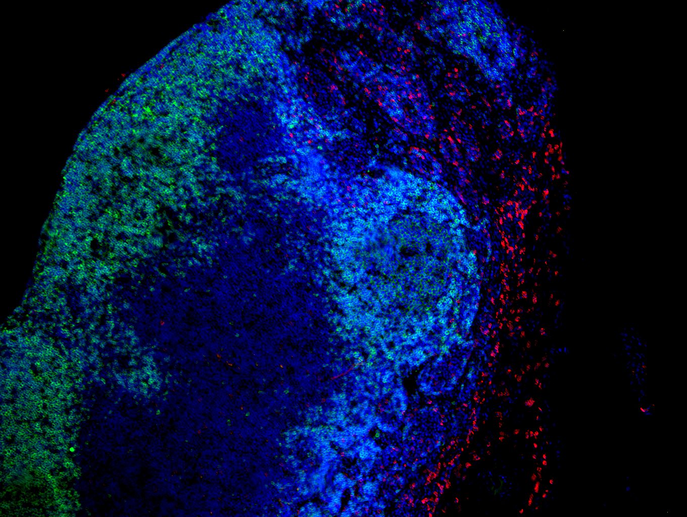
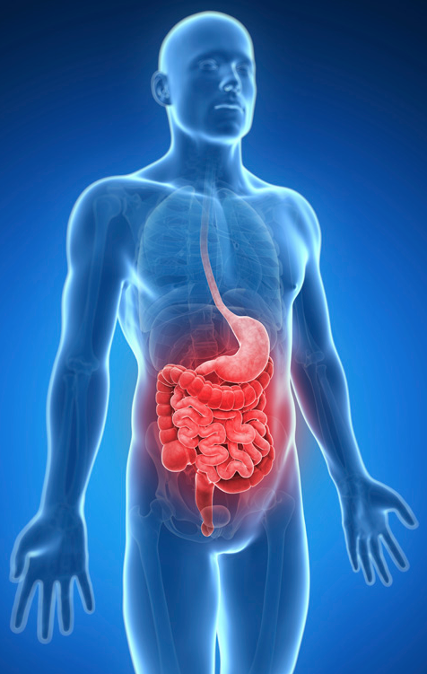
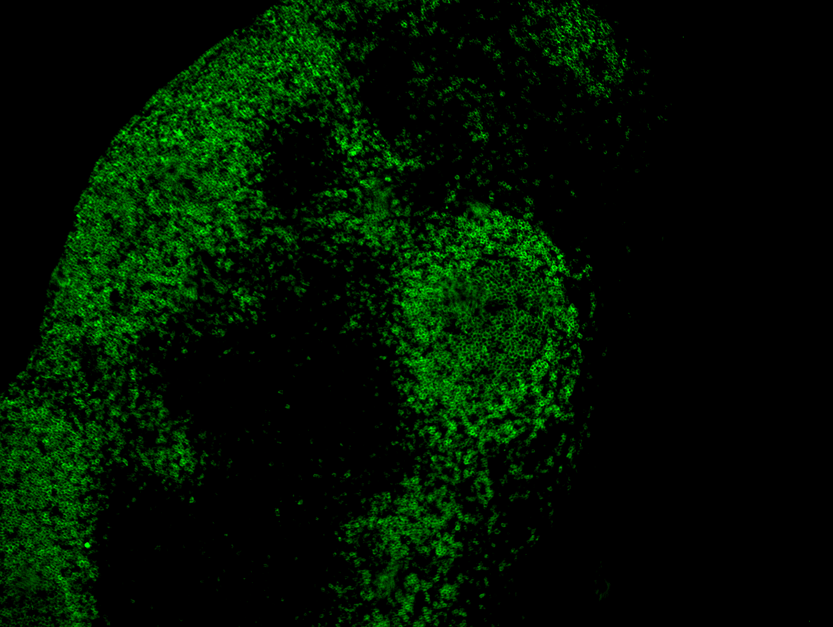
Lektor Jesper Bonnet Moeller, jbmoeller@health.sdu.dk
Understanding the role of host-microbe interactions in human health and disease
How does intestinal fungi or protozoa influence the general composition of the gut microbiota?
How do intestinal epithelial cells recognize and respond to fungi and protozoa?
How does fungi and protozoa colonization influence intestinal inflammation?
Research Tools and Methods
Animal models of infection, inflammation and microbiome manipulation
Detailed characterization of host immune cell composition and activity
Translational research investigating novel mechanisms and pathways using human tissues from patient specimens
SiglecF
B220
MERGED

Slide 7
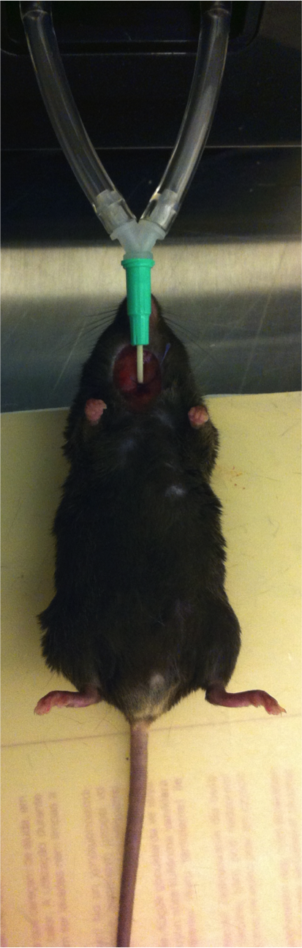
Adjunkt Bartosz Pilecki, bpilecki@health.sdu.dk
Interplay between the extracellular matrix and myofibroblast activation in fibrosis
DAPI
SMA
Ki-67
To study contribution of myofibroblasts in pathological fibrosis of lung and skin
To identify new extracellular matrix-based pathways that modulate myofibroblast phenotype
Research Tools and Methods
In vivo models of pulmonary and skin fibrosis
Live animal lung function testing
In vitro and ex vivo cellular analysis including transcriptome sequencing
Translational research on lung and skin tissues obtained from relevant patients and healthy controls

Slide 8
Thank you for your attention
Feel free to contact us: glsorensen@health.sdu.dk jbmoeller@health.sdu.dk bpilecki@health.sdu.dk

