Slide 1
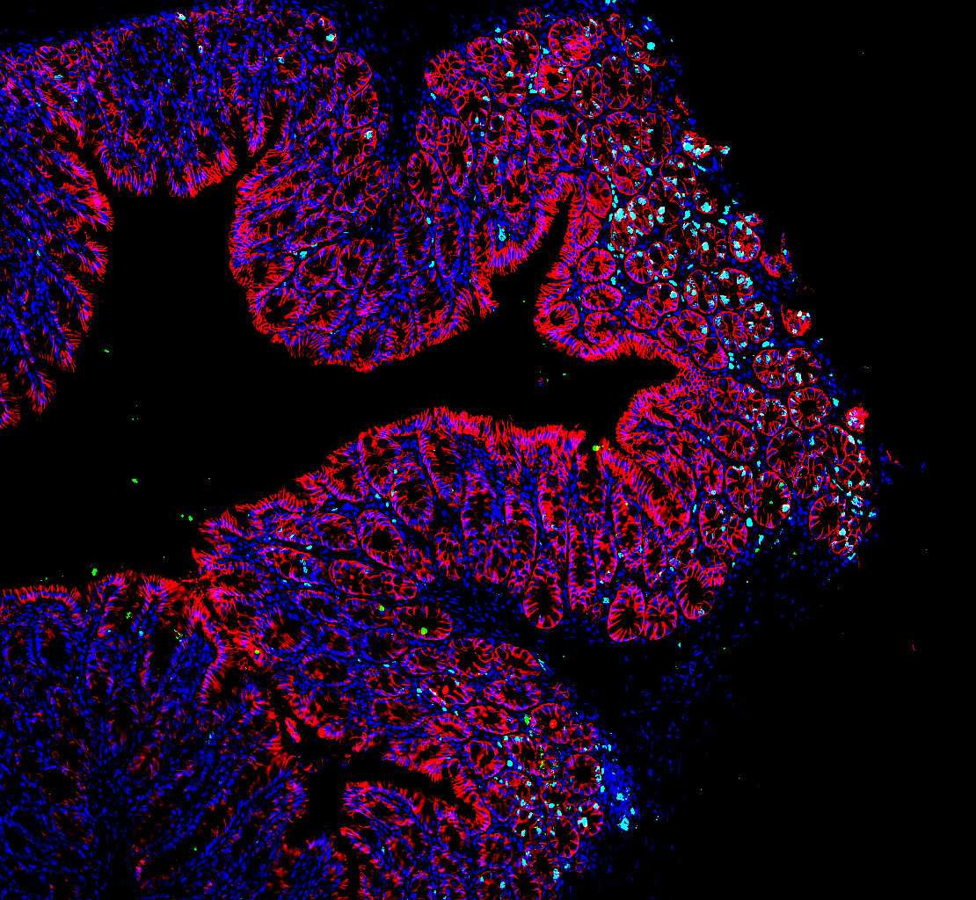
Inflammation Research
Jesper Bonnet Moeller's lab.
Department of Molecular Medicine
Notes:
…

Slide 2
Inflammation research
Translational and Functional Receptor Biology
Vascular Disease, Fibrosis, and Cancer
Assoc. Prof. Jonas Graversen
jgraversen@health.sdu.dk
Receptor characterization
Protein Engineering
Therapeutic Antibodies
Biomarker Research
Professor Grith L. Sørensen
glsorensen@health.sdu.dk
Extracellular matrix proteins
Development of biological therapies
Therapeutic Mechanisms in Cancer
Biomarker Research
Complement System and Coagulation
Mucosal Immunology and Barrier Functions
Assoc. Prof. Yaseelan Palarasah
ypalarasah@health.sdu.dk
Antibody Development
Inflammation and Coagulation
Immunotrombosis
Biomarker Research
Ass. Prof. Jesper B. Moeller
jbmoeller@health.sdu.dk
Barrier Immunity & Integrity
Intestinal Parasites and Fungi
Host-Microbe Interactions
IBD and Cancer
Notes:
The gastrointestinal tract harbors trillions of viruses, bacteria, fungi and protozoa, referred to as microbiota. Our intestinal microbiota plays an important role in variety of processes such as metabolism, development and immunity. Disruption of this complex…….. Microbiome research is dominated by studies describing the impact of prokaryotic bacteria on gut immunity with limited understanding on the mutualistic relationship with other integral microbiota constituents, such as commensal protozoa and fungi. The role of the ekuaryome in disease protection or development remains elusive.

Slide 3
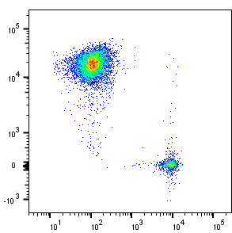
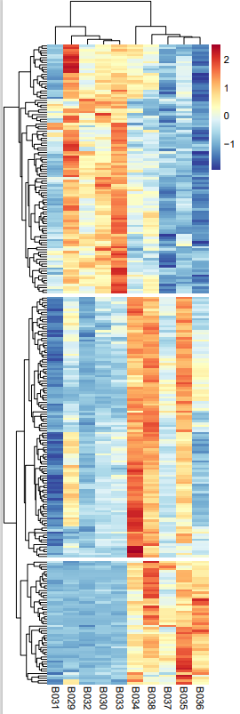
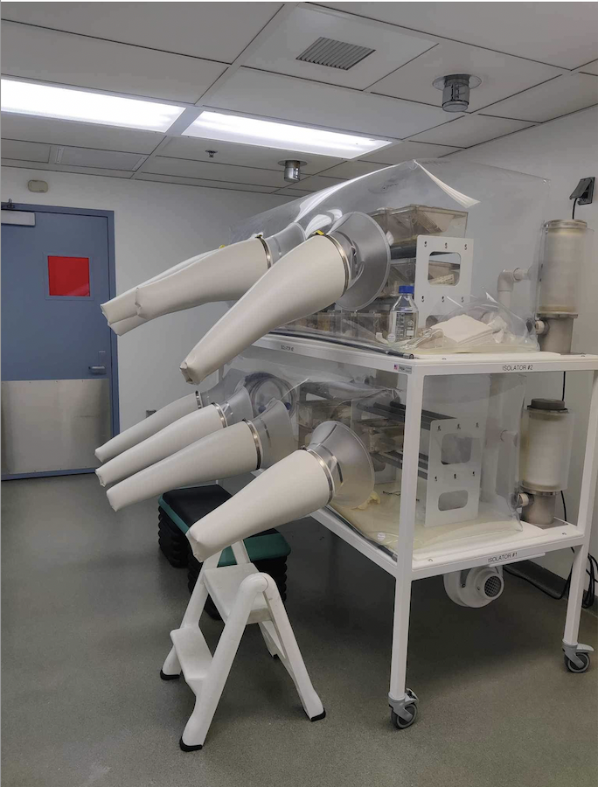
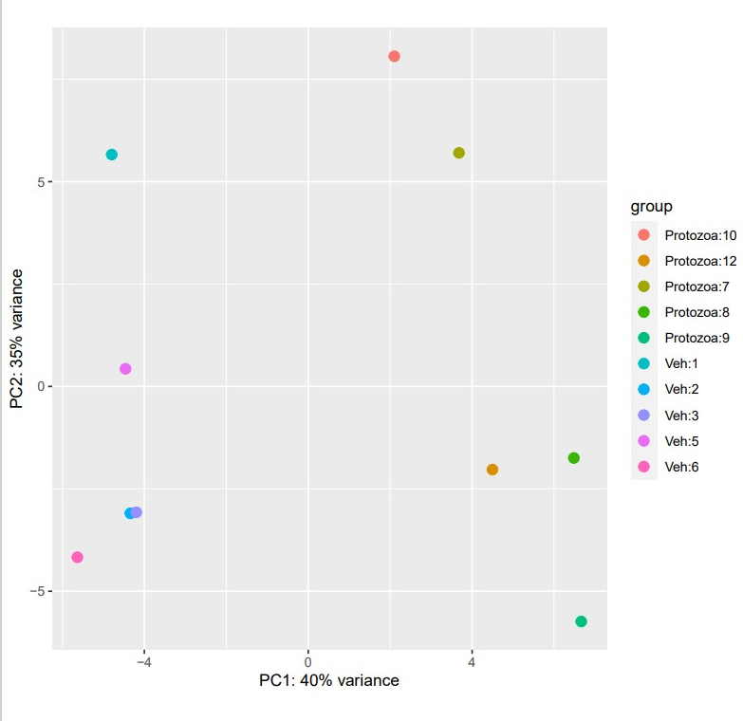
The Moeller Lab
Mucosal Immunology and Barrier Functions
Research Interest
To explore novel pathways and mechanisms associated with host-microbe interactions at barrier surfaces
Most research are rooted in animal models of disease
Employ state-of-the-art technologies
Translational perspective (from Bench to Bedside)
IEC
IEL
CD326
CD45
Notes:
The gastrointestinal tract harbors trillions of viruses, bacteria, fungi and protozoa, referred to as microbiota. Our intestinal microbiota plays an important role in variety of processes such as metabolism, development and immunity. Disruption of this complex…….. Microbiome research is dominated by studies describing the impact of prokaryotic bacteria on gut immunity with limited understanding on the mutualistic relationship with other integral microbiota constituents, such as commensal protozoa and fungi. The role of the ekuaryome in disease protection or development remains elusive.

Slide 4
The Moeller Lab
Mucosal Immunology and Barrier Functions
Research Interest
To explore novel pathways and mechanisms associated with host-microbe interactions at barrier surfaces
Most research are rooted in animal models of disease
Employ state-of-the-art technologies
Translational perspective (from Bench to Bedside)
Research Group
Group leader
Staff technician
Ph.D. students
MD. student
Starting
January
2024
Jesper B. Moeller
Rikke Hadow
Magdalena
Dubik
Sofie
Skallerup
Rasmus
Duus
Vahid
Shahgoli
Kat
Kiilerich
(Jan. 2024)
Sally
Adham
Notes:
The gastrointestinal tract harbors trillions of viruses, bacteria, fungi and protozoa, referred to as microbiota. Our intestinal microbiota plays an important role in variety of processes such as metabolism, development and immunity. Disruption of this complex…….. Microbiome research is dominated by studies describing the impact of prokaryotic bacteria on gut immunity with limited understanding on the mutualistic relationship with other integral microbiota constituents, such as commensal protozoa and fungi. The role of the ekuaryome in disease protection or development remains elusive.

Slide 5
Examples of student projects in the Moeller Lab
Molecular Screening for the presence of commensal intestinal protozoa in IBD and healthy cohorts using quantitative PCR.
Bachelor project: Simon Hoang Dinh - Pharmacy student – Spring 2023
Image of protozoa
Notes:
The gastrointestinal tract harbors trillions of viruses, bacteria, fungi and protozoa, referred to as microbiota. Our intestinal microbiota plays an important role in variety of processes such as metabolism, development and immunity. Disruption of this complex…….. Microbiome research is dominated by studies describing the impact of prokaryotic bacteria on gut immunity with limited understanding on the mutualistic relationship with other integral microbiota constituents, such as commensal protozoa and fungi. The role of the ekuaryome in disease protection or development remains elusive.

Slide 6
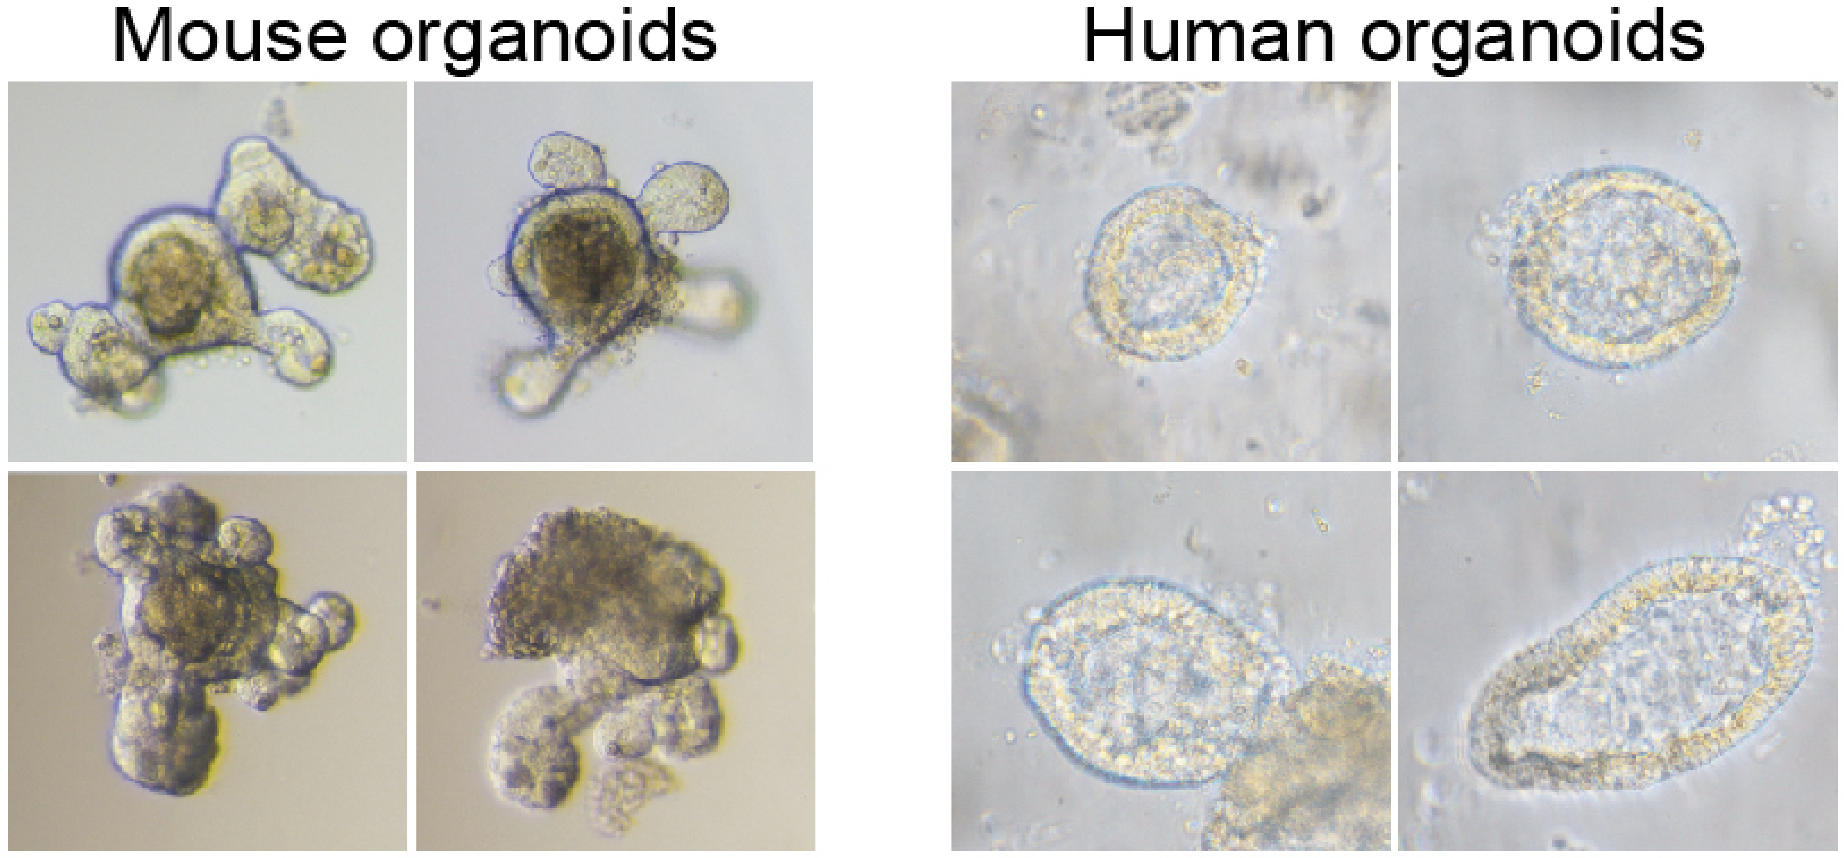
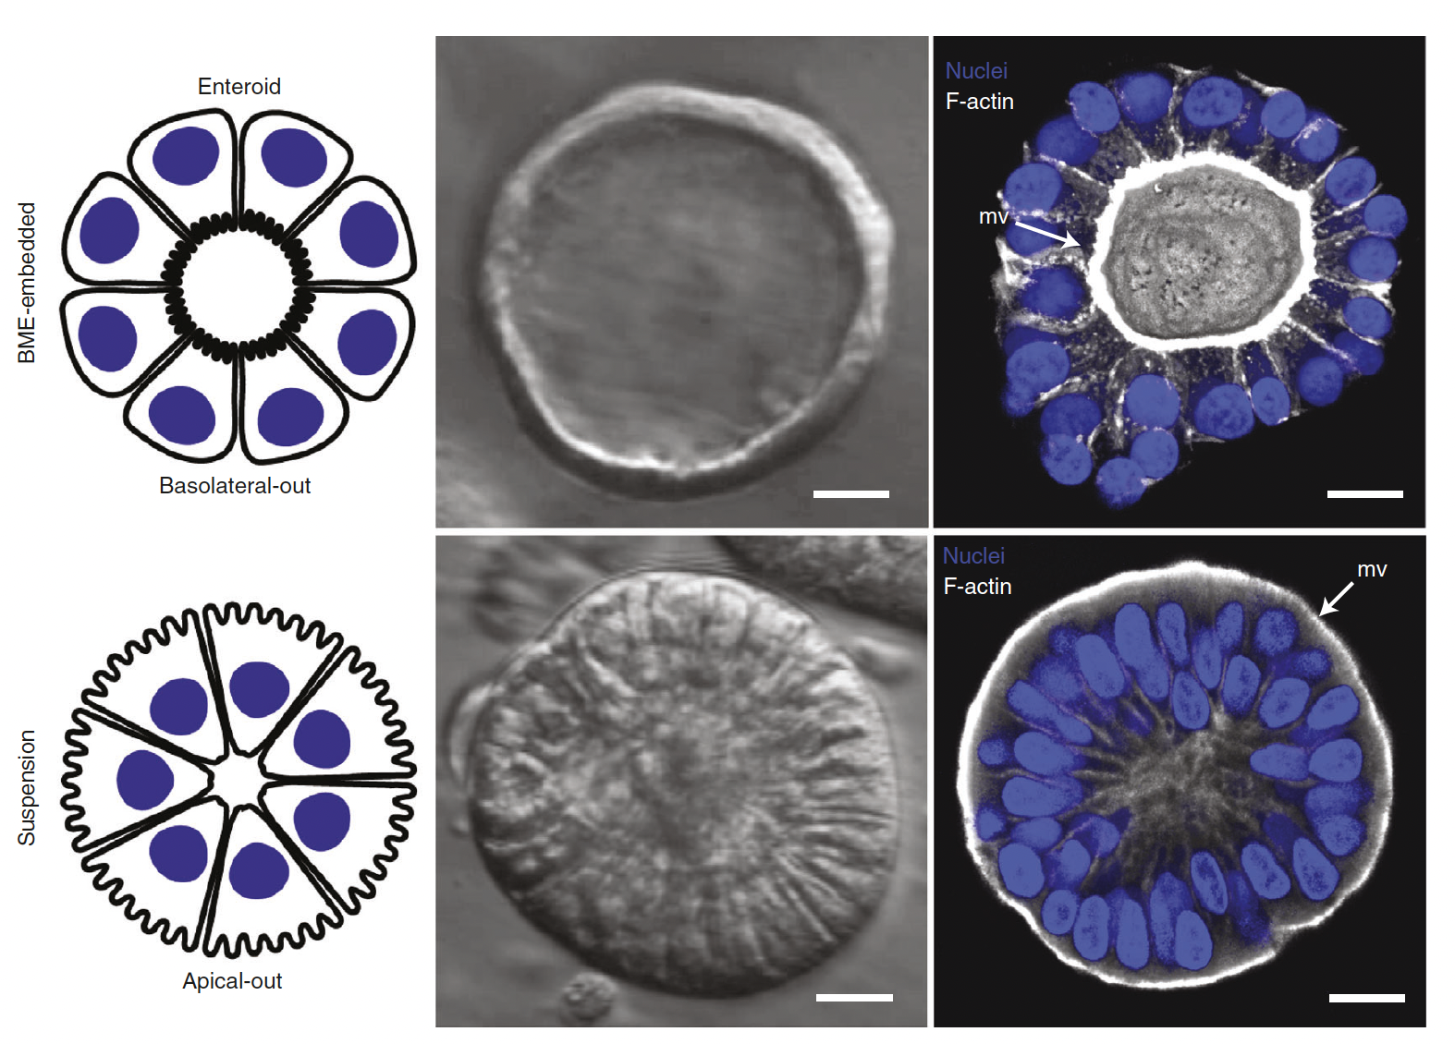
Examples of student projects in the Moeller Lab
Intestinal organoids as a model for host-microbe interactions at the mucosal surfaces
MD-master project: Sally Adham – Started September 2023, Ongoing….
Nature Protocols 2021
Notes:
The gastrointestinal tract harbors trillions of viruses, bacteria, fungi and protozoa, referred to as microbiota. Our intestinal microbiota plays an important role in variety of processes such as metabolism, development and immunity. Disruption of this complex…….. Microbiome research is dominated by studies describing the impact of prokaryotic bacteria on gut immunity with limited understanding on the mutualistic relationship with other integral microbiota constituents, such as commensal protozoa and fungi. The role of the ekuaryome in disease protection or development remains elusive.

Slide 7
Student projects in the Moeller Lab
For all student projects in general…
Should be well-defined with realistic aims
Should be linked and integrated into larger studies performed
Should introduce the student to state-of-the-art technologies and the forefront of biomedical research
Are Dynamic (developed over time) to reflect current projects and progress
Notes:
The gastrointestinal tract harbors trillions of viruses, bacteria, fungi and protozoa, referred to as microbiota. Our intestinal microbiota plays an important role in variety of processes such as metabolism, development and immunity. Disruption of this complex…….. Microbiome research is dominated by studies describing the impact of prokaryotic bacteria on gut immunity with limited understanding on the mutualistic relationship with other integral microbiota constituents, such as commensal protozoa and fungi. The role of the ekuaryome in disease protection or development remains elusive.

Slide 8
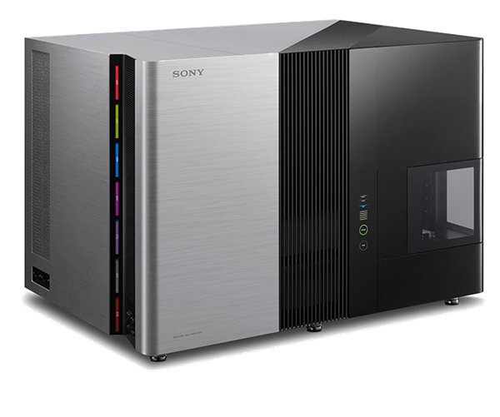
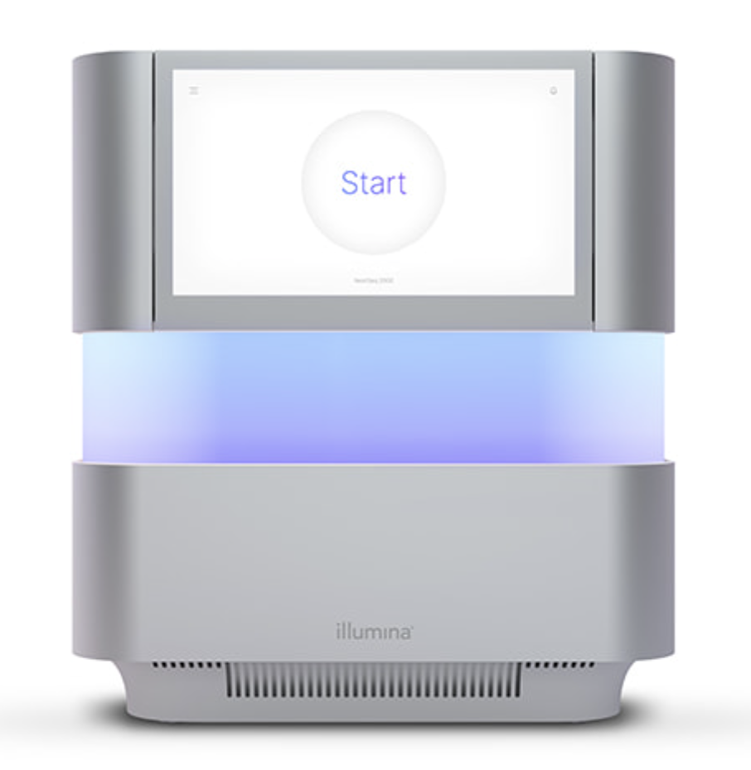
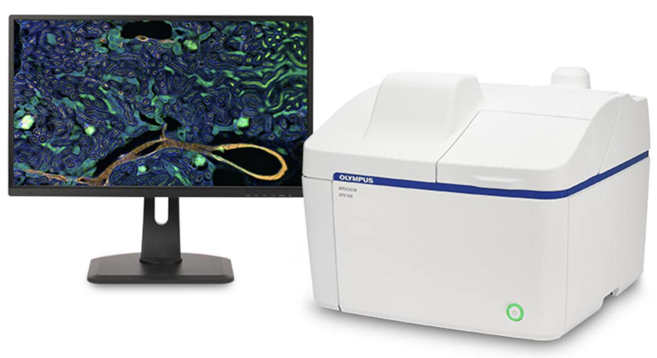
Core Technologies and Methodologies
Flow Cytometry and Cell Sorting
Center for Advanced Cell Analysis^{(NEW)}
(Best-in-class instrumentation)
Immunophenotyping
Isolation of cells for Sequencing
Functional studies
Transcriptomics
IMM Sequencing^{(NEW)}
(Local access and expertise)
RNA-Seq
Single Cell Analyses
Epigenetics
Fluorescence Microscopy
Imaging platforms
(Highly advanced instruments)
5-color immunofluorescence^{(NEW)}
Confocal microscopy
Helium-Ion Microscopy
Notes:
The gastrointestinal tract harbors trillions of viruses, bacteria, fungi and protozoa, referred to as microbiota. Our intestinal microbiota plays an important role in variety of processes such as metabolism, development and immunity. Disruption of this complex…….. Microbiome research is dominated by studies describing the impact of prokaryotic bacteria on gut immunity with limited understanding on the mutualistic relationship with other integral microbiota constituents, such as commensal protozoa and fungi. The role of the ekuaryome in disease protection or development remains elusive.

Slide 9
The End ☺
Feel Free to contact us for further information and project ideas
Notes:
The gastrointestinal tract harbors trillions of viruses, bacteria, fungi and protozoa, referred to as microbiota. Our intestinal microbiota plays an important role in variety of processes such as metabolism, development and immunity. Disruption of this complex…….. Microbiome research is dominated by studies describing the impact of prokaryotic bacteria on gut immunity with limited understanding on the mutualistic relationship with other integral microbiota constituents, such as commensal protozoa and fungi. The role of the ekuaryome in disease protection or development remains elusive.

