Slide 1
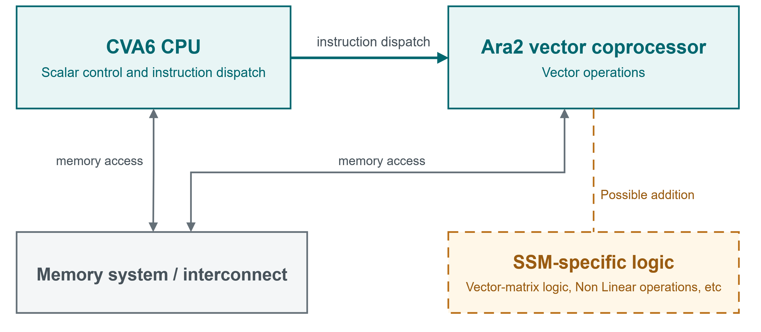
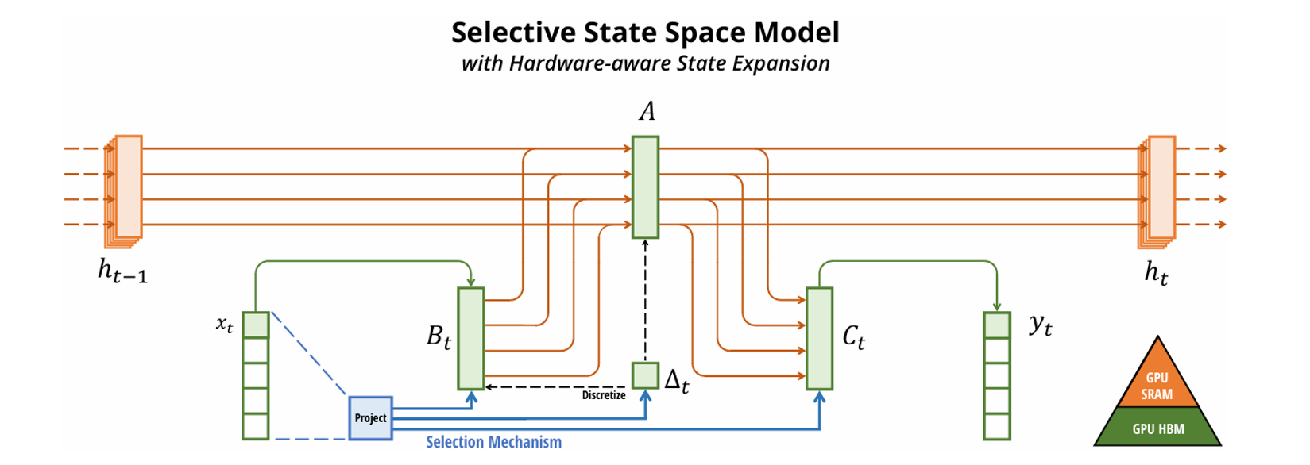



Low power integration of State-Space primitives in RISC-V architecture for efficient Sequential AI
Author – Jose Alejandro Sanchez Frias
Supervisor – Farshad Moradi
State-space models (SSMs) offer an efficient approach to sequential processing, with recent architectures such as Mamba and S4 improving their ability to capture contextual information. This project investigates how dedicated hardware SSM operations can be integrated into the RISC-V architecture, and evaluate what performance and energy savings can be achieved with this implementation.
Background
  SSMs are a state-of-the-art method for sequential processing. They are based on linear algebra and originally used for complex system modelling
  Modern architectures such as S4 and mamba have improved their ability at retaining information across sequences.
  RISC-V is an open standard ISA designed in a RISC (Reduced Instruction set Computer) style, whose extensibility enables custom instructions for specialized workloads.
Possible system architecture integrating with Ara Vector processor and CVA6 RISC-V CPUs
Project aims
  1. Design and implement an SSM accelerator connected to a RISC-V CPU, targeting ASIC implementation
  2. Benchmark the design against existing hardware accelerators, taking measurements such as latency, throughput, area and power.
  3. Investigate the possibility of multi-core implementations and their possible benefits/drawbacks
Project plan
  1. Analyse SSM operations and their hardware implementation requirements.
  3. Evaluate and select an open-source RISC-V platform. Currently the Ara/CVA6 CPU from PULP is being considered.
  4. Implement and verify the design through simulation.
  5. ASIC implementation and tape out.
  6. Benchmark the design and compare results to existing accelerators
Mamba SSM block diagram, from Albert Gu and Tri Dao, Mamba: Linear-Time Sequence Modeling with Selective State Spaces, licensed under CC BY 4.0. Reproduced unchanged.

