Slide 1
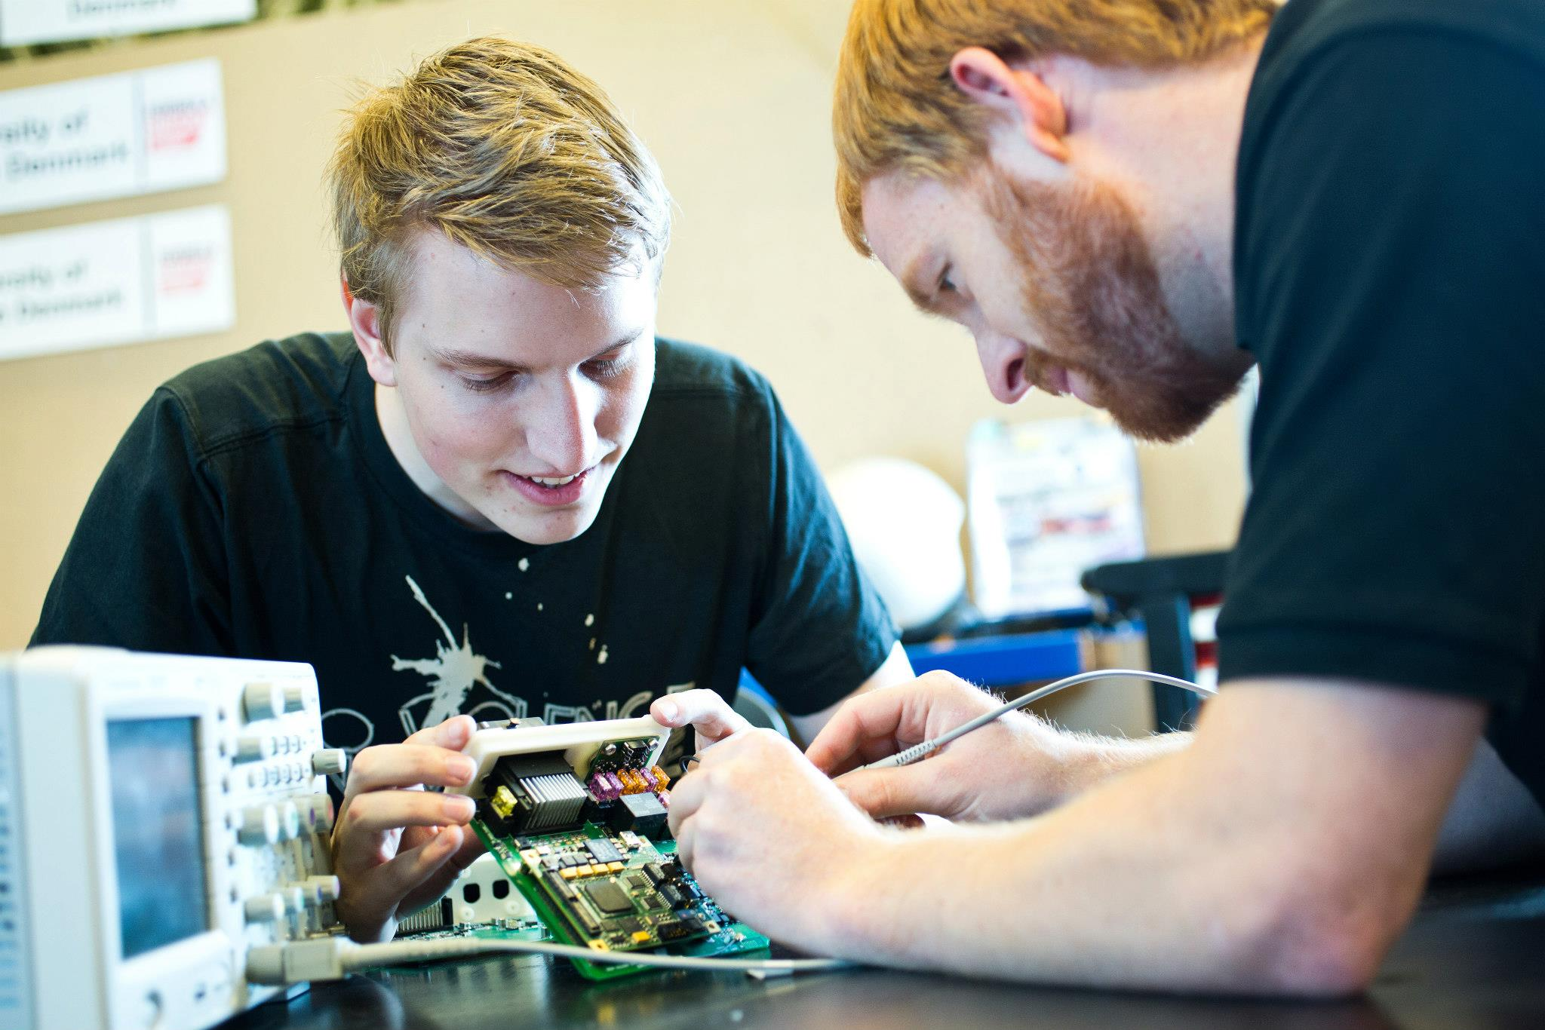
MSc in engineering (Electronics)

Slide 2
Agenda
10.00 Introduction to Master in Electronics
10.30 Electrical kart race #I
10.45 Introduction to semester courses
11.30 Electrical kart race #II
11.45 Lunch
12.30 Electrical kart race #III
12.45 Introduction to semester project
13.30 Electrical kart race #IV
13.45 Student presentation
14.30 Electrical kart race #V
14.45 Race result & end of day

Slide 3
Introduction to
MSc in engineering - Electronics

Slide 4
MSc in Engineering (Electronics)
As an MSc in Engineering (Electronics) you will gain skills in power electronics and embedded systems and a combination of the two disciplines.
The programme has two profiles
  Power electronics
  Embedded systems
Experimental and project work

Slide 5
Programme structure

Slide 6
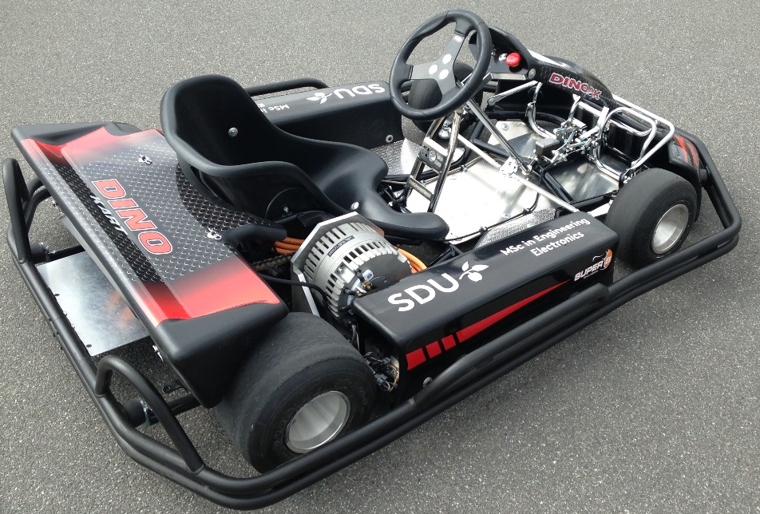
1. semester
Theme: Electrical drives and control
Introduction to power electronics and
embedded systems
Drives and control
  DC-AC inverters
  Simulation and control
  Electrical motors
Project
  Drivetrain for electrical go kart
  Implementation, test and electrical safety

Slide 7
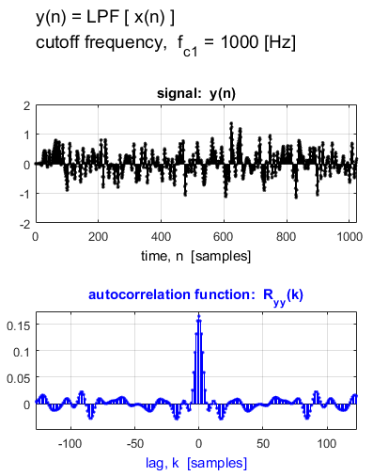
2. semester
Advanced DC-DC converters
Embedded Software Design
Modeling and Control
Statistical Signal Processing
Project
  Project of your own choice*
  Prototyping
  Experimental verification
*The project must include contents from at least one 2. semester course

Slide 8
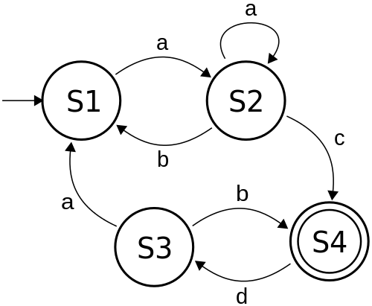
2. semester – Profile courses
  Embedded Software Design
  Model-driven design of software for real-time systems
  Modeling techniques for complex embedded systems
  Systematic testing of real-time systems
Advanced DC-DC Converters
  DC-DC converters topologies
  Advanced magnetics design
  Snubbers, driver circuits, output filters
  Practical converter design

Slide 9
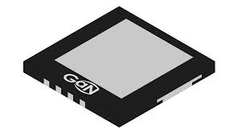
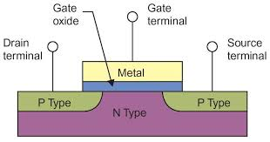
Power electronics – profile courses
Advanced Power Components
  Power switches
  Capacitors
  EMI filters
  FEM simulation of magnetics circuits
Power Electronic Systems
  Power Factor controllers
  PV and fuel cell converters
  Inverters
  Battery systems

Slide 10
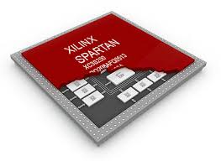
Embedded systems – Profile courses
  Advanced Programmable Electronics
  HDL coding style, constrains, simulation, debugging and floorplanning
  Softcore processors and IP cores
  Application specific architectures
  Real-Time Systems
  Real-time systems architecture
  Real-time operating systems
  Real-time communication

Slide 11
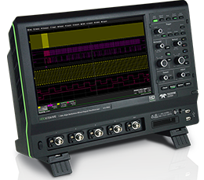

General skills
Experimental work
  Construction of electronics circuits
  Programming
  Simulation tools
  PCB layout
  Measurement techniques
  EMC
Test and verification
Electrical safety
Cooperation
Notes:
3D tegning af dc-dc converter

Slide 12
Elective courses
20 ECTS points elective courses
Possibility to select elective courses form other educations
  Motion planning and navigation
  Artificial intelligence
  Digital signal processing
  MEMS / Nano / Optik
  Drone technology
  Project management
  Entrepreneurship

Slide 13
Other relevant stuff
Master Thesis
  30 ECTS point over one semester or 40 ECTS point over the last 2 semesters
  In cooperation with a company
Study abroad
  Normally on 3. semester
In company period
  15 ECTS point in company period, (elective course)

Slide 14
How does this education benefit from research activities ?
Access to advanced measurement and laboratory equipment
Access to state of the art knowledge
Lots of practical experience
International network
Industrial network (Danfoss, Grundfos, Vestas, KK-elektronik, Banke, Danfysik m.fl.)
Possibility to be part of a research project
Ph.D. programme

Slide 15
Timetable - Spring 2018
Changes may occur !
Time | Monday | Tuesday | Wednesday | Thursday | Friday
8.15 – 11.45 |  |  | Drive and Control |  | Embedded systems
12.15 – 15.45 | Drive and Control |  |  | Power Electronics
Use “my Timetable” in Blackboard

Slide 16
Semester groups
Group 1 Karsten Holm Andersen | Group 2 Karsten Holm Andersen
Kenneth Konstmann-Lange | Lasse Stræde Bjerregaard Nielsen
Carsten Engelsgaard | Ruben Bak Sørensen
Kasper Kring Jensen | Tomas Anton Bragason
Søren Dahlstrøm Larsen | Anders Bjørk
Dan Skovlod Clausen

Slide 17
Electrical kart race
8 laps for each student
2 students at each race
Winning group
  Average of all group members individual best lap time

Slide 18
Electrical kart race – Groups
Race | Driver | Group
1 | Kenneth Konstmann-Lange | 1
 | Lasse Stræde Bjerregaard Nielsen | 2
2 | Ruben Bak Sørensen | 2
 | Carsten Engelsgaard | 1
3 | Kasper Kring Jensen | 1
 | Tomas Anton Bragason | 2
4 | Anders Bjørk | 2
 | Søren Dahlstrøm Larsen | 1
5 | Dan Skovlod Clausen | 1

Slide 19
Electrical kart race #I
Driver | Group | Best lap time
Kenneth Konstmann-Lange | 1 | 29.642
Lasse Stræde Bjerregaard Nielsen | 2 | 28.170

Slide 20
Introduction to semester courses

Slide 21
Electrical kart race #II - Before lunch
Driver | Group | Best lap time
Ruben Bak Sørensen | 2 | 26.511
Carsten Engelsgaard | 1 | 27.779

Slide 22
Electrical kart race #III - After lunch
Driver | Group | Best lap time
Kasper Kring Jensen | 1 | 28.263
Tomas Anton Bragason | 2 | 28.320

Slide 23
Introduction to semester project

Slide 24
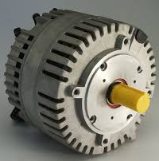
Semester project
Control of PMAC motor for an electrical kart
Voltage 48 V, Max Motor Current: 300 A
Power: 4.5 kW continuous, 14 kW peak
Maximum speed: 5000 RPM, Mechanical gearing ration: 12/44

Slide 25
Motor controller - block diagram

Slide 26
SDU electrical kart – wiring diagram

Slide 27
Replace Sevcon gen4 controller with self‐designed controller

Slide 28
DC/AC conversions
Power switches
Gate drivers
Gate driver supply
Filter capacitor

Slide 29
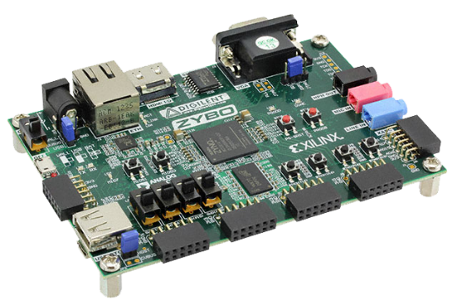
Motor control software
Communication to PC/MAC/?
Inverter control
4 ADC’s 0-1V input

Slide 30
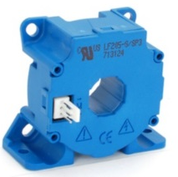
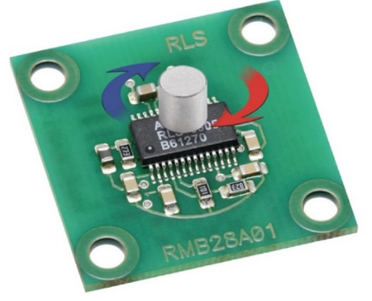
Interface between inverter board, kart sensors and Zybo board
Low voltage power supply for Zybo board, sensors, and interface board
LEM current sensor
RLS position encoder

Slide 31
Main interface board
The interface board consist of two boards
  Main interface board, Analog interface board

Slide 32
Analog interface board

Slide 33
Grounding

Slide 34
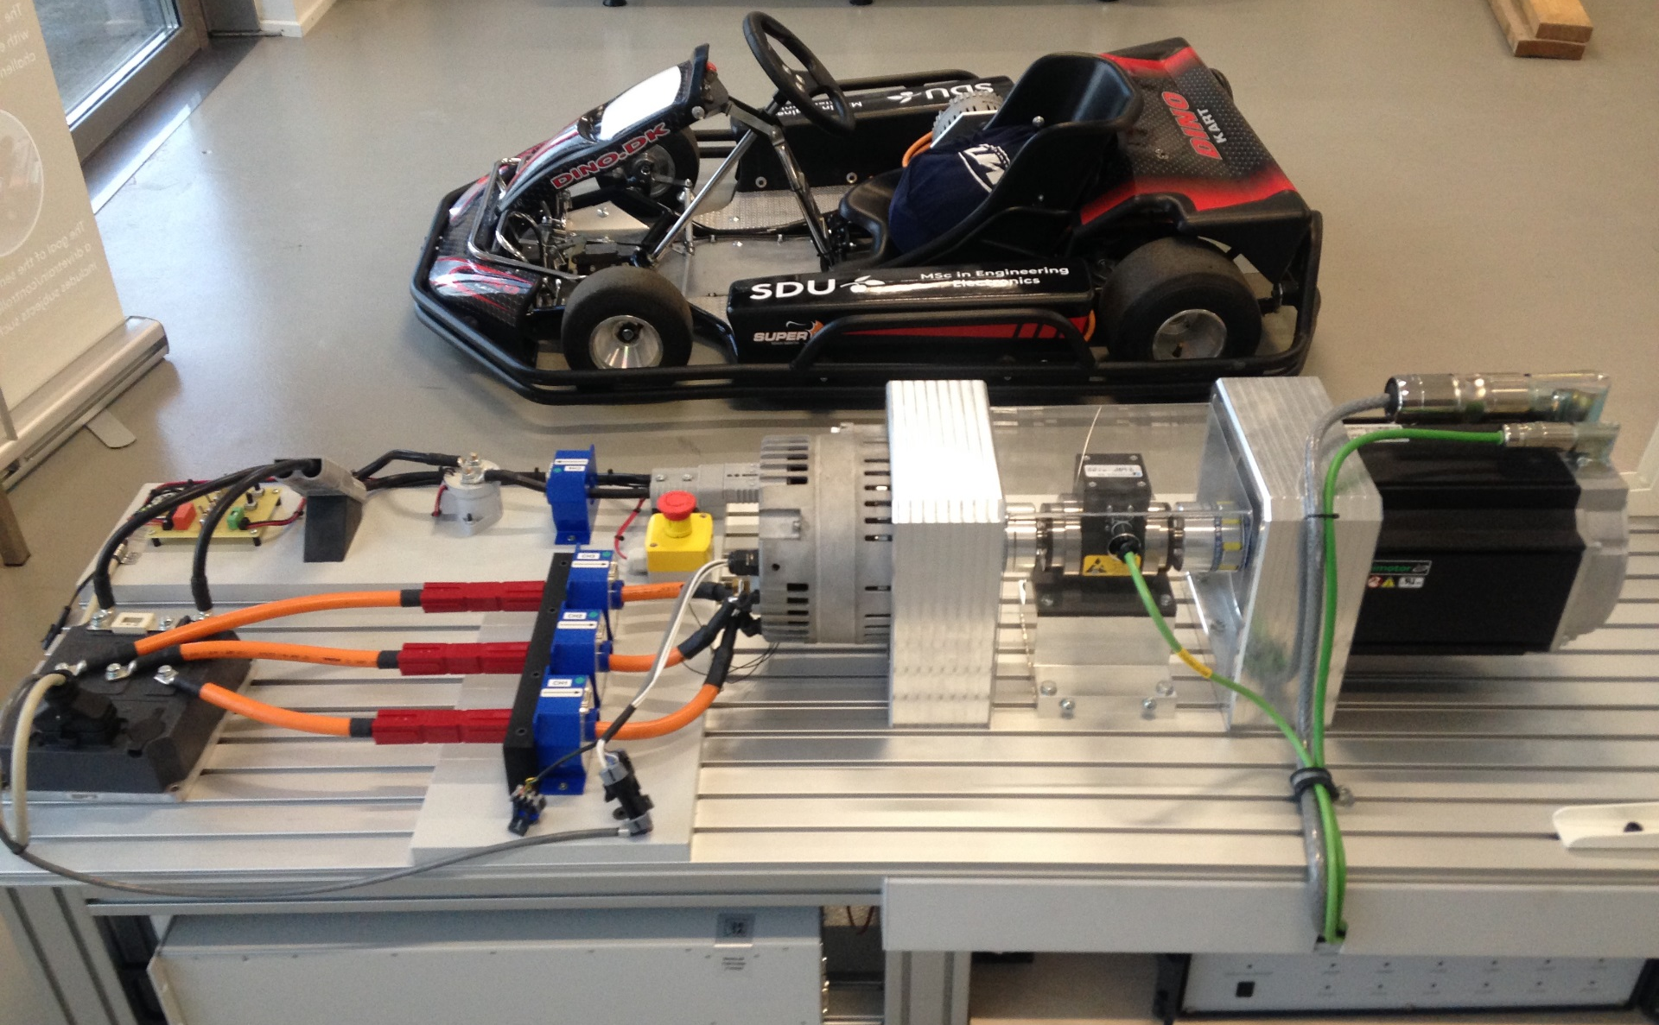
Motor test bench

Slide 35
Purchasing project parts
Each group will have a budget of 3000 DKK. for purchasing project parts.
  Try to use components from the electronics workshop
  Preferred supplier: RS components, www.rsonline.dk
    Optional suppliers: www.mouser.com, www.digikey.com
  Ordering of components – Send shopping basket from supplier to Jesper Nielsen, jesn@mmmi.sdu.dk
  All components for each board (Analog interface board and Inverter board) must be ordered at the same time

Slide 36
Semester project evaluation
Report hand in
  No later then 29. of may 2018 at 12.00
Examination conditions
  Project report must be submitted on time and in accordance with the requirements specified during the semester
Evaluation
  Internal oral examination with co-examiner assessed according to the 7-point grading scale. The project report will be included as basis for the examination

Slide 37
Software tools
Schematic and PCB design tool
  Circuit Maker (Free tool from Altium)
    Introduction 8. February by Jesper Nielsen in meeting room: Ellehammer – Ø28-600-3 from 8.15 – 11.45
Electrical circuit simulation tool
  SDU has license to Orcad Pspice
  See “Installing Orcad Pspice” document on Blackboard

Slide 38
Project - time schedule
Preliminary
February | Master programme and semester kick off
8. February | Introduction to Schematic and PCB design tool (Meeting room: Ellehammer – Ø28-600-3)
16. February | Analog interface board – Diagram design review
23. February | Analog interface board – PCB design review
2. Marts | Ordering of PCB board
19. Marts | Expected PCB delivery
29. May | Project report hand in
?. Marts | Electrical safety course (LAUS)

Slide 39
Electrical kart race #IV
Driver | Group | Best lap time
Anders Bjørk | 2 | 34.984
Søren Dahlstrøm Larsen | 1 | 29.058

Slide 40
Student presentation

Slide 41
Electrical kart race #V
Driver | Group | Best lap time
Dan Skovlod Clausen | 1 | 27.844

Slide 42
Race result & end of day
Group | Group average lap time | Position
1 | (29.642 + 27.779 + 28.263 +29.058 + 27.844)/5 = 28.517 | 1
2 | (28.170+26.511+28.320+34.984)/4 = 29.450 | 2
Max time = 35 sec

