Slide 1
Collaborative Learning in Higher Education: Reflections and New Directions
Nikol Rummel Anne Deiglmayr
Ruhr-Universität Bochum ETH Zurich / University of Leipzig

Slide 2
TAL case studies
31 studies (30 short communications; 1 poster)
25 include at least some elements of collaborative learning, 14 focus on collaborative learning
many examples of CSCL (e.g. online learning, e-learning, classroom response systems, using apps / digital tools to support learning,…)

Slide 3
Supporting (CS)CL in Higher Education
WHY
goals, expected outcomes
WHAT
targeted aspects
timing (prior to, during, after)
adaptivity and granularity of implementation
WHO
sources, mediators, and addressees of support
HOW
(technical) solutions for delivering support

Slide 4
TAL 2018 case studies
project-based learning
collaborative video creation
start-up(-like) teams
collaborative case study
 | Group | Individual
now | group product (sometimes), e.g. video, tool, case study
future (→ transfer) |  | soft skills; management skills domain knowledge?
How should we grade students on team products?
How can we minimize the time and effort for using technical tools?
Notes:
Time and effort for technical tools (e.g. video creation)
Select tools that are easy; provide reliably and fast tech support
training
curriculum design?
self-regulation?

Slide 5
TAL 2018 case studies
quiz-based collaboration
“team-based learning”
scripted quiz-taking & group discussion
classroom response systems
 | Group | Individual
now |  | preparation for class (e.g. in a flipped classroom) participation in group discussions
future (→ transfer) |  | individual conceptual knowledge
How can we make the most of students’ discussions?
learning task design
adaptive support?
Notes:
How can we make the most of students discussions?
Mutual tutoring? Error detection? Conceptual change?
e.g. use concept inventories
Build in mutual tutoring
Pair students with incompatible solutions / opposing opinions

Slide 6
TAL 2018 case studies
game-based learning
role playing
tournaments
 | Group | Individual
now | interactivity | participation in group discussions “fun”
future (→ transfer) |  | domain knowledge soft skills
How can we make positive effects of “fun” activities last throughout the semester?
→ motivational & affective support
Notes:
sustainable “fun” (motivational benefits)?
Use games to facilitate getting-to-know / group formation in the beginning
Use gamification to build up knowledge and skills that students can use also later
Use game elements more than once

Slide 7
TAL 2018 case studies
scripted (CS)CL
rotating roles (journal club)
peer feedback routines
 | Group | Individual
now | smoothing group processes | individual reflection participation in group discussion
future (→ transfer) |  | domain knowledge? methodological skills? social & communicative competences?
How can we avoid under- and over-scripting?
formative assessment & feedback
student participation
Notes:
Support targets social and meta-cognitive dimensions – but what are the outcomes?
Comparisons help to single out relevant factors, e.g. quality of peer feedback with or without rubrics etc.
What students like is not always what helps them most for learning… (e.g. blocked vs. interleaved practice)

Slide 8
Supporting (CS)CL in Higher Education
WHY
goals, expected outcomes
WHAT
targeted aspects: How do we know what “worked”? What dimensions did the support affect?
timing (prior to, during, after): adding pre-training and/or reflection elements?
adaptivity and granularity of implementation: increasing adaptivity?
WHO
sources, mediators, and addresses of support: (peer) tutors as supporters of learning?
HOW
(technical) solutions for delivering support: CSCL / TEL

Slide 9
Supporting (CS)CL in Higher Education: New Directions
Intelligent support for small group collaboration (IKARion project)
Teacher orchestration tools (project with Anouschka van Leeuwen)
Human/AI co-orchestration (NSF-project with Ken Holstein and Vincent Aleven, CMU)
Notes:
From a project funded by our German Federal Ministry of Education (actually a whole program of research)
Reporting on hot topics from this year’s conferences: Symposium at ICLS 2018; invited symposium at EARLI 2019 Extension of work that received best paper awards at ICLS and AIED

Slide 10
Effects of CSCL scripts: Empirical Evidence
meta-analysis of effects of CSCL scripts (Vogel, Wecker, Kollar & Fischer, 2016)
22 articles (published between 2005 and 2012) included
overall 2,825 participants (M = 101; SD = 99.85)
average age was 20 years (M = 20.17; SD = 4.85)
effect on domain-specific knowledge (d = 0.20)
effect on collaboration skills (d = 0.65)
Notes:
Slide I showed you this morning.
But despite the evidence on positive effects of CSCL scripts, there has also been critism….

Slide 11
Effects of CSCL scripts: Criticism
drawbacks:
can under- or over-constrain collaboration (Dillenbourg, 2002; Dillenbourg & Jermann, 2007)
ignore internal collaboration scripts (Kollar, Fischer & Slotta, 2007)
criticism led to research towards more flexible scripts:
faded scripts (Wecker & Fischer, 2011)
adaptable scripts (Wang, Kollar, Stegmann & Fischer, 2011)
adaptive scripts (Diziol, Walker, Rummel & Koedinger, 2010; Rummel, Mullins & Spada, 2012; Walker, Rummel & Koedinger, 2009a, 2009b, 2011, 2014)
Notes:
But collaboration scripts of the kind introduced with the example from my own work also have drawbacks…
The amount of needed external support depends on the collaboration experience

Slide 12
Adaptive Collaborative Learning Support (ACLS)
adaptive support theoretically more effective
tailored to student needs
adaptive support requires that we
automatically assess student interactions
provide adaptive feedback based on the difference between the assessment and a model of optimal collaboration (Soller, Martinez, Jermann & Muehlenbrock, 2005)
leverage work on Intelligent Tutoring Systems (ITSs)

Slide 13
ACLS: Empirical Evidence
Does adaptive support improve collaboration & learning compared to fixed support?
collaborative skill (Walker, Rummel & Koedinger, 2011)
knowledge of good collaboration (Baghei, Mitrovic & Irwin, 2007)
domain learning (Kumar, Rosé, Wang, Joshi & Robinson, 2007; Karakostas & Demetriadis, 2011; Walker, Rummel & Koedinger, 2014)
It is indeed the adaptivity that matters (Walker, Rummel & Koedinger, 2014)

Slide 14
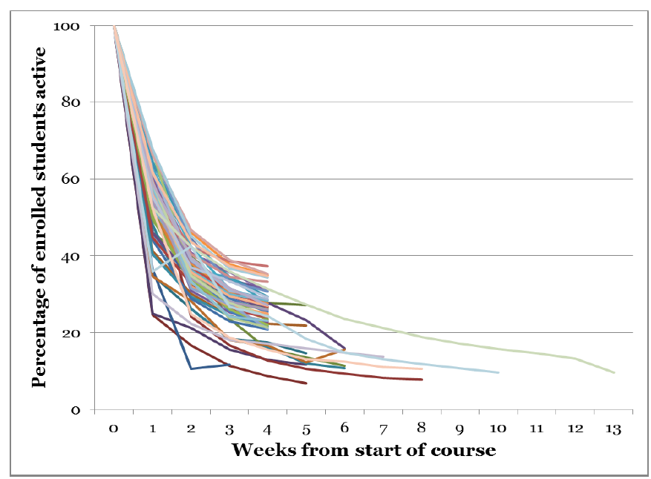
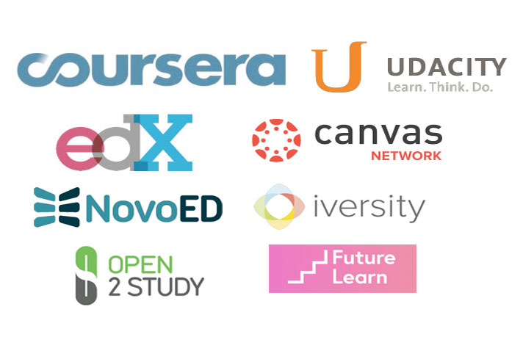
Intelligent support for small group collaboration
Factors influencing student attrition from online courses
too little interaction with other students and with the instructor (Gütl et al., 2014)
feelings of isolation (Khalil & Ebner 2014)
Jordan 2015, p. 351
Nikol Rummel, Anne Deiglmayr
06.11.2018
Notes:
context we’re considering is online learning, like in MOOCs or in blended-learning elements.
during the early years of MOOCs, one phenomenon was very dominant: That is, dropout from online courses. Which, even today, is still an issue
Research on student dropout has identified many factors contributing to this problem.
One factor is the lack of interactivity in the courses, either between students and the teachers, or interaction among students.
This lack of interactivity leads to feelings of isolation and decreases course satisfaction.
These factors eventually contribute to students dropping out of the course.
https://www.diygenius.com/wp-content/uploads/2013/08/ultimate-mooc-guide.jpg

Slide 15
Intelligent support for small group collaboration
scripting
Interactivity:
Collaborative learning
+
-
sense of community
Course satisfaction
Feelings of isolation
+
+
Remaining in the course
Nikol Rummel, Anne Deiglmayr
06.11.2018
Notes:
One mean to increase interactivity in online courses: introduction of collaborative learning.
If a task is truly collaborative, it leads to meaningful interaction among students, which decreases feelings of isolation and increases satisfaction with the course.
→ students are less likely to leave the course.
collaborative learning does not always work out:
On the one hand: usually absence of productive interactions.
On the other hand: presence of problematic interactions, e.g. social loafing.
→ Hence, either way, it is important to support students during their collaboration.
default approach to supporting collaborative learning, especially in CSCL, is scripting.
The goal of collaboration scripts: fostering productive interactions.
But, most collaboration scripts are static; that is, they do not take into account the actual performance of the group and changes in performance during the collaboration.

Slide 16
Intelligent support for small group collaboration
(Strauss, Rummel, Stoyanova, Kraemer, 2018)
Step 1
Step 2
Step 3
Step 4
Collecting potential problematic interactions
Library of typical problems during (online) collaboration
Learning Analytics
Repository of interventions & expert system
Automated and adaptive
Nikol Rummel, Anne Deiglmayr
06.11.2018
Notes:
Our approach to this challenge is the opposite: focus on unproductive interactions, that typically occur during collaborative learning. And then provide adaptive support for the students
in order to design support for groups, at first, potential problems as well as corresponding beneficial interactions need to be collected.
Second, unproductive interactions, that are likely to occur and have an impact on the outcomes we want to address need to extracted.
we chose interactions, that are likely to produce frustration and therefore increase the risk of dropout.
The context we are designing the support for is asynchronous, text-based collaboration.
Afterwards: we need to design ways to detect these unproductive interactions, as well as design interventions that help students overcome these problems.
With larger online courses in mind: support to be automated as well as adaptive, as it is impossible for teachers to attend to all groups. → But I’ll get to these steps later in the outlook.
Strauß, S., Rummel, N., Stoyanova, F., & Krämer, N. (2018). Developing a library of typical problems for collaborative learning in online courses. In J. Kay & R. Luckin, R. (Eds.), Rethinking Learning in the Digital Age: Making the Learning Sciences Count, 13th International Conference of the Learning Sciences (ICLS) 2018, Volume 2 (pp. 1045-1048). London, UK: International Society of the Learning Sciences.

Slide 17
Supporting (CS)CL in Higher Education: New Directions
Intelligent support for small group collaboration (IKARion project)
Teacher orchestration tools (project with Anouschka van Leeuwen)
Human/AI co-orchestration (NSF-project with Ken Holstein and Vincent Aleven, CMU)

Slide 18
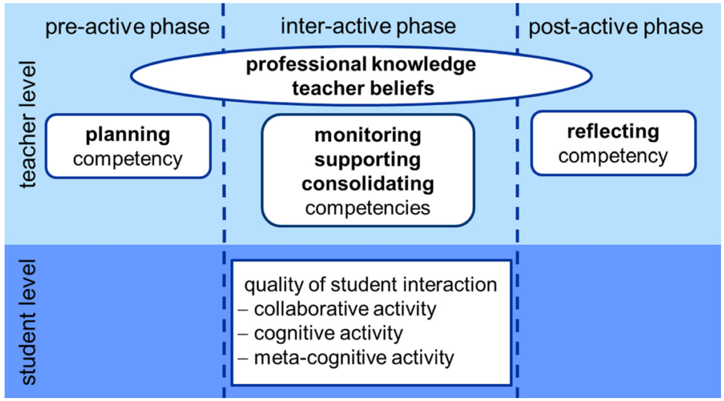
Teacher Support of Collaborative Learning
Kaendler et al., 2015

Slide 19
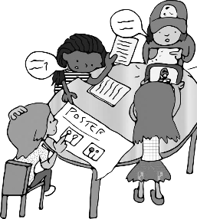
Teacher Support of Collaborative Learning
Monitor
Intervene
Effect on CL/Learning
What are groups really doing?
Individual versus group level
Limited time
Groups work on different tasks
Cognitive and social aspects to monitor
Feldon 2007
Gilles & Boyle 2010
Greiffenhagen 2012
Kaendler et al., 2015
Onrubia & Engel 2012
Van Leeuwen et al 2013;2015
Reactive versus proactive
Nikol Rummel, Anne Deiglmayr
06.11.2018
19
Notes:
Identify the challanges
the interactive phase is also the phase that requires a high orchestration load from teaches: time available to teachers is limited, and so are their cognitive resources (Feldon, 2007). This makes monitoring collaborative activities a demanding if not impossible task (Van Leeuwen, Janssen, Erkens, & Brekelmans, 2015). There are multiple groups to monitor, which could be working on different stages of the task. Furthermore, groups require support at multiple levels: not only concerning the task itself, but also the regulative and social aspects of collaboration (Van Leeuwen, Janssen, Erkens, & Brekelmans, 2013). the role of the teacher during the interactive phase of collaboration is manifold. Teachers monitor and offer assistance on multiple aspects of a task, may monitor individual versus groups of students, and act both reactively (in response to students’ request for support) and proactively (based on the teacher’s observations) (Greiffenhagen, 2012; Onrubia & Engel, 2012). As Dillenbourg and Jermann note (2010), even within activities, teachers often adapt their behavior on the fly according to classroom constraints.
Losing overview is a commonly encountered obstacle for teachers to successfully implement collaborative learning (Gillies & Boyle, 2010; Van Leeuwen et al., 2015). Teachers may therefore be in need of support to monitor groups’ activities.

Slide 20
Teacher Orchestration Tools
Collaboration between teacher and technology?
Traces of student activity as input for Teacher Dashboard → support teacher monitoring
“People and machines join together in helping someone learn something” (Pea, 2004)
Notes:
Here is where LA comes in: possible collaboration between teacher and technology
When dashboards provide support to students (intervening function), the pressure on teachers to regulate students’ activities can be relieved, and the teacher is in that sense off-loaded. As Ertmer and Glazewski (2015) note, some “scaffolds may serve as intermediate structures that support teachers in the task of […] scaffolding by creating time for reflection before their response is required” (p. 100). This “time for reflection” is also noted by Schwarz and Asterhan (2011) as a key component of effective human tutoringer and dashboard

Slide 21
Teacher Orchestration Tools
Monitor
Intervene
Effect on CL/Learning
Detect
Interpret
Decide
What information do teachers need?
How do teachers use the tool in their classrooms?
Van Es & Sherin, 2008
Notes:
The dashboard as additional source of information to monitor students.
In the model, it looks like this.
Theoretical model - Monitoring
Data sources for teacher: classroom observation + DASHBOARD
In the project, we zoom in on teacher sense making of dashboard

Slide 22
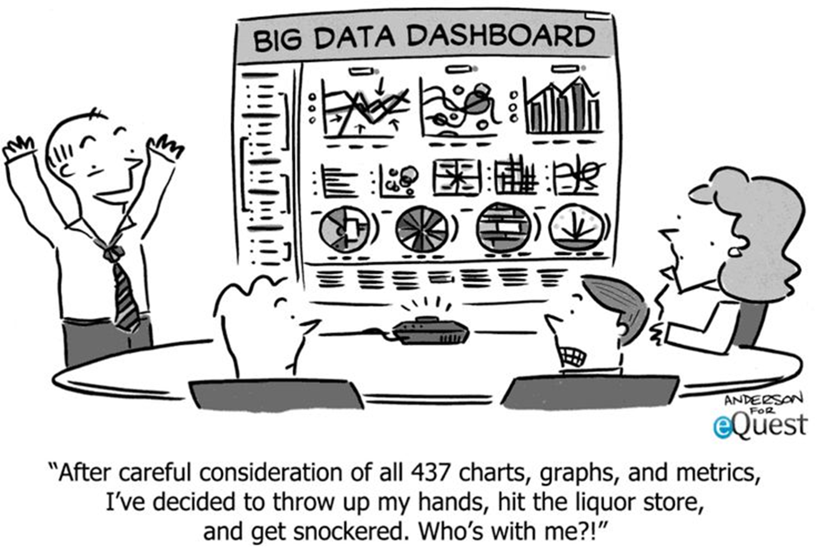
Notes:
Arrow 1 (teacher-student) Teachers play an essential role for student learning, as they are responsible for monitoring and orchestrating both cognitive and metacognitive processes, as well as social processes when it concerns collaboration among students (Kaendler et al., 2015; Prieto et al., 2011).
Arrow 2,3,4: Most computer-supported learning environments enable capturing of student activities, which can then be (automatically) analyzed and visualized on so called teacher orchestration tools to support teachers in the real-time orchestration of student learning (Verbert et al., 2014; Wise & Vytasek, 2017).
In the growing field of research on teacher orchestration tools, important questions arise concerning the design and implementation of teacher orchestration tools (Van Leeuwen & Rummel, 2017).
Two research questions: 1) what information do teachers need that would help them to support their students, and how does that translate to design of an orchestration tool? Subsequently, 2) once the orchestration tool is designed, how do teachers actually use them in their classrooms? As an overarching question, we are interested in what lessons can be drawn about what makes orchestration tools helpful for teaching and learning.

Slide 23
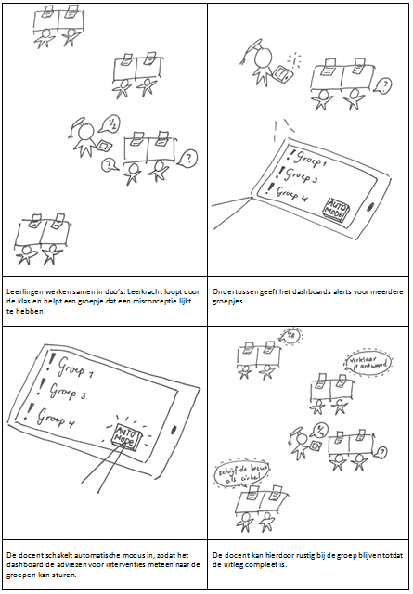
Inquiry into Teacher Practice
Inquiry into teacher practice
Contextual Inquiry by envisioning specific situations
Teachers’ stance towards dashboard
React to scenarios in form of visual storyboards
General interview questions

Slide 24
Main Outcome: Inquiry into Teacher Practice
Types of events teachers typically look for when monitoring CL:
background information about students
information about dyads’ grasp of the material
dyads’ involvement or engagement with the task
information about dyads’ progress on the task
potential difficulties with interaction between group members

Slide 25
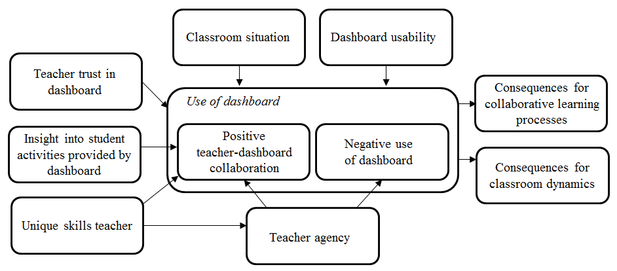
Main Outcome: Teachers’ Stance Towards Dashboards
Visual display of most important themes

Slide 26
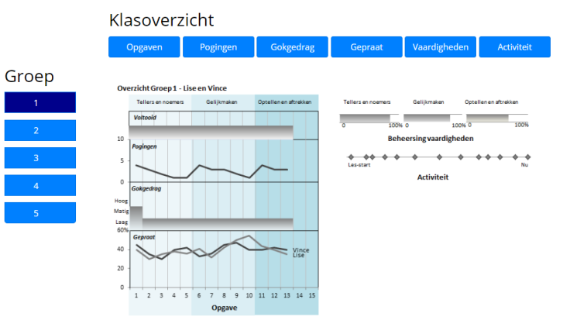
Mirroring
Alerting
Advising
Nikol Rummel, Anne Deiglmayr
06.11.2018
26

Slide 27
Supporting (CS)CL in Higher Education: New Directions
Intelligent support for small group collaboration (IKARion project)
Teacher orchestration tools (project with Anouschka van Leeuwen)
Human/AI co-orchestration (NSF-project with Ken Holstein and Vincent Aleven, CMU)

Slide 28
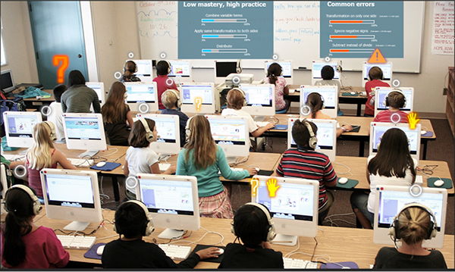
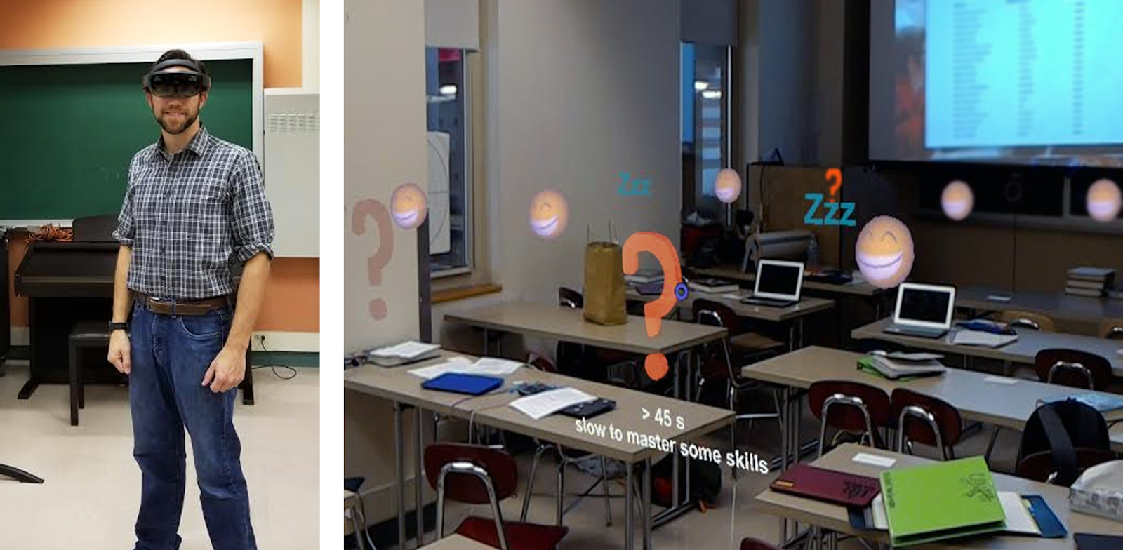
Human/AI co-orchestration
NSF project: Towards Human/AI co-orchestration of dynamically-differentiated collaborative classrooms
Notes:
Holstein, K., McLaren, B. M., & Aleven, V. (2018). Student learning benefits of a mixed-reality teacher awareness tool in AI-enhanced classrooms. In Proceedings of the 19th International Conference on Artificial Intelligence in Education (AIED’18). [pdf] *Best Paper Award*
Holstein, K., McLaren, B. M., & Aleven, V. (2018). Informing the design of teacher awareness tools through Causal Alignment Analysis. In Proceedings of the 13th International Conference of the Learning Sciences (ICLS'18). [pdf] *Best Student Paper Award*

Slide 29
Supporting (CS)CL in Higher Education: Take Away Messages
Collaborative learning (CL) has the potential to promote learning, but it depends…
There some important conditions (e.g. positive social interdependence and individual accountability)
Ultimately, the effectiveness of CL depends on the quality of student interactions
Research shows that promotive interaction can be facilited
Adapting support to students needs is difficult, but important to avoid over- or underscripting
Computer support offers promising ways of adaptively supporting CL
Still a long way to go until widely applicable in education

Slide 30
Supporting (CS)CL in Higher Education: Take Away Messages
Teaching with (CS)CL is challenging; teachers need support
New technologies hold great potential for providing support to teachers as they orchestrate collaborative classroom
Yet, research on teacher/AI co-orchestration is still in its infancy

Slide 31
Supporting (CS)CL in Higher Education: Take Away Messages
(CS)CL is challenging, but also worth the while!

