Slide 1
Collaborative Learning in Higher Education:
Relevant Dimensions
Nikol Rummel Anne Deiglmayr
Ruhr-Universität Bochum ETH Zurich / University of Leipzig
Notes:
Say a few words about who we are/what our background is wrt research on collaborative learning/CSCL

Slide 2
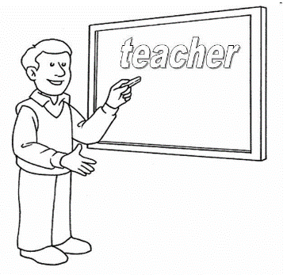
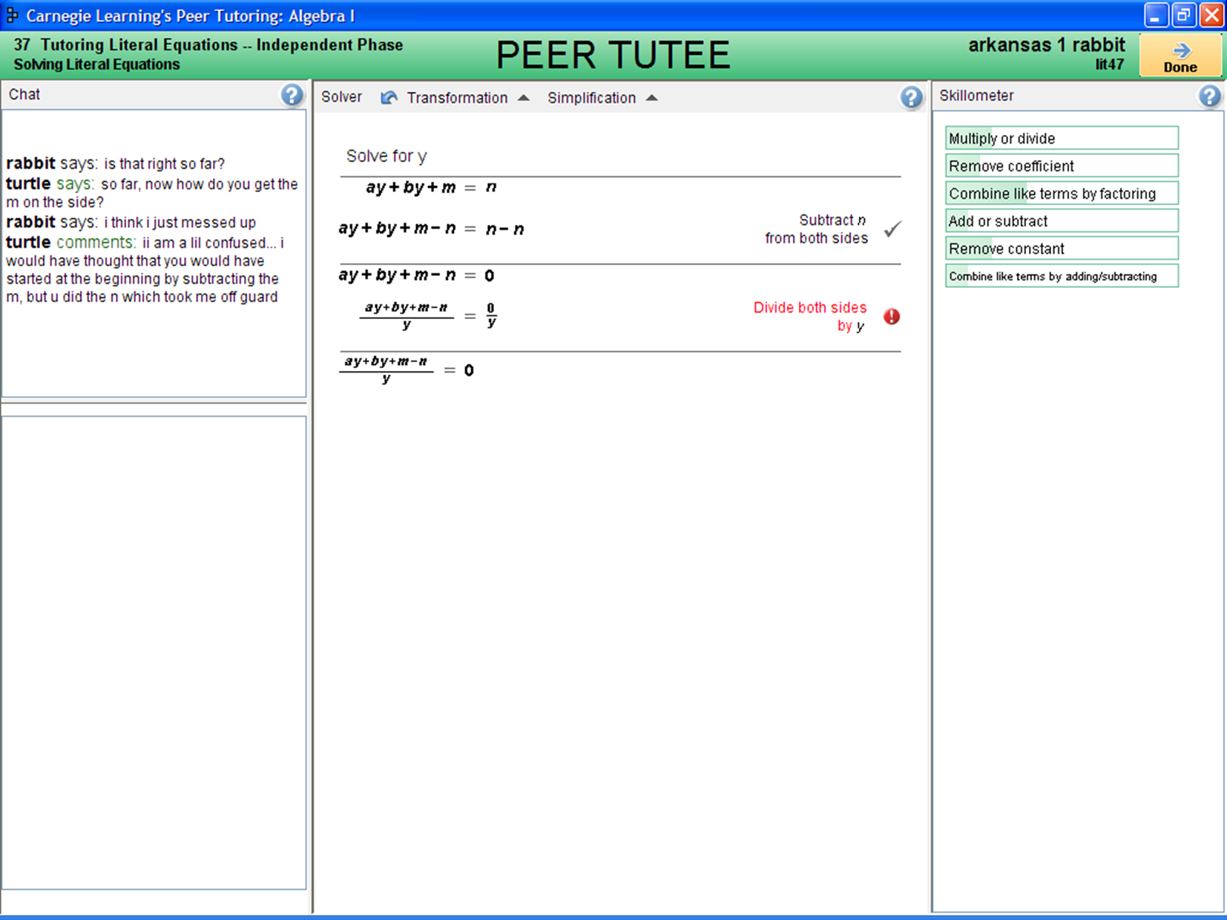

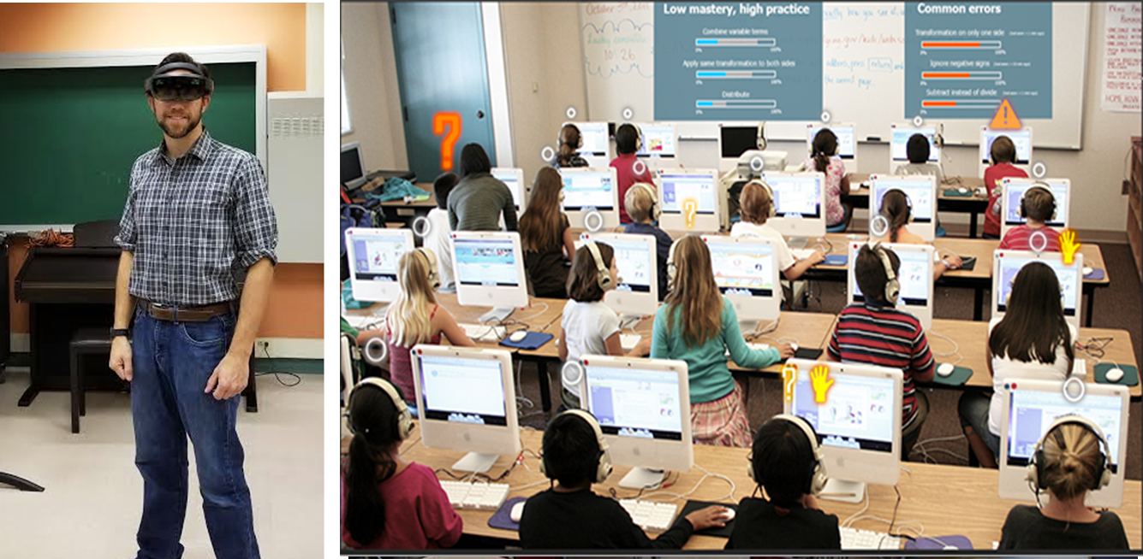
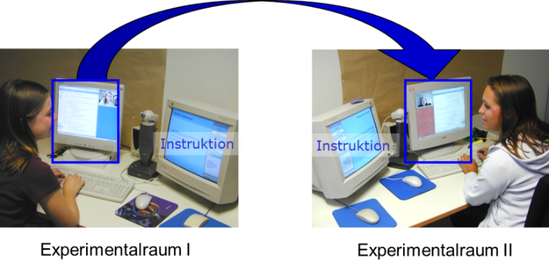
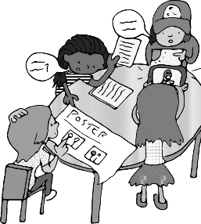
Introductions: Nikol Rummel
What are groups really doing?
Individual versus group level
Limited time
Groups work on different tasks
Cognitive and social aspects to monitor
Reactive versus proactive
Notes:
Book edited by Koschman that had just appeared inspired me to do research on (CS)CL. This was also the time when I was studying in the US (Madison, Wisconsin) where they were beginning to use Learning Management Systems and where we as students were asked to collaborate using these.
Then, during my PhD, I focussed on questions that lie at the core of (CSC)CL: What makes good collaboration? How can we support it? But also: how can students learn to collaborate successfully (i.e. how can we promote good collaboration a sustainable way).
I found that instructionally supporting collaborative learning can be very effective, but that it is also difficult to tailor the support to students needs. I thus partnered up with a group of colleagues at CMU (Pittsburgh) who have been very successful at developing intelligent tutoring systems. The behind our joint work was to provide adaptive support that automatically adjusts to the needs of the (collaborative) learners.
At the same time I began a second strand of research focusing on the challenges that teachers and educators experience when they implement collaborative learning in their classrooms, and on exploring the role that technology can play in this (teacher dashboards).
Very recently – and I will tell you a little bit about this work in the outlook this afternoon – we have begun to to pull both threads together: intelligent, adaptive support for students and for small group collaboration, and technology support for teachers to orchestrate this complext situation with its many facets…..

Slide 3
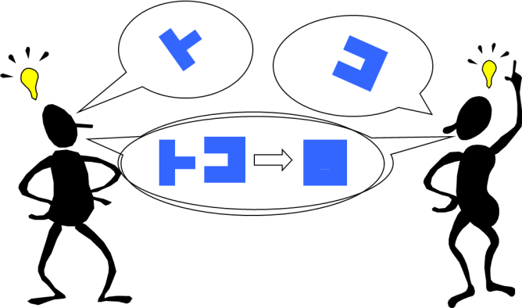
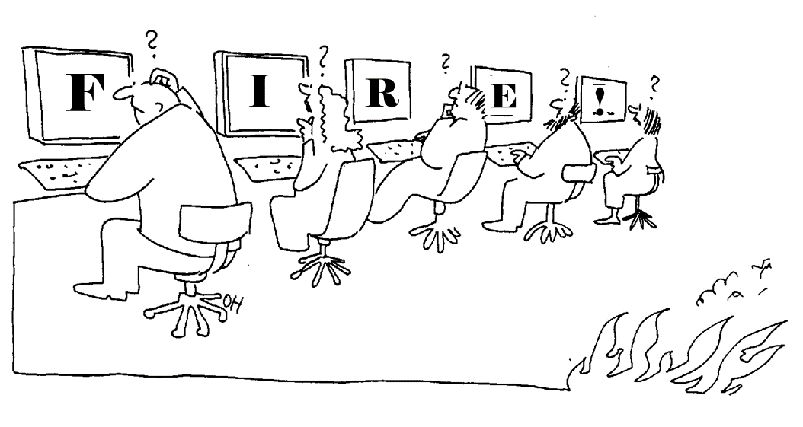
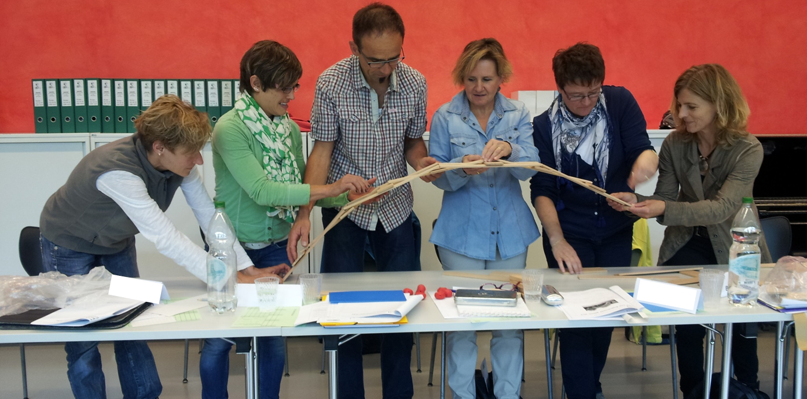
Introductions: Anne Deiglmayr
Notes:
My research in collaborative learning initially came from a project in which aimed to find ways to determine the quality of interdisciplinary collaboration (together with Nikol). It’s clear that good collaboration is “good” on multiple dimensions – cognitive, communicative, social, motivational – and we developed a rating scheme to assess collaboration quality that aims to cover a broad range of dimensions.
In my later work, I have, however, focused on the cognitive dimension in particular, because I became interested in how dialog with peers has the potential for the individual to see new connections, draw new inferences, and reach new insights. One interesting field of study, for example, is how transactive dialogue, i.e. dialogue in which students build extensively on one another’s contributions, can contribute to individual conceptual learning. For example, in a recent study together with my colleague Lennart Schalk at ETH, we could show that an intervention to facilitate collaborative learning increased individual conceptual knowledge (in a Mathematics topic), but only to the extent that it helped students discuss in a more transactive way.
Another interest of mine is to see how knowledge interdependence affects collaborative processes and individual learning outcomes. Knowledge interdependence is what you establish in a group jigsaw, for example. We could show that distributing core learning content does increase interdependence, but can also decrease transactive talk and decrease learning. Also, a meta-analysis that we are currently doing on studies that have systematically tested the effectiveness of the jigsaw method shows that it is less effective than one might think (given that it is advocated in so many methods books for educators), and that other form of CL are often more effective.
Finally, I am also a teacher educator, and I am interested in how children acquire knowledge about science and scientific methods, with and without collaborative learning; so many of the examples that I talk about are from the STEM fields.

Slide 4
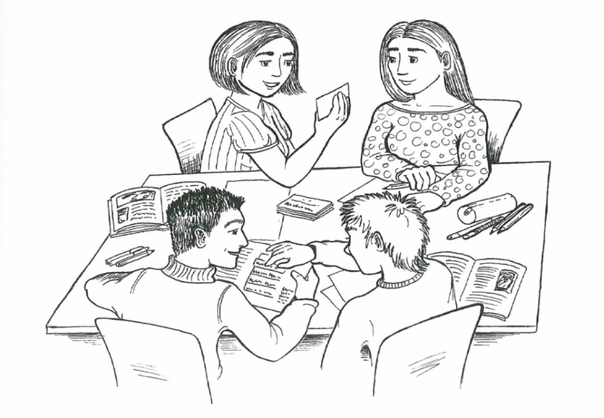
Collaborative Learning (CL)
“… a situation is termed 'collaborative' if peers are more or less at the same level, can perform the same actions, have a common goal and work together.”
(Dillenbourg, 1999, p. 9)
“… describes a variety of educational practices in which interactions among peers constitute the most important factor in learning, although without excluding other factors such as the learning materials and interactions with teachers.”
(Dillenbourg, Järvelä & Fischer, 2009, p. 3)
learners working together in pairs or small groups towards shared, learning-related goals

Slide 5
Processes during collaborative learning…
Listening
Planning
Sustaining common ground
Integrating perspectives
Technical coordination
Questioning
Consensus-building
Explaining
Reflection
Information sharing
Argumentation
Task coordination
Time management
Team building
Notes:
These interactions can take various forms; here are just a few examples of processes during CL
As you will se throughout our talk, CL, to us, is not so much about specific instructional methods, or about specific technical tools, but about what students are doing.

Slide 6
Outline
What does the research say?
What makes CL effective?
  conditions
  interactions
How do I design for effective CL?
  scripts
  CSCL
A framework of dimensions

Slide 7
What does the research say?
effects
conditions
interactions
How effective is collaborative learning?
How should instructors design collaborative learning?
How do students learn from collaboration with peers?
Dillenbourg et al. (1999) «The evolution of research on collaborative learning»

Slide 8
What does the research say?
effects
conditions
interactions
How effective is collaborative learning?
Dillenbourg et al. (1999) «The evolution of research on collaborative learning»

Slide 9
Typically targeted CL outcomes
 | Group | Individual
now | high-quality group product motivational, e.g. team formation, group cohesion affective, e.g. positive team climate | high-quality individual contributions motivation to collaborate (again) affective, e.g. satisfaction with group work; liking of other group members
future (→ transfer)

Slide 10
Typically targeted CL outcomes
 | Group | Individual
now | high-quality group product motivational, e.g. team formation, group cohesion affective, e.g. positive team climate | high-quality individual contributions motivation to collaborate (again) affective, e.g. satisfaction with group work; liking of other group members
future (→ transfer) | improved collaboration as a team on future tasks | improved performance in related individual tasks: individual domain knowledge & skills other collaborative tasks: social skills

Slide 11

What does the research say?
CL can…
contribute to a positive classroom climate
improve social relationships and foster friendships among students
help teachers in realizing more student-centered instruction
help students acquire important communicative and social skills
lead to improved student achievement
(Gillies, 2014; Johnson & Johnson, 1989, 2014; Slavin, 1996, 2014; Tolmie et al., 2010)

Slide 12
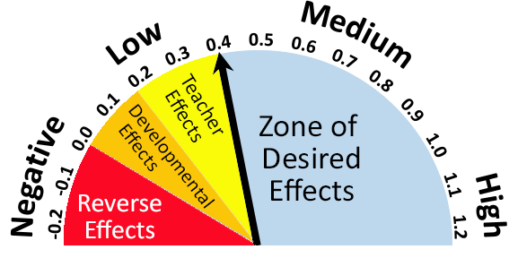
What does the research say?
“The Hattie Study”: 1000+ meta-analyses, 50’000+ studies, 240’000+ students
effect sizes:
> 0.2 “small”
> 0.5 “medium”
> 0.8 “large”
collaborative vs. individualistic learning
(d= .59)
(Hattie, 2009)
Notes:
Collaborative vs. individualistic learning d= .59
Peer tutoring d= .55

Slide 13
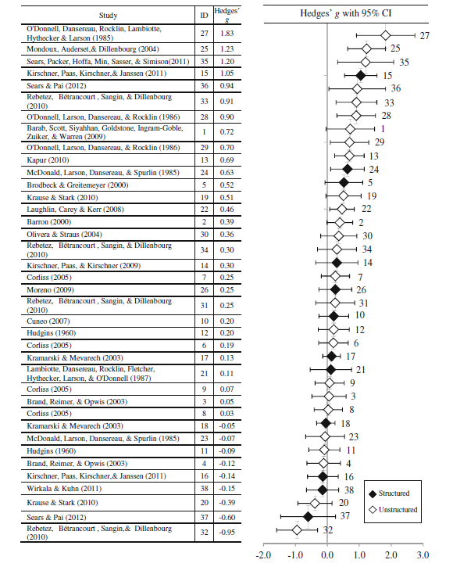
meta-analysis: effects of small group work on transfer of learning
mean effect size: g = .30
(Pai, Sears, & Maeda, 2015)

Slide 14
What makes CL effective?
effects
conditions
interactions
How should instructors design collaborative learning?
Dillenbourg et al. (1999) «The evolution of research on collaborative learning»

Slide 15
Conditions
Core ingredients of effective CL (Johnson & Johnson, 1989, 2014)
positive social interdependence
individual accountability
appropriate use of social skills
group processing
promotive interaction
motivational
Notes:
You will find these in any textbook on collaborative learning!

Slide 16
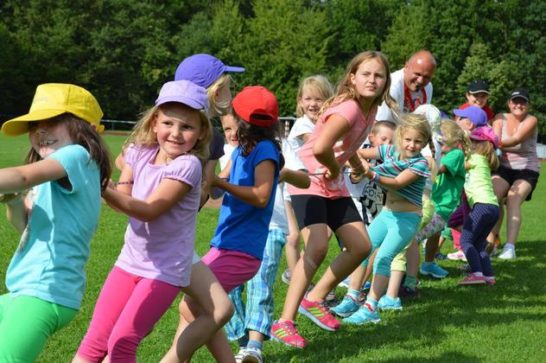
Positive social interdependence
“…the perception that one is linked with others in a way so that one cannot succeed unless they do (and vice versa) and that groupmates’ work benefits you and your work benefits them”
(Johnson & Johnson, 2014, p. 845)
Notes:
tug of war
Students may be interdependent with regards to
outcomes (e.g. rewards, grades),
means to fulfil the task (e.g. resources, roles, subtasks),
and due to environmental factors: e.g., shared history, competition with other teams,…

Slide 17
Positive social interdependence
What teachers can do:
choose group tasks wisely
  avoid tasks that could just as well be completed individually
  avoid competitive tasks
  emphasize joint learning goals
support “team building” (social cohesion), e.g. by allowing teams to sit together, select a team name & logo, compete with other teams,…
use group rewards
distribute roles and/or responsibilities

Slide 18
Individual accountability
“Each group member has a personal responsibility for completing one's share of the work and facilitating the work of other group members ” (Johnson & Johnson, 2014, p. 845)
Teachers can, for example:
assess individual achievement (e.g. regular quizzes)
have students document their contributions to the group work (e.g. joint essay in which each student signs his / her chapter; individual learning journals)
observe groups, and give feedback
use the «random reporter» technique

Slide 19
Example: The “random reporter” technique
When assigning group tasks, inform students that they do NOT get to decide themselves who will present the group's results.
Rather, you will RANDOMLY select a student who will then be responsible for REPORTING on the group results.

Slide 20
Conditions
Core ingredients of effective CL (Johnson & Johnson, 1989, 2014)
positive social interdependence
individual accountability
appropriate use of social skills
group processing
promotive interaction
social
Notes:
You will find these in any textbook on collaborative learning!

Slide 21

Appropriate use of social skills
Examples for relevant social skills (Slavin, 2014):
active listening
explaining ideas
and opinions
encouraging
teammates
completing tasks
Notes:
some teachers (e.g. teachers following the method of collaborative learning proposed by Johnson & Johnson, 1989) select on content-related and one social skill as targets for each collaborative activity

Slide 22
Group Processing
collaborating to learn
learning to collaborate

Slide 23
Group Processing
collaborating to learn
learning to collaborate
feedback (from peers, from teacher)
…not only on learning content, but also on social skills!

Slide 24
Conditions
Core ingredients of effective CL (Johnson & Johnson, 1989, 2014)
positive social interdependence
individual accountability
appropriate use of social skills
group processing
promotive interaction
socio-cognitive
Notes:
You will find these in any textbook on collaborative learning!

Slide 25
What makes CL effective?
effects
conditions
interactions
How do students learn from collaboration with peers?
Dillenbourg et al. (1999) «The evolution of research on collaborative learning»

Slide 26
Promotive interactions
Dialogs with peers often enhance learning (more than listening to a teacher).
(Chi & Wylie, 2014; Howe & Abedin, 2013; Johnson & Johnson, 2013; Slavin, 1996)
Three main, cognitive perspectives on CL (Slavin, 1996):
socio-cognitive: resolution of socio-cognitive conflicts (Damon, 1984; Piaget, 1926)
socio-cultural: mutual scaffolding in the zone of proximal development (Rogoff, 1990; Vygotsky, 1978)
cognitive elaboration: co-construction of knowledge (Chi & Wylie, 2014)
  learning by explaining (Webb, 1989), learning by teaching (Leelawong & Biswas, 2008)

Slide 27
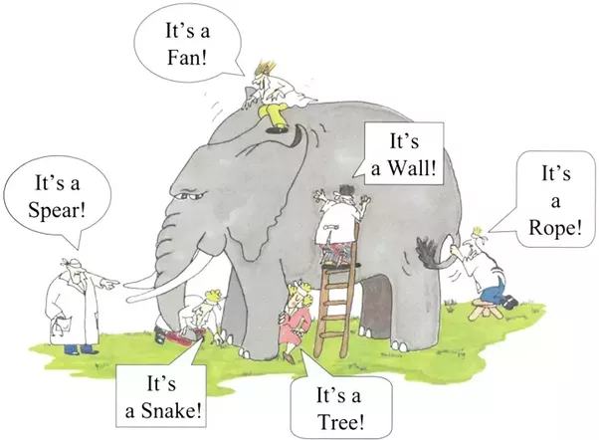
Socio-cognitive perspective
Experiencing and resolving socio-cognitive conflict, e.g. learning from argumentation
socio-…: i.e. between people
cognitive: i.e. NOT concerning
status, power, resources,…
but: ideas, perspectives,
knowledge, opinions,…
Notes:
→ differences in opinions or perspectives that can be resolved by exchanging and evaluating arguments
To resolve socio-cognitive conflicts, learners have to restructure and broaden their knowledge, e.g. by taking into account new information, and / or generating arguments that back up their position.

Slide 28
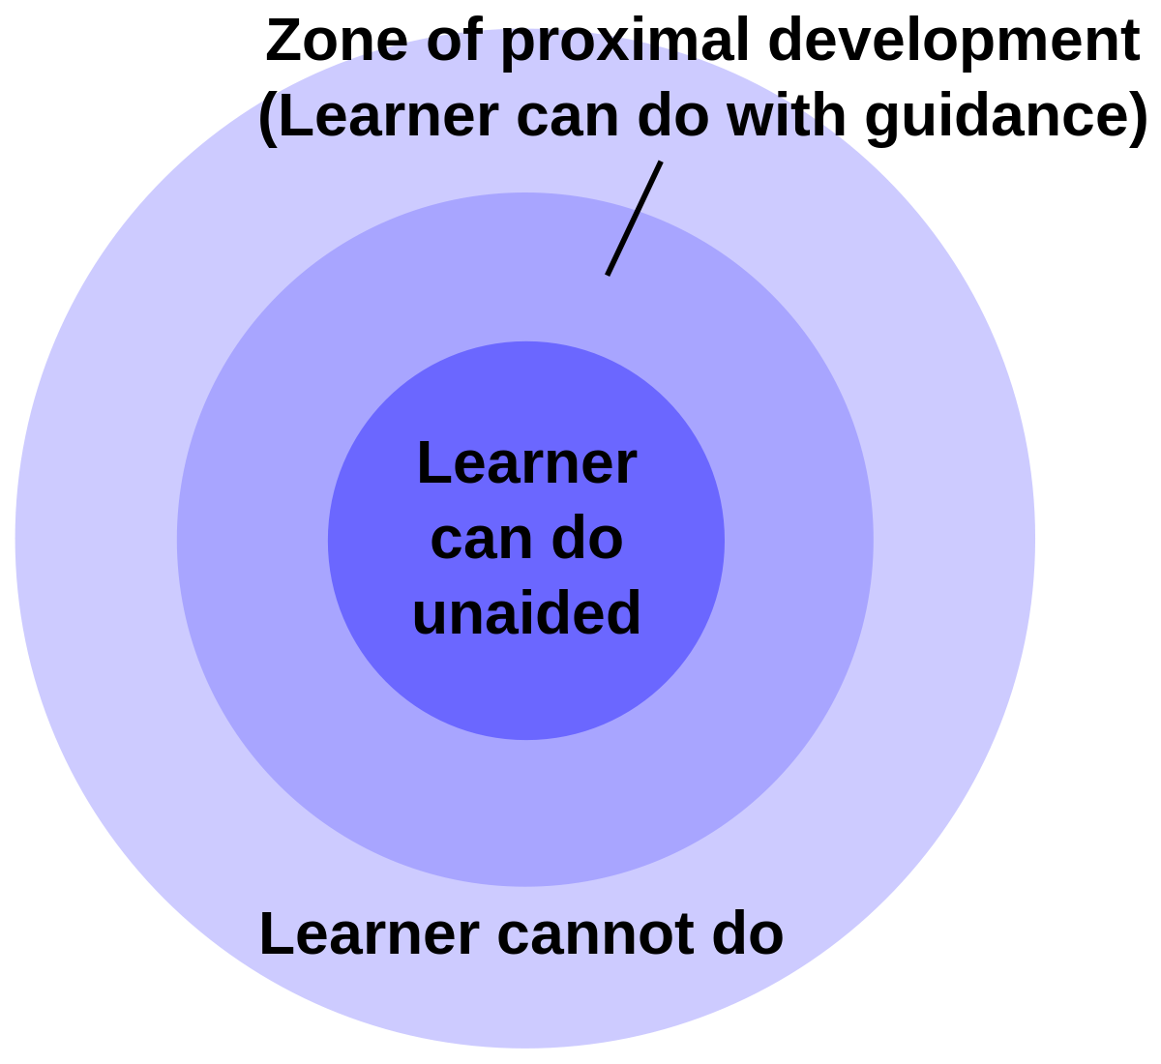
Socio-cultural perspective
Zone of Proximal Development: The range of things that a student cannot yet do herself, but can when collaborating with another person (peer or teacher).
e.g. learning from (mutual) scaffolding;
internalization of (meta-)cognitive
strategies
Notes:
"Functions are first formed in the collective in the form of relations among children and then
become mental functions for the individual ...."

Slide 29
Cognitive elaboration perspective
ICAP-Framework (Chi, 2009; Chi & Wylie, 2014)
four «modes of engagement» with decreasing likelihood of conceptual learning:
Interactive > Constructive > Active > Passive
e.g.
co-constructing
mutual tutoring
argumentation
e.g.
self-explaining
drawing inferences
re-structuring
e.g.
summarizing
repeating
highlighting
e.g.
reading
listening
observing
Notes:
Knowledge co-construction

Slide 30
Cognitive elaboration perspective
Characteristics of co-constructive (transactive) dialogue:
all group members contribute
students take turns talking
students engage deeply with the learning content (e.g. finding examples, generating explanations, drawing inferences, justifying claims, testing ideas,…)
students build upon one another
in their reasoning

Slide 31
What makes CL effective?
learning processes
(design) conditions
outcomes
(cf. Deiglmayr, Loibl, & Rummel, 2015; Dillenbourg, Baker, Blaye, & O'Malley, 1996

Slide 32
What makes CL effective?
learning processes
(design) conditions
outcomes
(cf. Deiglmayr, Loibl, & Rummel, 2015; Dillenbourg, Baker, Blaye, & O'Malley, 1996

Slide 33
What makes CL effective?
learning processes
(design) conditions
outcomes
cognitive
motivational
social
CL scripts
technology (CSCL)
design dimensions
individual / group
now / future
(cf. Deiglmayr, Loibl, & Rummel, 2015; Dillenbourg, Baker, Blaye, & O'Malley, 1996
Notes:
“Effectiveness” always depends on the targeted outcomes, with the aim in educational context typically being individual, conceptual learning beyond the concrete CL situation (i.e., transfer).
Learning processes explain why CL is effective (or not). Motivational and social factors play an important role here, in addition to cognitive processes.
Finally, designers / teachers aim to design conditions (learning environments, instructional communication, tasks, scaffolds,…) that will make effective learning processes more likely. This also includes adaptive support during CL (i.e., this is a conceptual diagram, not a sequence).

Slide 34
Outline
What does the research say?
What makes CL effective?
  Conditions
  interactions
How do I design for effective CL?
  scripts
  CSCL
A framework of dimensions

Slide 35
Scripts
Olaf went to a restaurant. He ordered a hamburger. The burger was cold, therefore he did not tip the waiter.
Nikol Rummel, Anne Deiglmayr
Notes:
Skripte helfen, solche «unvollständigen» Erzählungen zu verstehen!

Slide 36
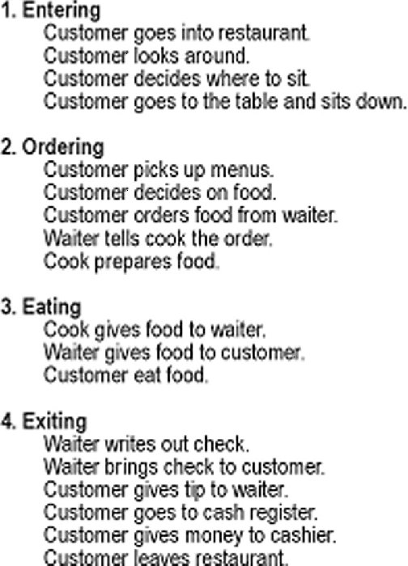
Scripts
“Restaurant Script”
roles
scences
activities
(adapted from Schank & Abelson, 1977)
Nikol Rummel, Anne Deiglmayr

Slide 37

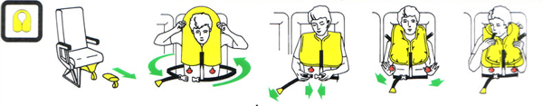
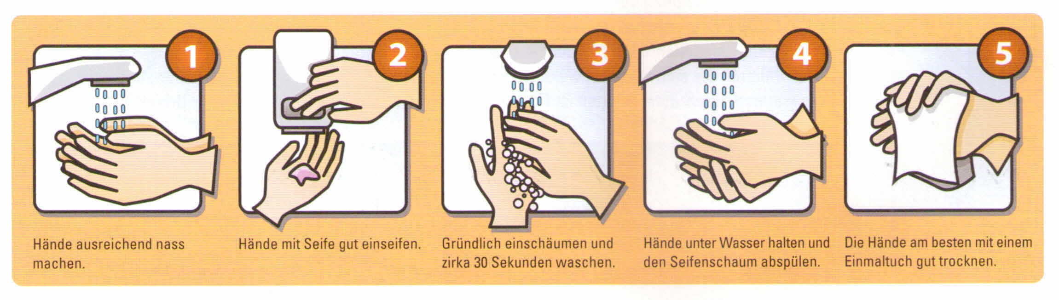
External Scripts
Nikol Rummel, Anne Deiglmayr
Notes:
Speicherung von typischen Abläufen im Gedächtnis als «Skript» (Schank & Abelson, 1977)
z.B.: Restaurantbesuch, Flugzeug besteigen, ein Buch lesen,
in einem Gruppenpuzzle mitarbeiten, Argumente formulieren…
bietet Orientierung, ist aber flexibel anpassbar
ähnlich wie ein Drehbuch (engl. «movie script»)…
Schemata und Skripte werden für Schlussfolgerungen genutzt und erleichtern somit das Verstehen
bestimmen unsere Erwartungen, z.B. an einen Text, oder daran, was als nächstes passieren wird
neue Information kann schnell eingeordnet werden, wenn ein passendes Schema gefunden wird
Schemata werden genutzt, um Verstehenslücken zu schliessen

Slide 38
External Scripts for Collaboration
Discuss the text on pages 141 – 143 in small groups. Organize its main points in a mind map. You have 20 minutes.
Nikol Rummel, Anne Deiglmayr
Notes:
Welches Skript / welche Skripts müssen die SuS beherrschen, um diesen Arbeitsauftrag zu verstehen bzw. ihm nachzukommen?
«Skripte» dafür, wie
man einen Text liest
In Kleingruppen einen Text bespricht (plus diverse Unterskripte, z.B. für «eine für andere verständliche Aussage zum Text formulieren», «das Wort ergreifen», «Zustimmung ausdrücken»,…)
eine MindMap erstellt
eine gestalterische Aufgabe in einer Gruppe angeht (Arbeitsteilung, Koordination,…)
mit anderen zusammenarbeitet (z.B. um Hilfe fragen, einen Vorschlag machen,…)

Slide 39
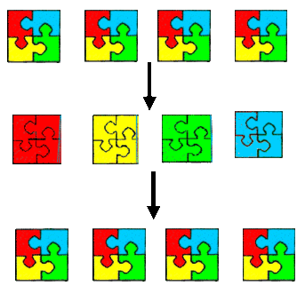
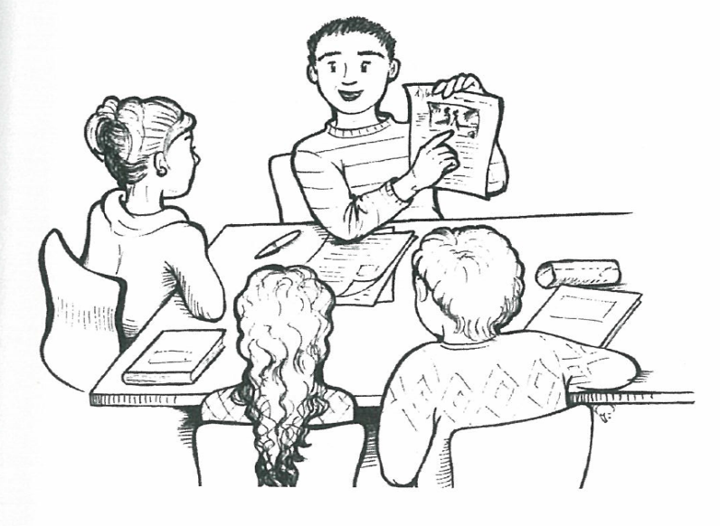
The Jigsaw Method (Aronson & Patnoe, 1987)
home groups
expert groups: students become expert for part of the material
teaching to each other
Notes:
Example: students are supposed to learn how news articles, and headlines and bylines, are typically structured
After discussing the main principles in class, you use Jigsaw to let students look at real news articles from different newspapers, that they study in expert groups first and then present to the members of their home group. The task for their homegroup then is to find commonalities and differences between these examples.

Slide 40
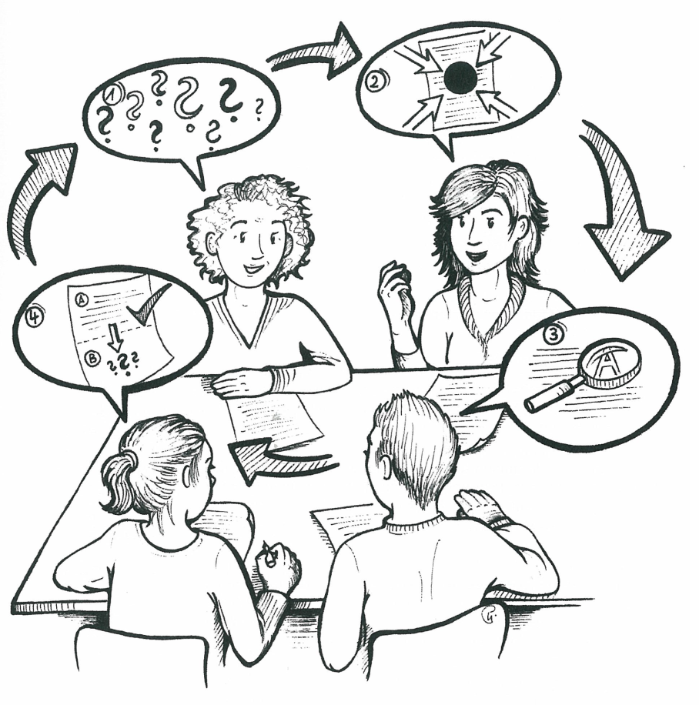
Reciprocal Teaching (Palincsar & Brown, 1984)
Summarizing
Questioning
Predicting
Clarifying

Slide 41
Collaboration Scripts
collaboration scripts guide learners during collaboration by:
  specifying and prompting of learning activities and/or roles
  sequencing learning activities and/or roles
(e.g.: Fischer, Kollar, Stegmann & Wecker, 2013; Rummel & Spada, 2007)
Notes:
What are collaboration script?
Collaboration scripts guide learners during collaboration by:
Specifying and prompting of learning activities and/or roles
Sequencing learning activities and/or roles
(Fischer, Kollar, Stegmann & Wecker, 2013; Rummel & Spada, 2005)
41

Slide 42
Collaboration Scripts
How do students acquire collaboration scripts?
external scripts support the acquisition of new methods
(check lists, visualization, written instructions, role model,…)
deliberate practice leads to improved and more flexible performance, and to the creation of routines
internalization: the external script becomes an internal script
Notes:
je komplexer, desto aufwändiger die Einführung
zu Beginn braucht es “externe” Skripts
klare Arbeitsanweisungen
Visualisierungen, Ablaufschemata
Lehrperson als Modell
…
zur «Internalisierung» braucht es reflektiertes Üben
Feedback (durch Lehrperson, durch MitschülerInnen, selbst)
Reflektion der Kooperation(smethode), z.B. anhand von Checklisten / Fragebögen
Wiederholung! Nicht ständig eine neue Methode

Slide 43
Computer-supported collaborative learning
The rapid progress of information-technology offers new possibilities for interacting and learning with others
Information and communication technologies are increasingly being used to support collaboration in educational settings
→ Computer-Supported Collaborative Learning (CSCL)
Notes:
Übergang: Much of the research on collaboration scripts has been conducted in CSCL settings as these settings enable special opportunities for implementing scripts

Slide 44



What do you mean by “computer-supported”?
How people can learn together with the help of computers
(Stahl, Koschmann, & Suthers, 2006)
“ … refers not only to connecting remote students but also using technologies to shape face-to-face interactions.” (Dillenbourg, Järvelä & Fischer , 2009, p. 3)
ex. USA
ex. Japan
Computer mediated
→ no face-to-face communication
→ web-based collaboration
Computer supported
→ face-to-face-collaboration
→ scaffolds for collaboration

Slide 45
What do you mean by “computer-supported”?
Possible roles of the computer
  Provide a medium of communication
  Add special functionalities (e.g. awareness tools, community building tools)
  Shared external representations, e.g. whiteboard, argumentation spaces
  Provide various forms of pedagogical support (e.g. hints)
  Collaboration scripts: cognitive and social scaffolding

Slide 46
CSCL Scripts: Example
Setting (Rummel & Spada, 2005; Rummel, Spada & Hauser, 2009)
interdisciplinary, video-mediated collaboration
dyads of advanced medical and psychology students
solve psychiatric cases with combined
physical and psychological pathology
Learning phase (case 1) | Implementation of support (scripting)
Test phase (case 2) | Assessment of effects (no scripting) → collaboration → outcome (joint solution) → knowledge of collaboration (posttest)
Notes:
In two studies we found empirical evidence that our collaboration script supported the interdisciplinary dyads in the collaborative problem-solving (i.e. in developing a joint solution for the case at hand).
However, the benefits were strongest for collaboration skills (both: displayed in behavior and knowledge about good collaboration)
46

Slide 47
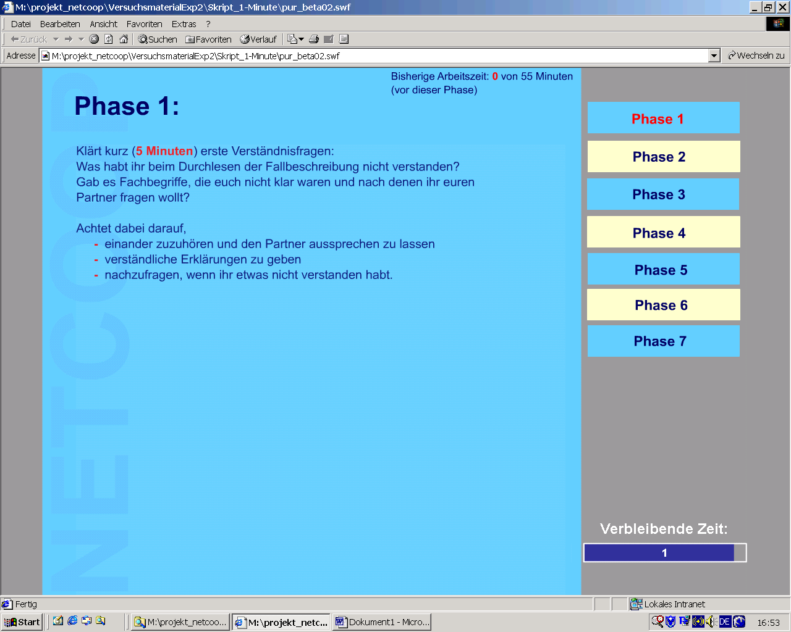
CSCL Scripts: Example
Phases of the collaboration
blue: collaborative
yellow: individual
Instructions for the phase, including timing
Notes:
Here‘s an example of a computer-supported collaboration script from my own research.
Phases: coll, ind
Instructions for each phase: tasks, timing
(Roles: medical students, student of psychology -> natural distribution of information)
47

Slide 48
Effect of CSCL scripts: Empirical evidence
Meta-analysis of effects of CSCL scripts (Vogel, Wecker, Kollar & Fischer, 2016)
22 articles (published between 2005 and 2012) included
  overall 2,825 participants (M = 101; SD = 99.85)
  average age was 20 years (M = 20.17; SD = 4.85)
effect on domain-specific knowledge (d = 0.20)
effect on collaboration skills (d = 0.65)
Notes:
Not only we found benefits of supporting CSCL with collaboration scripts.
In a recent meta-analysis Vogel and colleagues looked at 22 articles (published between 2005 and 2012) and found benefits for scripted collaboration on both domain-specific knowledge and collaboration skills (again this second effect was particularly strong)
So collaboration scripts are conducive to supporting (CS)CL. But what do we need to pay attention to when designing and implementing them?
Vogel, F., Wecker, C., Kollar, I., & Fischer, F. (2016). Socio-Cognitive Scaffolding with Computer-Supported Collaboration Scripts: a Meta-Analysis. Educational Psychology Review, 1–35.
The 22 articles (published between 2005 and 2012) that were finally included
comprised 24 studies containing 34 comparisons, from which 45 effect sizes were estimated.
Overall, the studies included had 2,825 participants (MN = 101; SDN = 99.85), whose mean
age was on average 20 years (Mage = 20.17; SDage = 4.85).
In 21 of the articles, personal computers were used as electronic devices and in only one article mobile devices were used
(Huang, Wu, & Chen 2012). The average time that the participants worked with support from
the treatment was about four hours (Mduration = 239.08 minutes; SDduration = 341.45). The
shortest overall learning time supported by the treatment in a study was 12 minutes (Molinari
et al. 2009), and the longest was about 24 hours (Haake & Pfister 2010). The studies included
represent a certain bandwidth of further characteristics, such as the educational background of
the participant or the subject discipline in which the study was conducted, as shown in
Table 1.
The chosen index of effect size was the unbiased estimate of the standardized mean
difference between experimental and control conditions with pooled standard deviations
across groups (Hedges 1981; Hedges & Olkin 1985). Following Cohen’s (1988) suggestion,
effect sizes of d = 0.20‒0.49 are considered as small effects, effect sizes of d = 0.50‒0.79 as
medium effects, and effect sizes of d = .80 and higher as large effects (Cohen 1988).
effect on collaboration skills significantly greater than on domain-specific knowledge (ZDiff = 3.24; p < .01, two-tailed).
48

Slide 49
Outline
What does the research say?
What makes CL effective?
  conditions
  interactions
How do I design for effective CL?
  scripts
  CSCL
A framework of dimensions
Notes:
In the remaining time of this morning keynote I would like to introduce a framework of support dimensions that can guide you in reflecting on your teaching with CL and guide you in designing for CL. We have also prepared a handout for you to take with you into today‘s sessions or back to your workplace.

Slide 50
A Framework for Support Dimensions
Rummel, N. (2018). One framework to rule them all? Carrying forward the conversation started by Wise and Schwarz. International Journal of Computer-Supported Collaborative Learning, 13(1), 123-129. doi: 10.1007/s11412-018-9273-2.
see also: Diziol & Rummel (2010); Rummel (2016)
Notes:
The framework originates from an attempt to summarize and structure the research that has been conducted on effects of collaboration support, particularly collaboration scripts. It can thus help CSCL reseachers in describing their work and also help the field to gain a more systematic overview of findings that allows us to draw more valid conclusions.
But it can also be used to help guide design of and reflection about collaborative learning practices.

Slide 51
WHY: Goals, Expected Outcomes
Which goal(s) does the support aim to achieve?
individual and /or group level?
now, or / and for future activities?
More specifically:
interaction/group processes
outcome/result of the collaboration (i.e. an artifact)
domain knowledge
social skill (i.e. collaborative competence)
affective outcomes (e.g. satisfaction with the collaboration)
motivational outcomes (e.g. learning motivation, attitude towards future collaboration)

Slide 52
WHAT: Targeted Aspects
Which aspects of collaboration are targeted by the support?
cognitive (i.e. domain help)
metacognitive (e.g. reflection, employment of learning strategies)
social (e.g. managing the interaction)
affective (e.g. coping with frustration)
motivational (e.g. participation)
Notes:
Explain difference between dimension „goal“ and dimension „targeted aspects“

Slide 53
WHAT: Timing
At which point in time (relative to the start of collaboration) is support provided?
prior to the collaboration (e.g. instruction, training, group formation)
during the collaboration (e.g. prompts, resources):
  immediate,
  delayed
after the collaboration (e.g. reflection)

Slide 54
WHAT: Adaptivity
Is the support is implemented in a fixed, adaptive or adaptable manner?
fixed (one size/time fits all)
adaptive (i.e. automated)
adaptable (i.e. user-based)

Slide 55
WHAT: Granularity
How specific is the support provided? At what time level is it provided?
unspecific/ general / for the whole semester
task-specific
step-level; turn-level

Slide 56
WHO: Source
Who provides support? E.g: teacher, researcher, tutor, peer,…
Is support given directly to the learner or group in need, or is it mediated through other actors in the setting (e.g. tutors)?

Slide 57
WHO: Addressee
Who is the support delivered to? e.g.:
class / semester
a specific group
an individual student

Slide 58
HOW: Delivery
Through what channels is the support provided to the learners?, e.g.
face-to-face, lecture, Moodle / LMS, email,…

Slide 59
HOW: Availability
How readily accessible is the support?
How salient is the support for the learners?
always visible
provided on demand

Slide 60
HOW: Directivity
Whether and how explicitly and concretely does the support give directions for possible or desired behaviors on the part of the learners?
no advice
implicit (i.e. enabling conditions, resources)
explicit: general advice
explicit: specific guidance

Slide 61
HOW: Foundation
How much and what kind of information about the state of their collaboration is provided to the learners?
no information on state (i.e. just alert)
show state (i.e. raw data)
show aggregated data (i.e. mean or other indicators)
show interpretation of state (i.e. assessment good vs. bad)

Slide 62
HOW: Coercion
To what extent do learners have to react to the support?
no action required
some/any action is required
specific action is required

Slide 63
Supporting (CS)CL in Higher Education
WHY
  goals, expected outcomes
WHAT
  targeted aspects
  timing (prior to, during, after)
  adaptivity and granularity of implementation
WHO
  sources, mediators, and addressees of support
HOW
  (technical) solutions for delivering support

Slide 64
The Collaborative Learning Triangle
learning processes
(design) conditions
outcomes
(cf. Deiglmayr, Loibl, & Rummel, 2015; Dillenbourg, Baker, Blaye, & O'Malley, 1996

Slide 65
Teaser: Afternoon Keynote
reflection on case studies from TAL 2018 in light of the framework of support dimensions: what do we see and what are potential future directions?
outlook: current and upcoming research

