Slide 1

Climate change: Basic mechanisms and cause-effect relationships
Peter Langen
Professor of Climate Modeling
iClimate center director
Department of Environmental Science
Aarhus University

Slide 2
Energy balance
IN
=
OUT
Top of
atmosphere
Surface
The simplest view:
Heating from sunlight is balanced by cooling from thermal radiation.

Slide 3
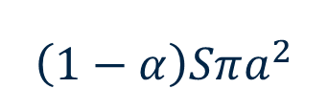
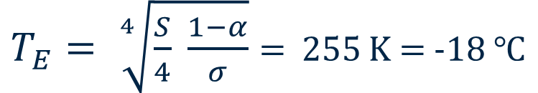
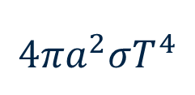
Earth’s emission temperature
Incoming (shortwave)
Outgoing
(longwave)
$$\left(1−α\right)Sπa^{2}$$
$$4πa^{2}σT^{4}$$
Energy balance:
$T_{E}= \sqrt[4]{\frac{S}{4} \frac{1−α}{σ}}$ = 255 K = -18 $℃$

Slide 4
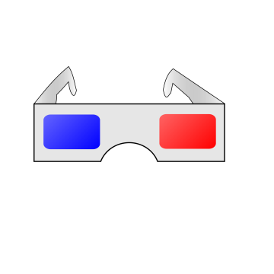
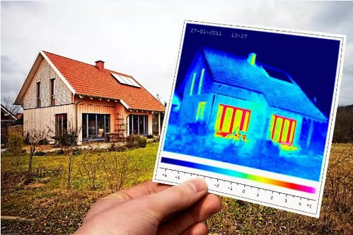
Put on your infrared goggles!
"Infrared Thermography Inspection - Thermo Élite Inc" by thermoeliteinc is licensed under CC PDM 1.0

Slide 5
Greenhouse effect
Height
New emission level
Emission level
Temperature
T_{E}
T_{S}
T_{S}

Slide 6
Climate models

Slide 7
Basic principles
Fundamental conservation principles:
Conservation of energy
Conservation of mass (air, water, etc)
Conservation of momentum
Ideal gas law (and equation of state for sea water)

Slide 8
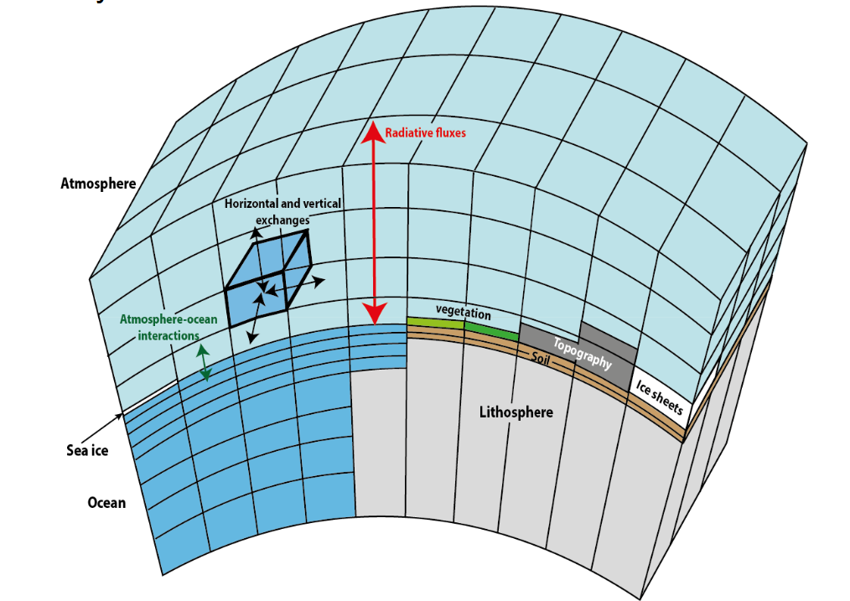
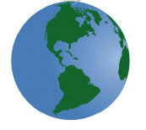
Grid cells
Climate models
Also known as General Circulation Models or Earth System models
Physics (energy balance, hydrology, flow of air and water, etc) is solved grid box by grid box
Goosse: Climate System
Dynamics and Modelling

Slide 9
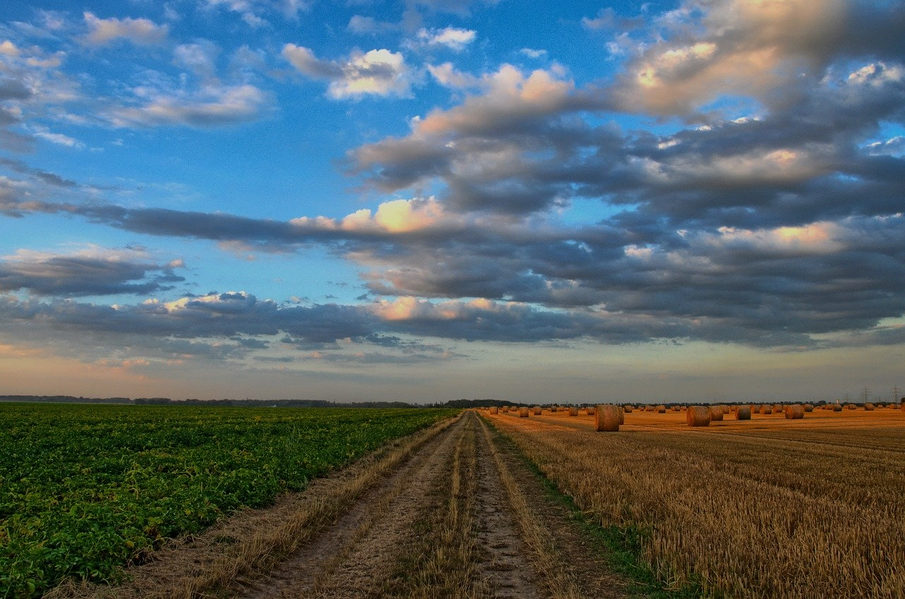
Parameterizations
Mathematical formulas that give the net effect of many small-scale effects that cannot be directly included:
For example
Clouds
Turbulence

Slide 10

Chaos and predictability
A Trajectory Through Phase Space in a Lorenz Attractor by Dan Quinn (CC BY-SA 3.0)

Slide 11
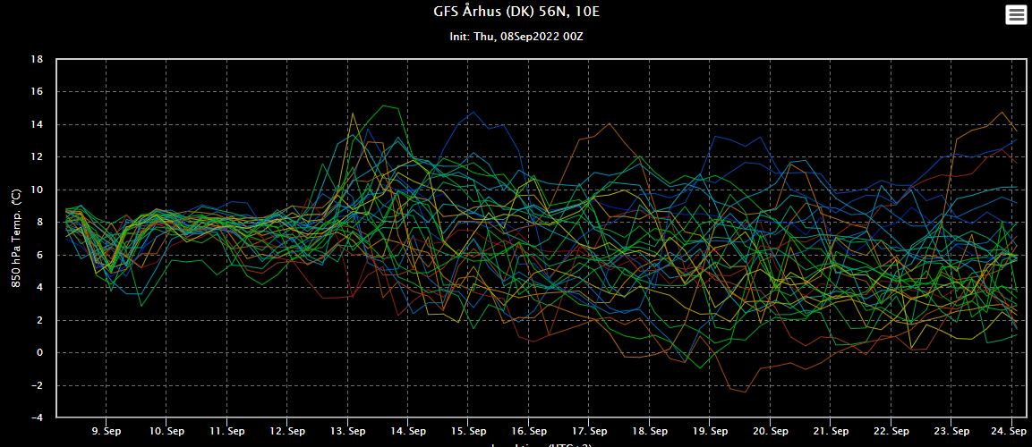
Today’s menu: Spaghetti
Wetterzentrale.de

Slide 12
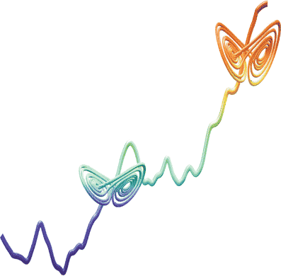
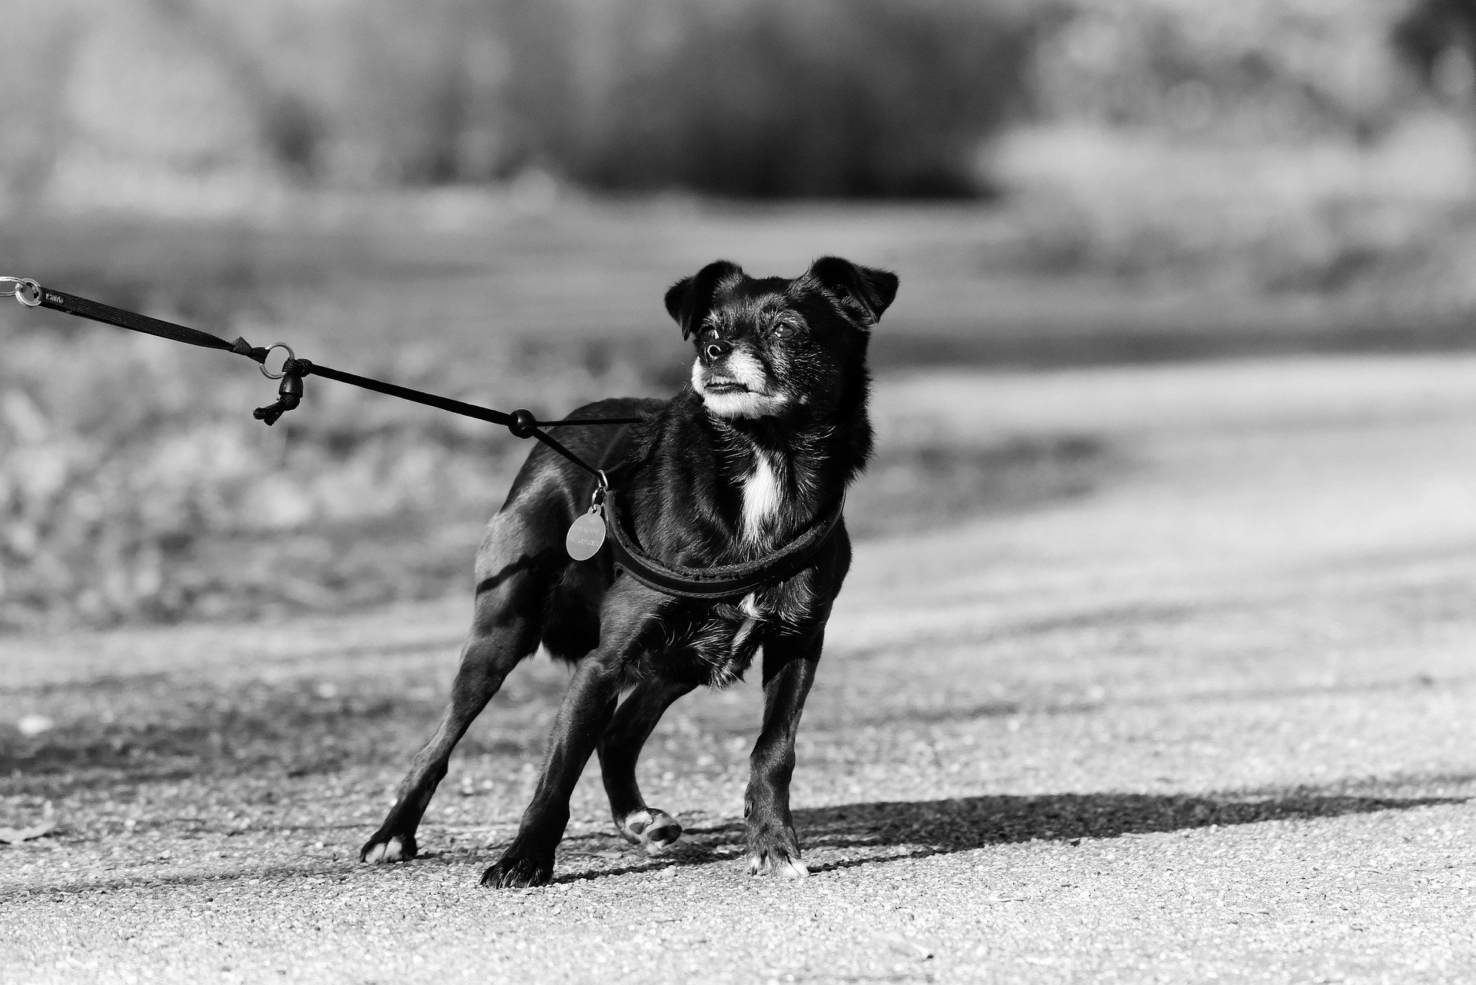
My dog Lorenz on a leash
Skeptical Science /
Jacob Bock Axelsen

Slide 13
observed changes

Slide 14
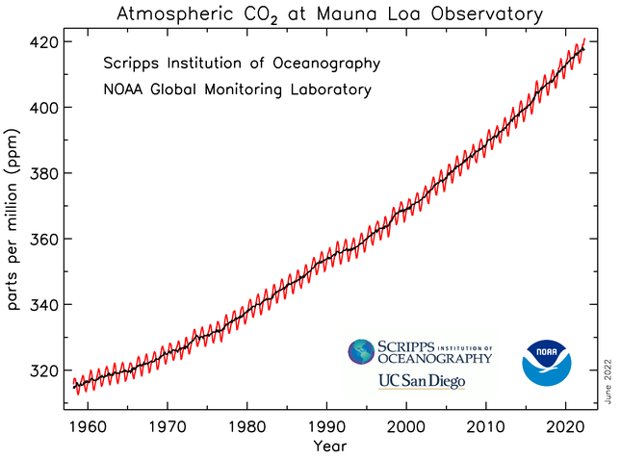
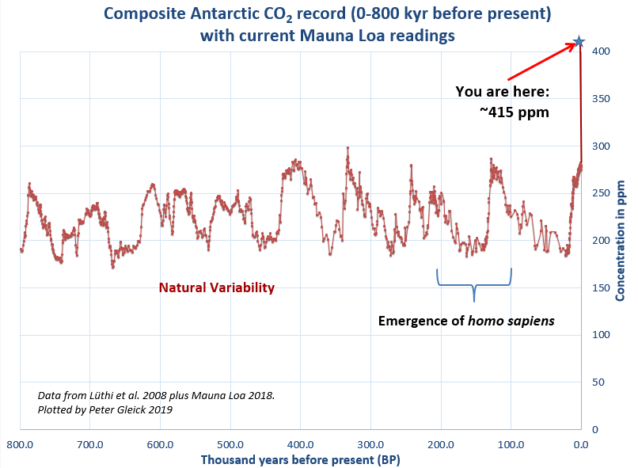
Observed changes: CO₂
950 ppm
May 2022:
421 ppm

Slide 15
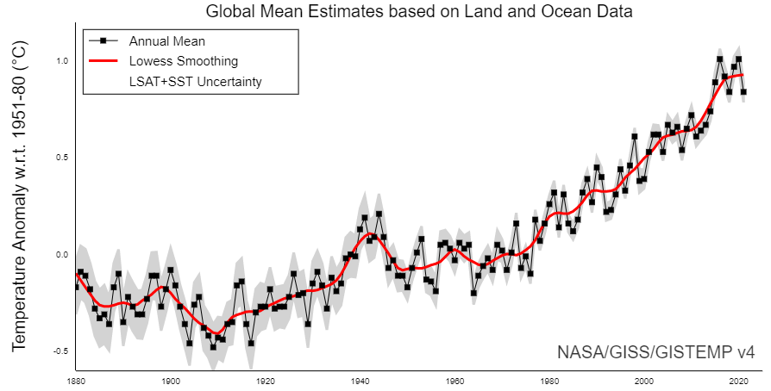
Observed changes: Temperature
2010’s warmer than 2000’s warmer than 1990’s, warmer than 1980’s, warmer than 1970’s.
7 warmest years are the 7 latest
21 of the 22 warmest years after 2000
Fewer cold days and nights More warm days and nights
More frequent heat waves

Slide 16
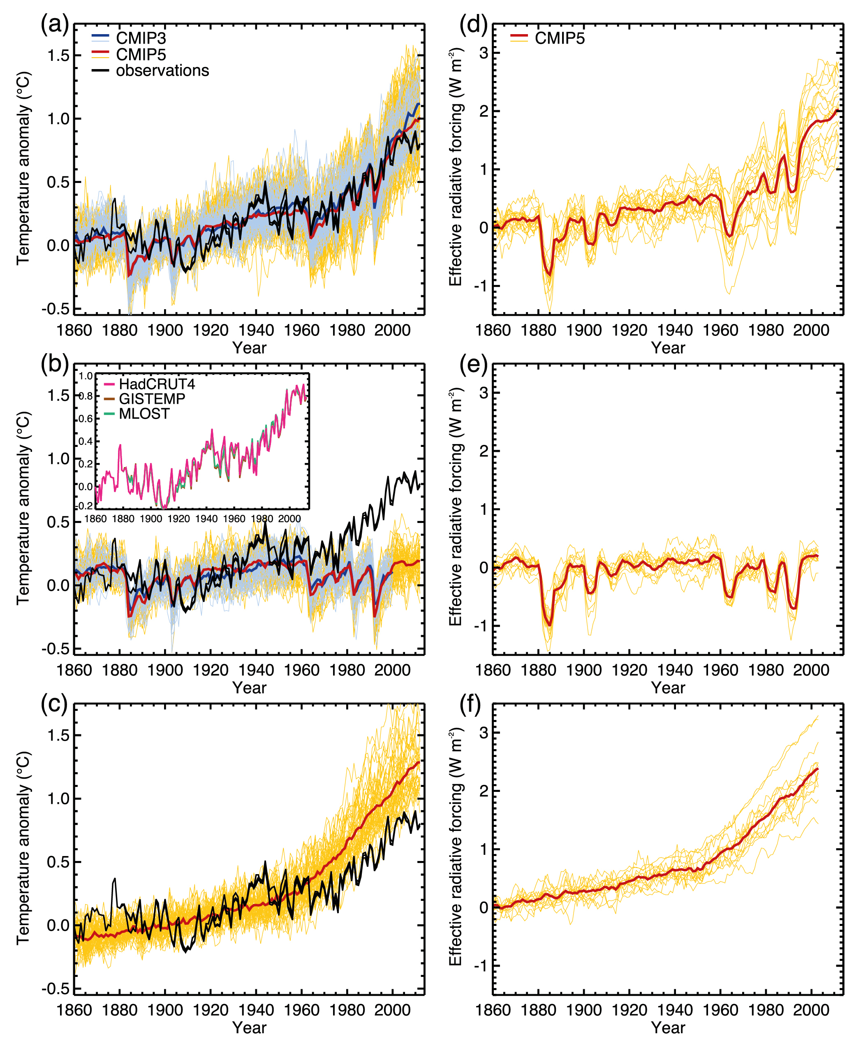
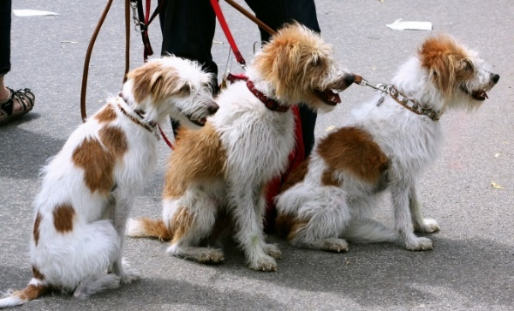
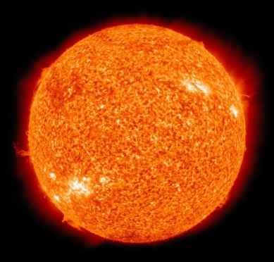
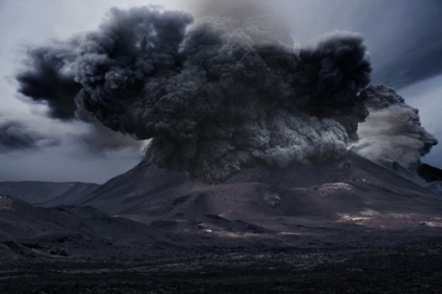
Natural changes?
IPCC AR5

Slide 17
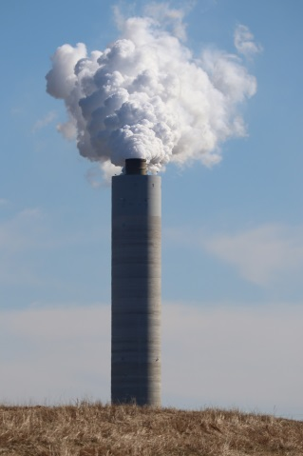
Man–made changes?
IPCC AR5

Slide 18
both?
IPCC AR5

Slide 19
Climate sensitivity and future projections

Slide 20
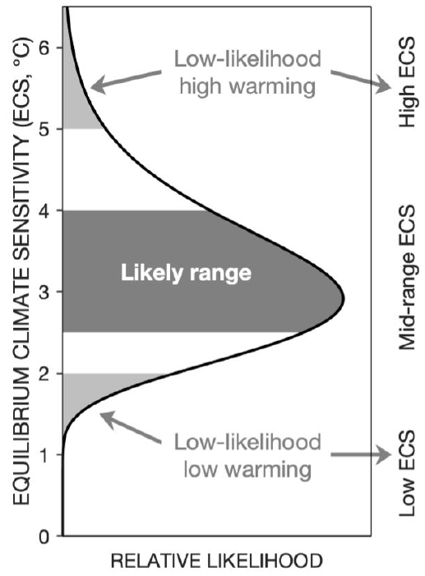
Climate sensitivity and feedbacks
2x CO₂
Direct warming
+1.2 C
Direct
Total warming
~ 3 C
Feedback
Water vapor
+1.5 C
Albedo
+0.4 C
Lapse rate
-0.6 C
Clouds
+0.3 C
IPCC AR6

Slide 21
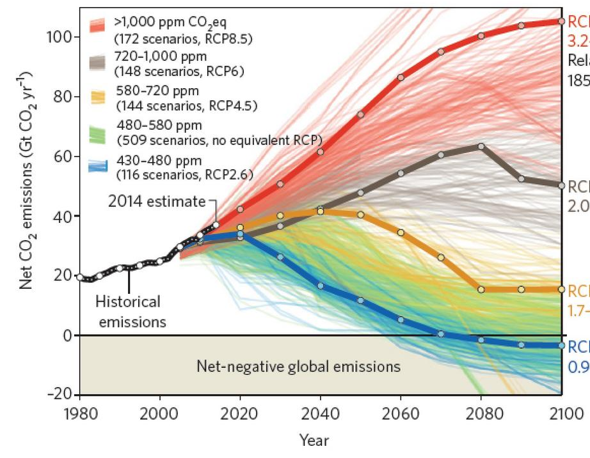
Future Co₂ scenarios
RCP 8.5
High
emission level
RCP 6
Medium
emission level
RCP 4.5
Medium-Low
emission level
RCP 2.6
Low
emission level
Global Carbon Project
(data: CDIAC/GCP/IPCC/Fuss et al. 2014)

Slide 22
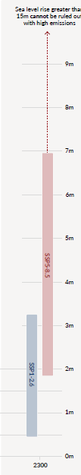
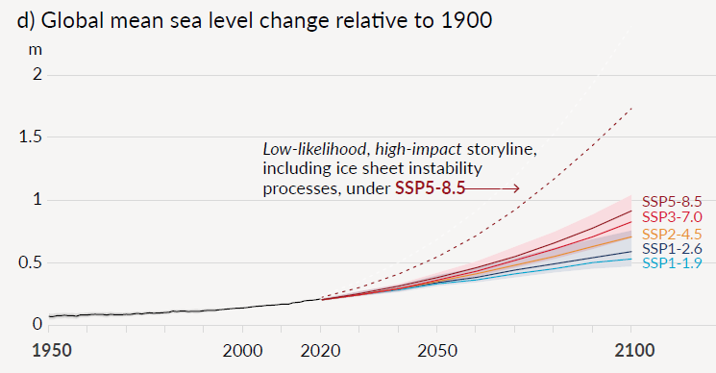
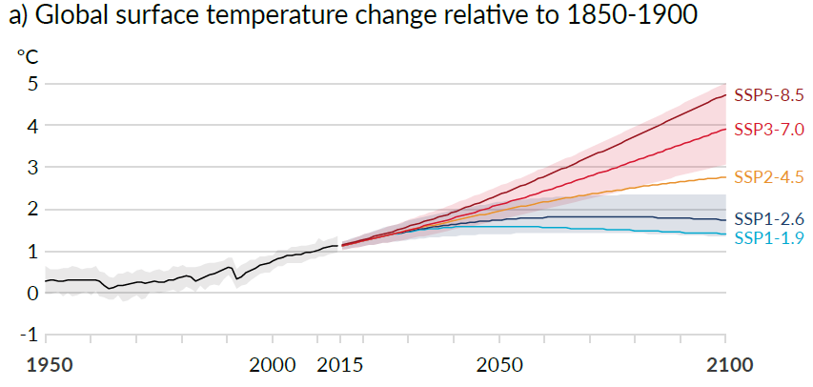
Scenarios for temperature and sea level
IPCC AR6

Slide 23
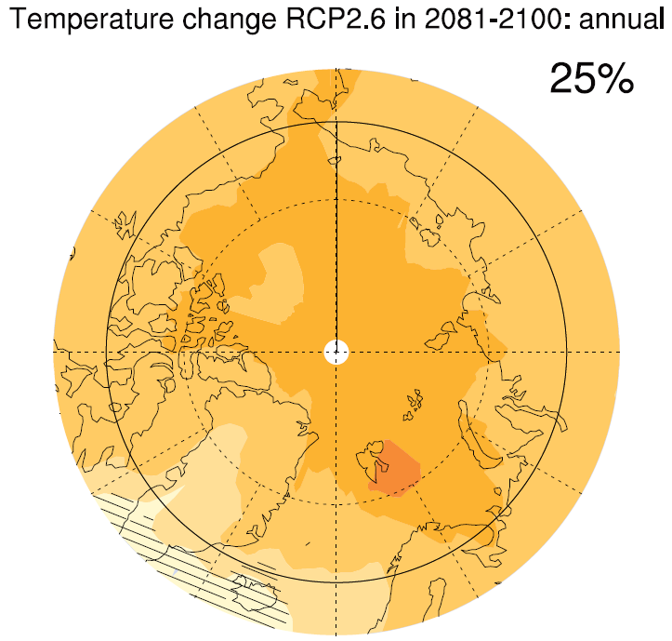
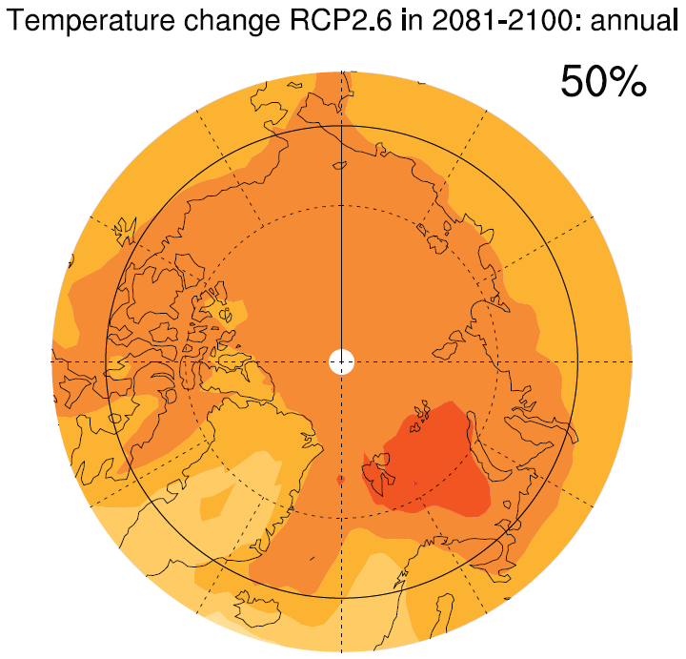
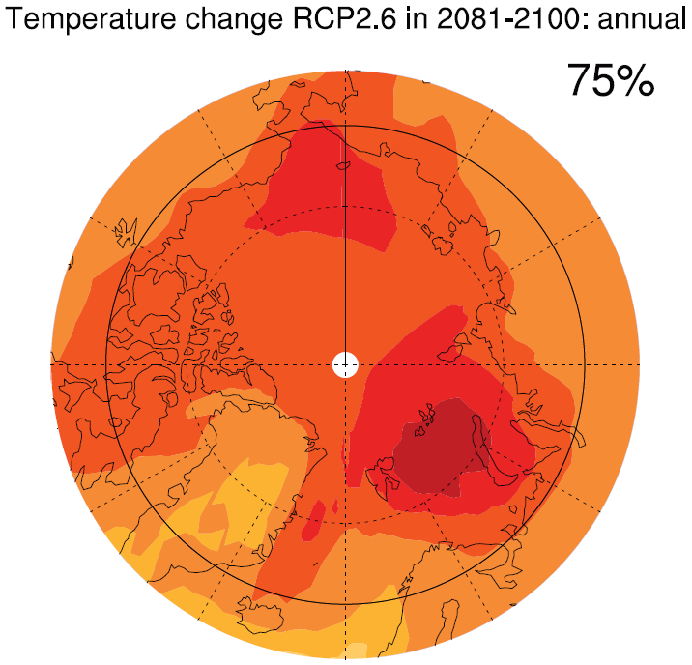
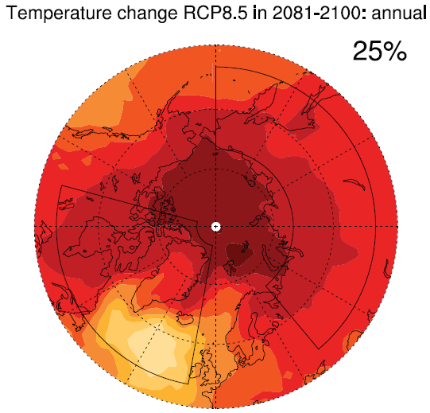
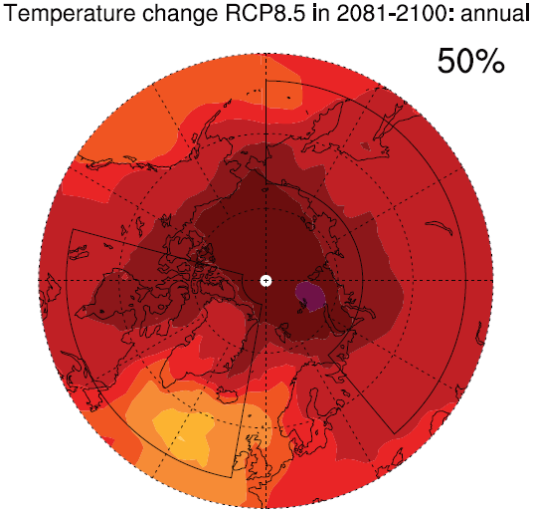
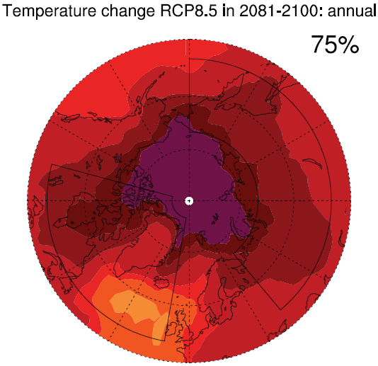

Future arctic warming uncertainty
Low
CO₂
High
CO₂
IPCC AR5

