Slide 1
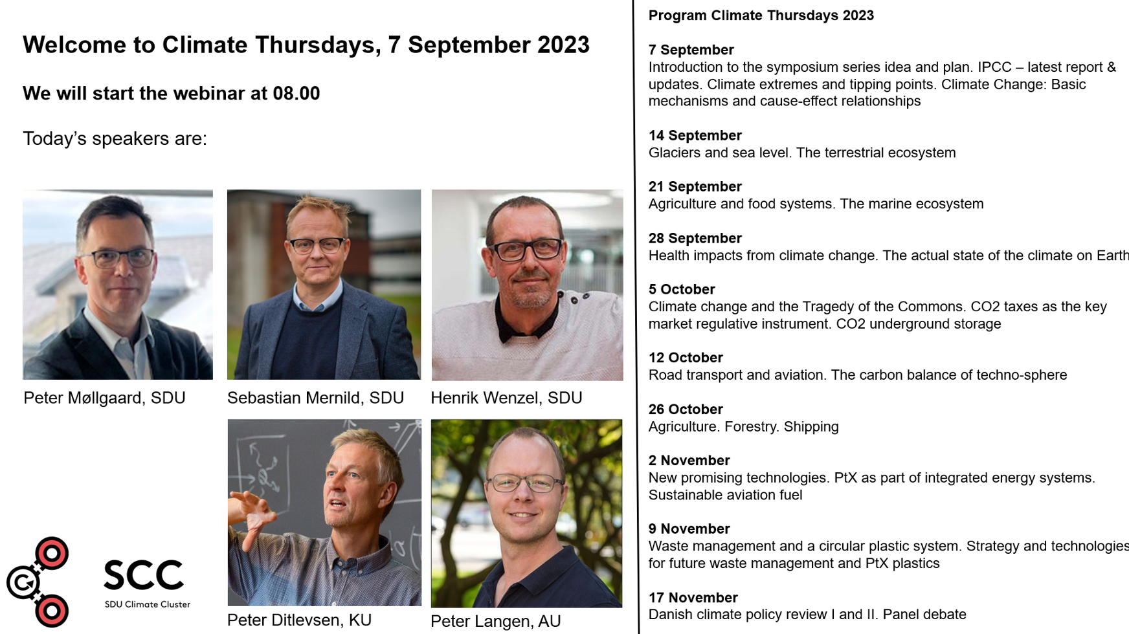
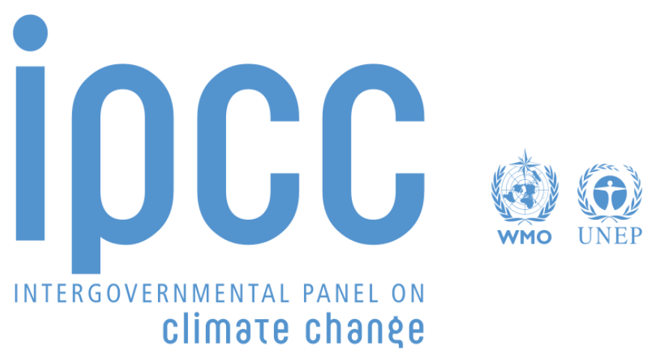

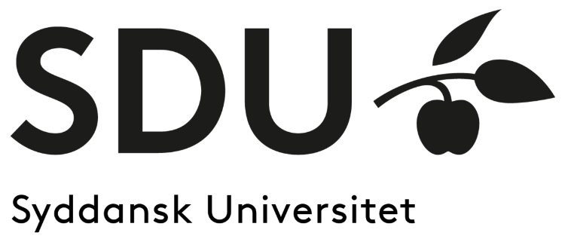
IPCC Assessments from the Synthesis Report (latest report), AR6
Sebastian H. Mernild, Prof. in Climate Change and Glaciology.
IPCC AR6/WG1, Lead Author Atlas Chapter/Contributing Author Ch. 9

Slide 2

Observed Warming and its Causes
A.1 Human activities, principally through emissions of greenhouse gases, have unequivocally caused global warming, with global surface temperature reaching 1.1°C above 1850–1900 in 2011–2020.
A.1.2 The likely range of total human-caused global surface temperature increase from 1850–1900 to 2010–2019 is 0.8°C–1.3°C, with a best estimate of 1.07°C.
A.1.1 Surface temperature has increased faster since 1970 than in any other 50-year period over at least the last 2000 years (high confidence).

Slide 3
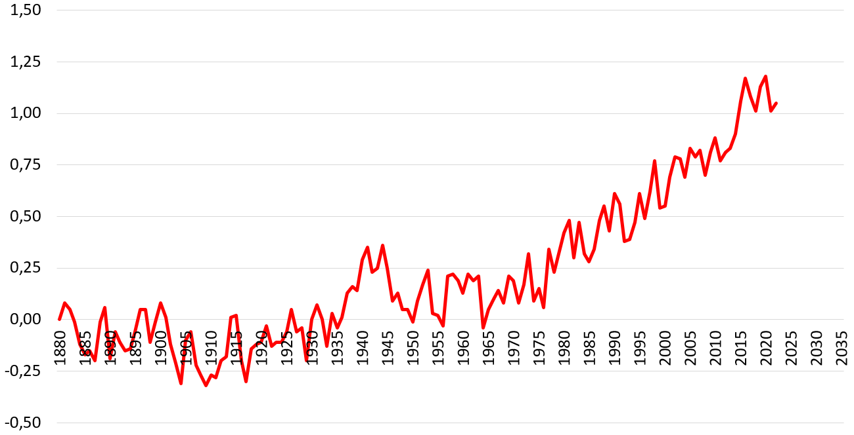
Global Mean Surface Air Temperature, 1880–2022
Degree C
Time
Source: NASA

Slide 4
Observed Warming and its Causes
A.1.3 Historical cumulative net CO2 emissions from 1850 to 2019 were 2400±240 GtCO2 of which more than half (58%) occurred between 1850–1989, and about 42% occurred between 1990–2019 (high confidence).
A.1.3 In 2019, atmospheric CO2 concentrations (410 parts per million) were higher than at any time in at least 2 million years (high confidence), and concentrations of methane (1866 parts per billion) and nitrous oxide (332 parts per billion) were higher than at any time in at least 800,000 years (very high confidence).

Slide 5
Observed Warming and its Causes
A.1.4 Average annual GHG emissions during 2010-2019 were higher than in any previous decade on record, while the rate of growth between 2010 and 2019 (1.3% year-1) was lower than that between 2000 and 2009 (2.1% year-1).
A.2 Human-caused climate change is already affecting many weather and climate extremes in every region across the globe.
A.2.1 Evidence of observed changes in extremes such as heatwaves, heavy precipitation, droughts, and tropical cyclones, and, in particular, their attribution to human influence, has further strengthened since AR5 (2013).
Observed Changes and impacts

Slide 6
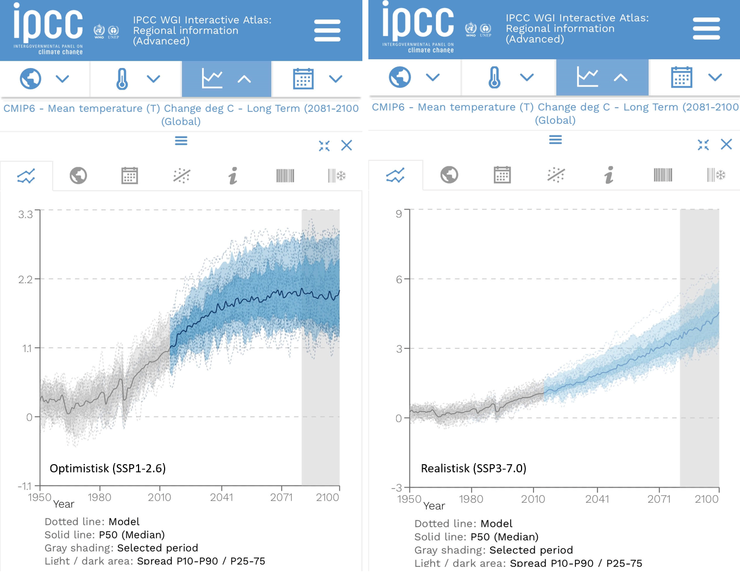
IPCC Interactive Atlas Scenarios
A.4.4 Without a strengthening of policies, global warming of 3.2 [2.2–3.5]°C is projected by 2100 (medium confidence)
https://interactive-atlas.ipcc.ch/
SSP1-2.6
SSP3-7.0

Slide 7
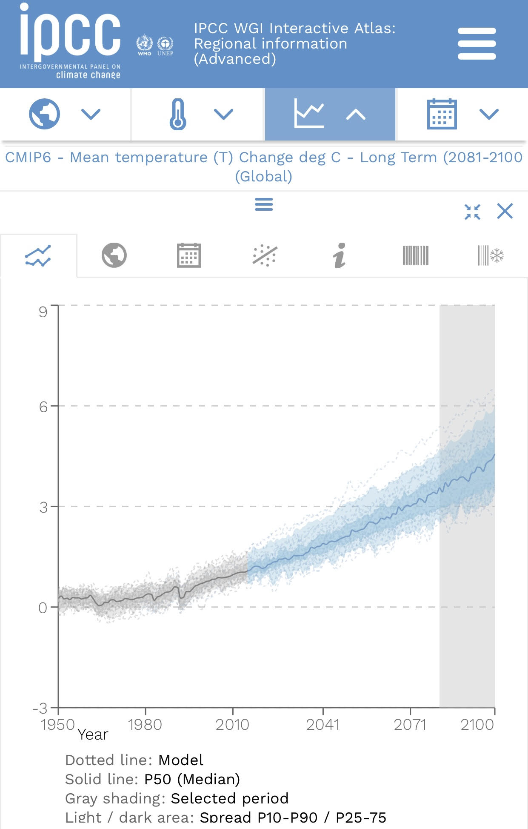
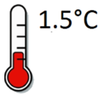
IPCC Interactive Atlas Scenarios
Mean Temperature Change (°C), Global
Global warming of 1.5°C is projected by early 2030s.
Global warming of 2.0°C is projected by late 2040s.
2.0 C
1.5 C
Scenario: SSP3-7.0

Slide 8
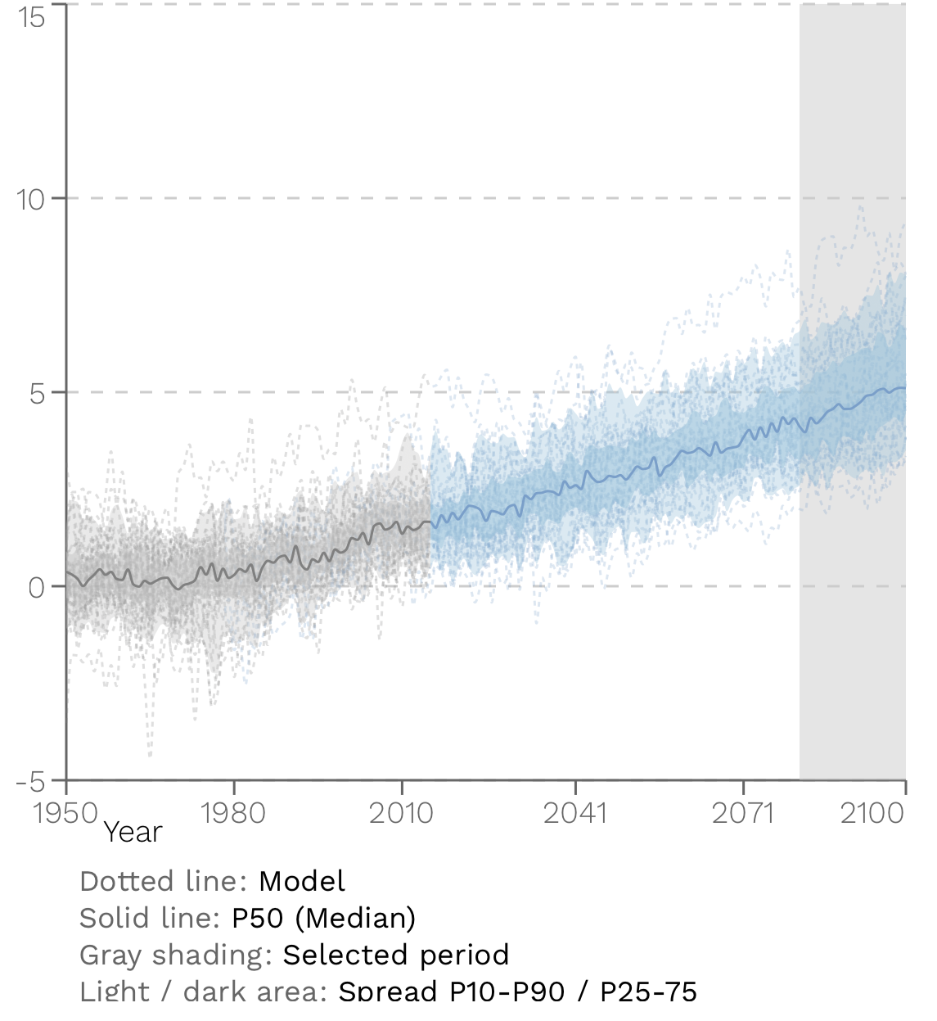
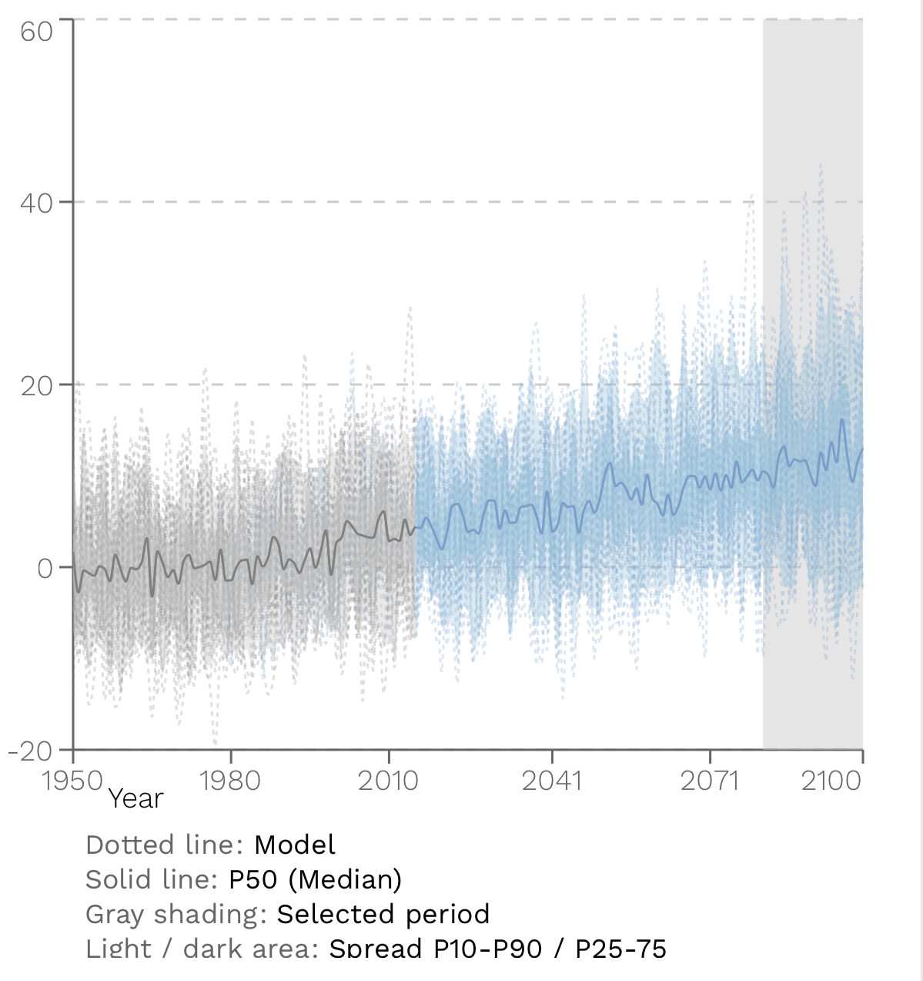
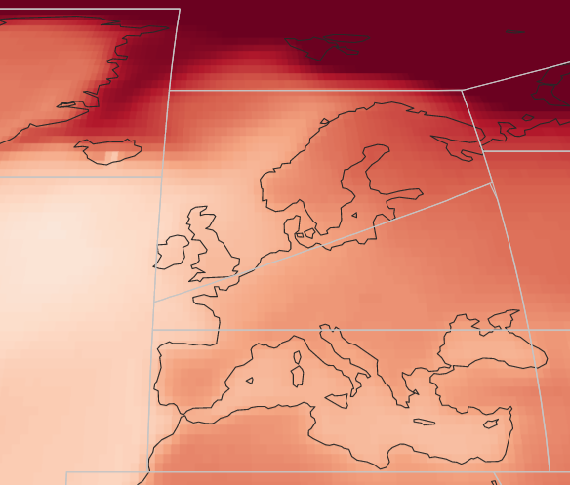
IPCC Interactive Atlas Scenarios
Region: Northern Europe
Mean temperature change (°C), Northern Europe
Total precipitation change (%), Northern Europe
Realistic: SSP3-7.0

Slide 9
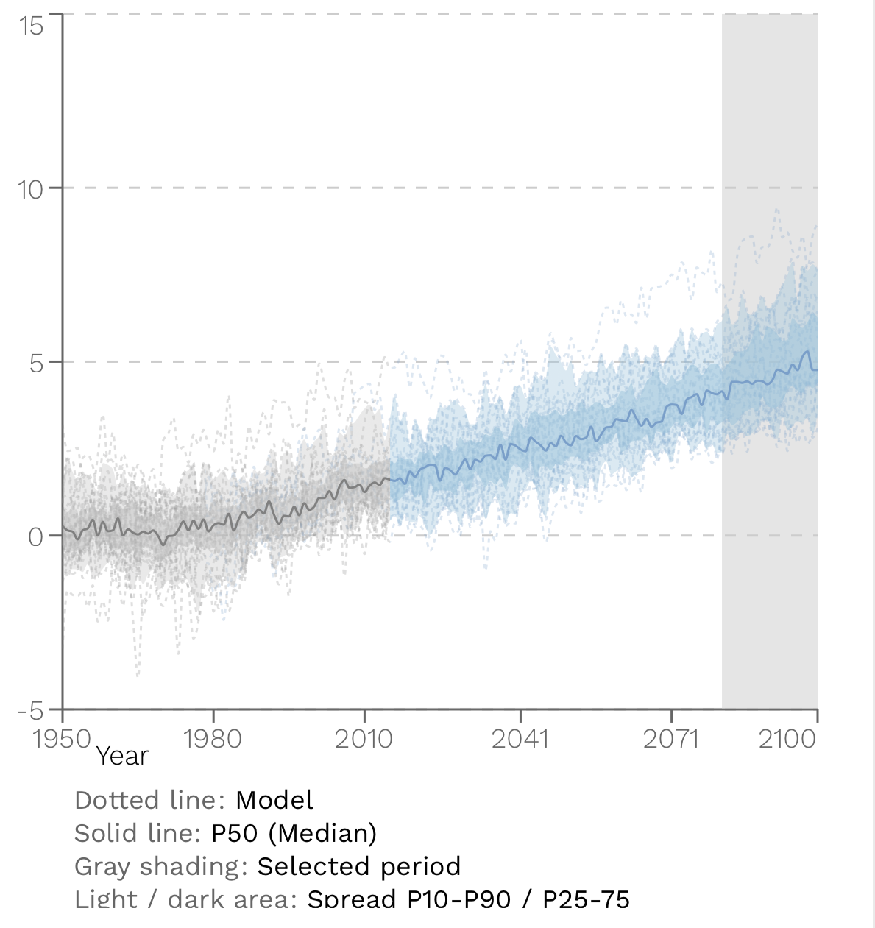
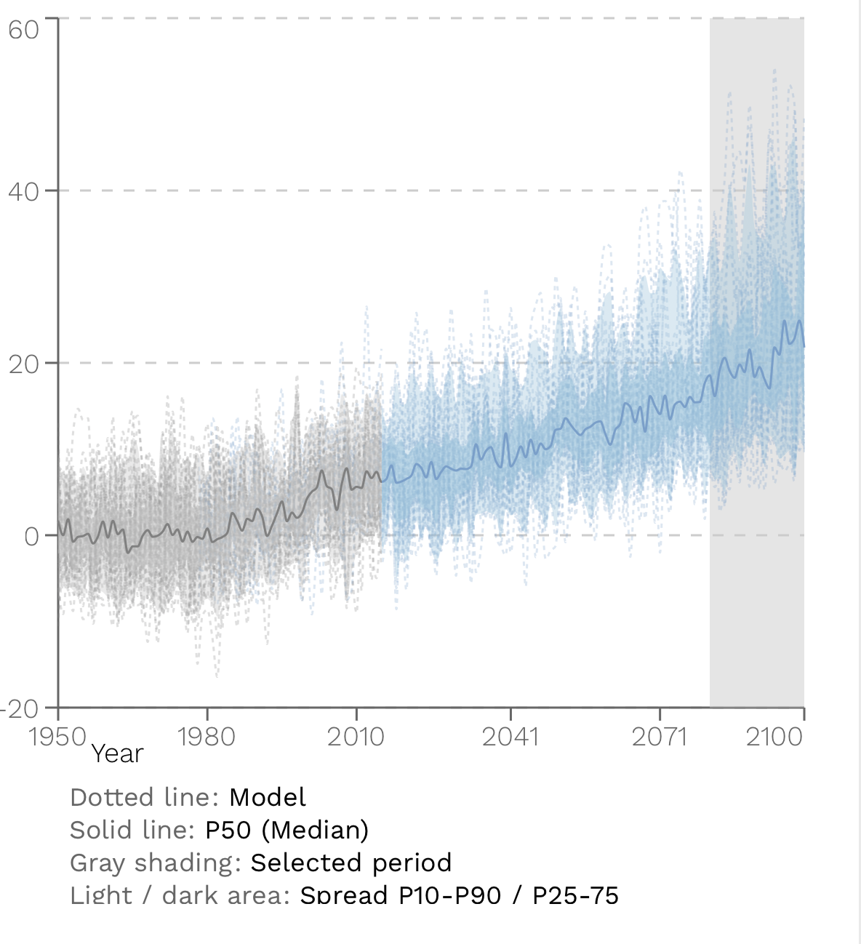
IPCC Interactive Atlas Scenarios
Region: Northern Europe
Maximum temperature change (°C), Northern Europe
Maximum 1-day precipitation change (%), Northern Europe
Mean temperature change (°C), Northern Europe
Realistic: SSP3-7.0

Slide 10
Climate Change Impacts and Climate-Related Risks
B.1.3 With every additional increment of global warming, changes in extremes continue to become larger.
Continued global warming is projected to further intensify the global water cycle, including its variability, and very wet and very dry weather and climate events and seasons (high confidence).
B.1.4 Compound heatwaves and droughts are projected to become more frequent.
B.2.1 In the near term, every region in the world is projected to face further increases in climate hazards (medium to high confidence, depending on region and hazard).

Slide 11
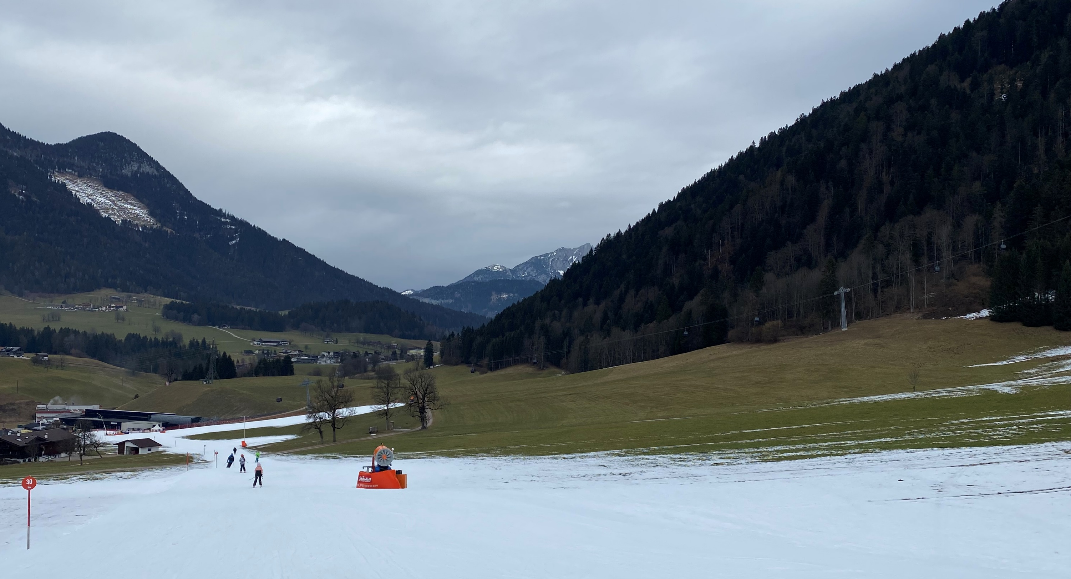
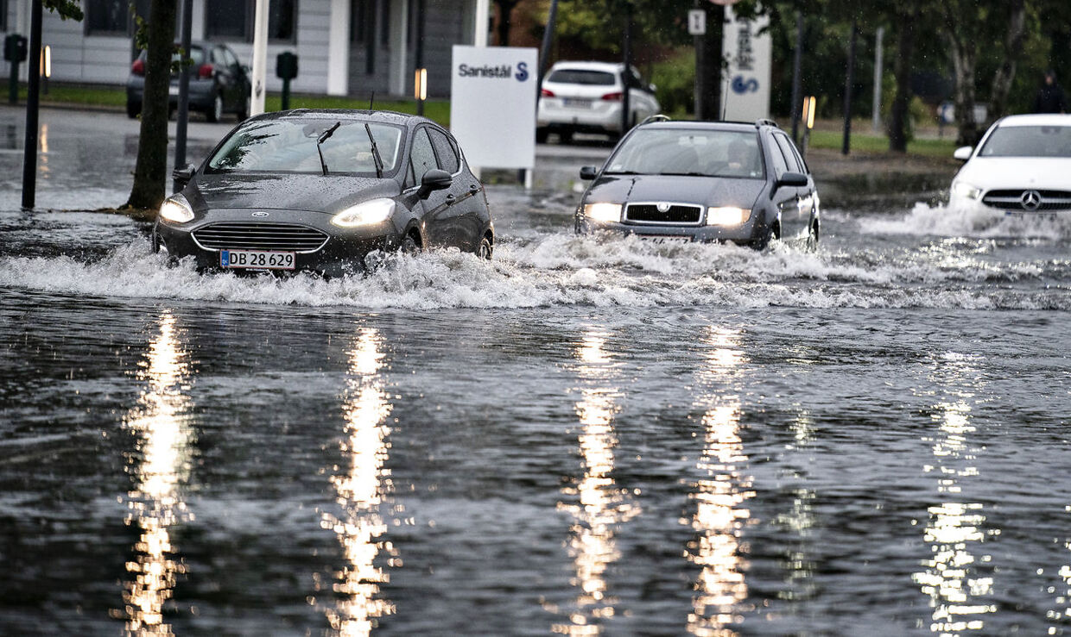
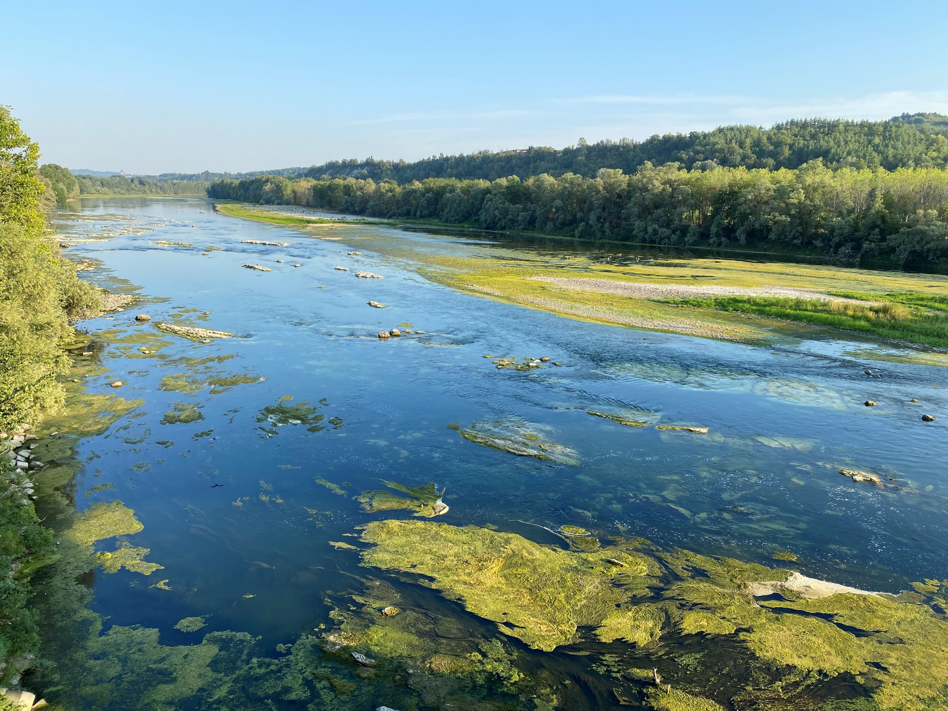
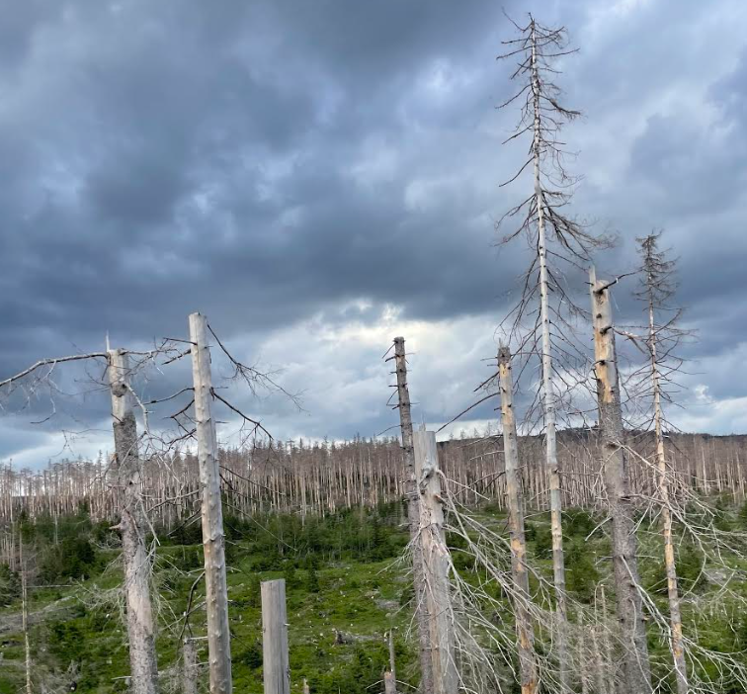
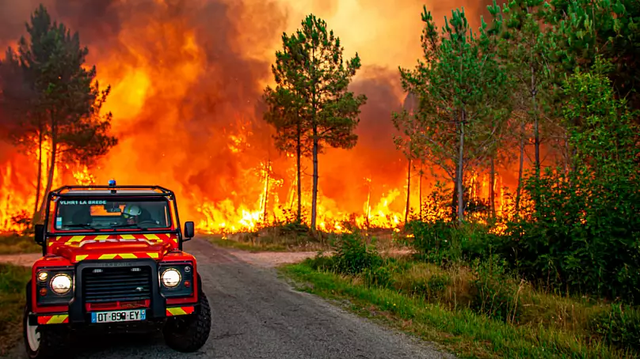
IPCC: Every additional 0.5°C of global warming causes clearly discernible increases in hot extremes and extreme precipitation

Slide 12
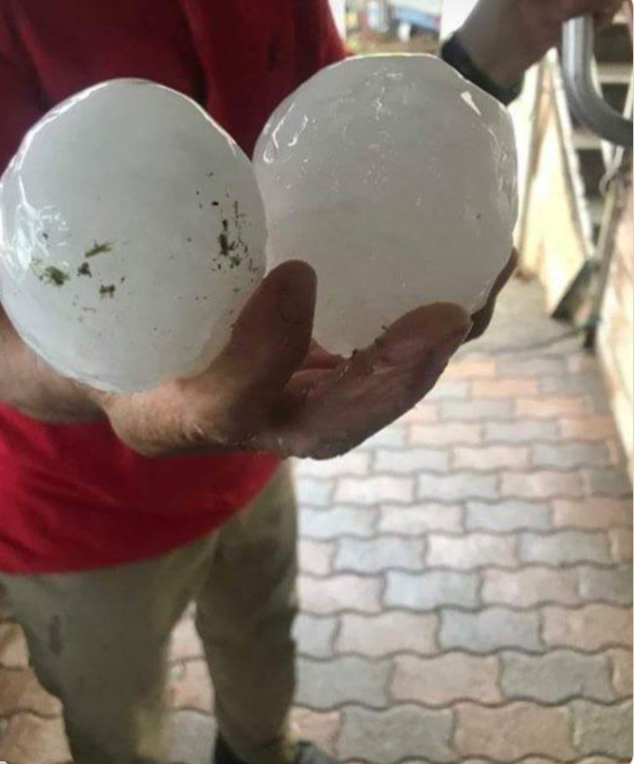
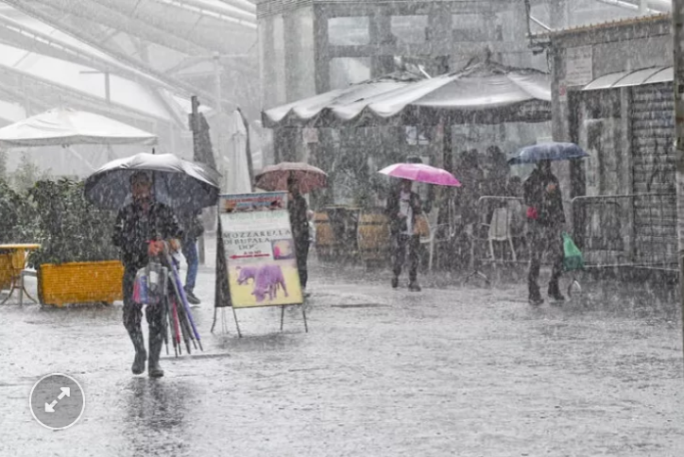
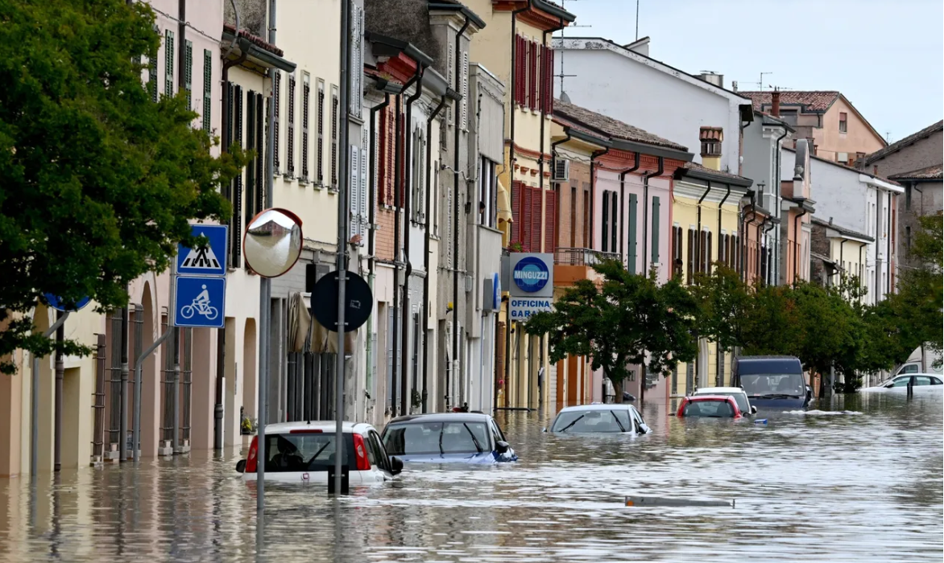




IPCC: Every additional 0.5°C of global warming causes clearly discernible increases in hot extremes and extreme precipitation

Slide 13
Thank you!

