Slide 1

Waste management and a circular plastic system
Henrik Wenzel, SDU Life Cycle Engineering
Climate Thursdays
Webinar,
9. November, 2023

Slide 2
Waste management and a circular plastic system
Presentation overview
A helicopter perspective on framework conditions for waste management
Recycled plastic quality
Climate benefits
The nature of the plastic system, material flows and plastic waste formation
Experience from abroad
The vision for the future waste and plastic system
Q&A

Slide 3
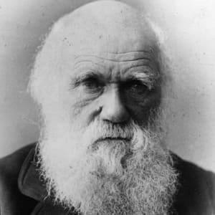
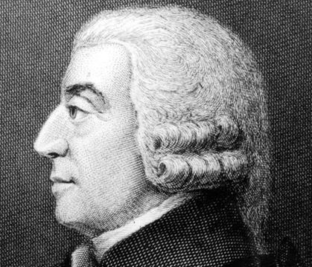
A helicopter perspective
- a ‘socio-darwinistic’ perspective on waste management
1859 Charles Darwin
1776 Adam Smith

Slide 4
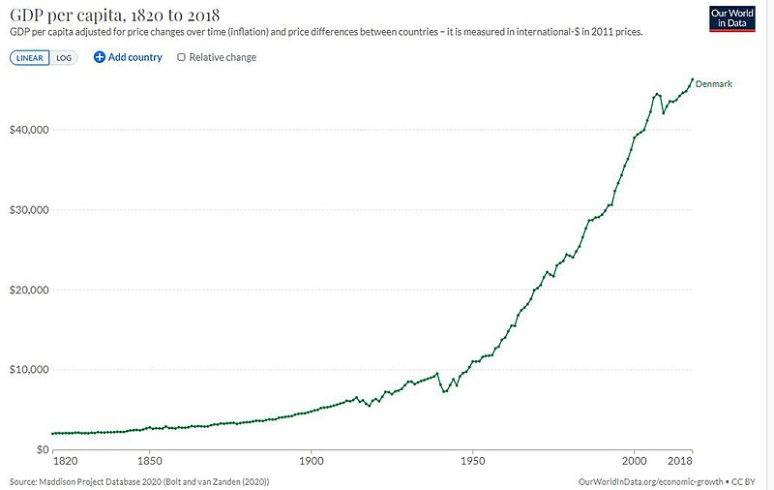
A helicopter perspective
- a ‘socio-darwinistic’ perspective on waste management

Slide 5
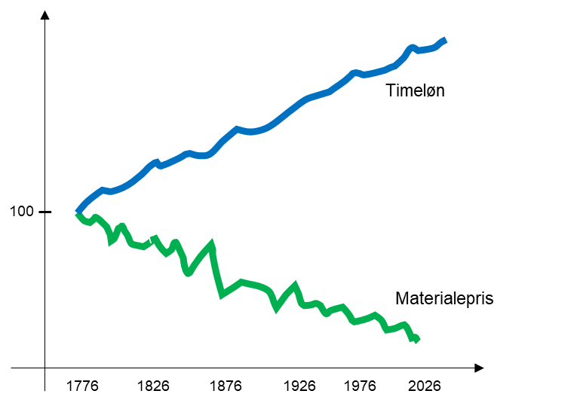
A helicopter perspective
- a ‘socio-darwinistic’ perspective on waste management
Index
salary
…in a high source separation situation, waste collection and transport represent 84 % of total waste management costs
- because this is where manual labour per ton of waste is by far the highest
Index
Ref.:
SYFRE II, slutrapport, SDU & COWI, september 2017
Price of materials

Slide 6
A helicopter perspective
- a ‘socio-darwinistic’ perspective on waste management
Cost of plastic recycling/recovery
Ref.: Ottesen og Petersen, 2021
Mid-way conclusions
Post sorting is cheaper than source separation
Plastic made from flue gas CO2 and hydrogen is cheaper than or equal to source separation
… so why source separate?
… maybe plastic quality is better when source separating?
… and maybe climate benefits and other environmental benefits are higher from source separation?
Ref.: ProCES-Fyn, 2022

Slide 7
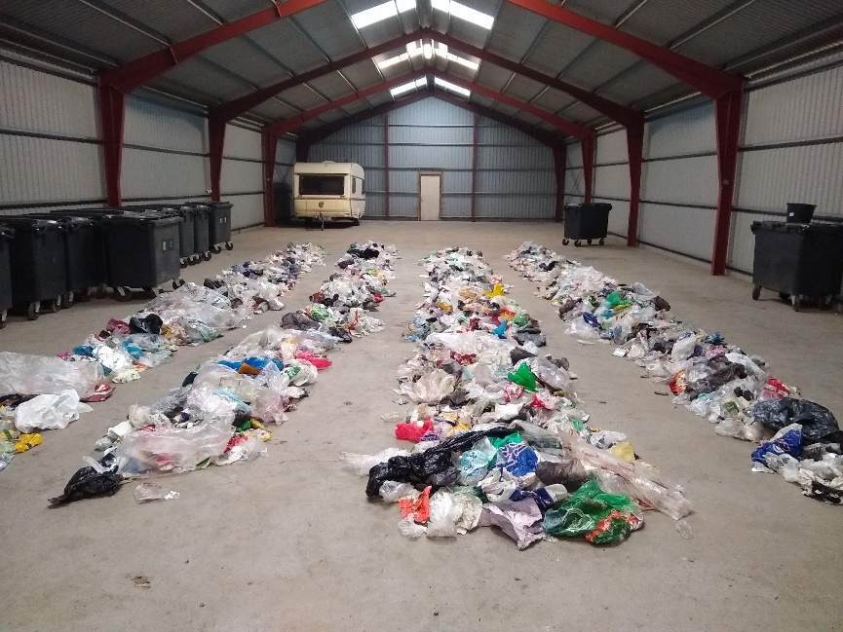
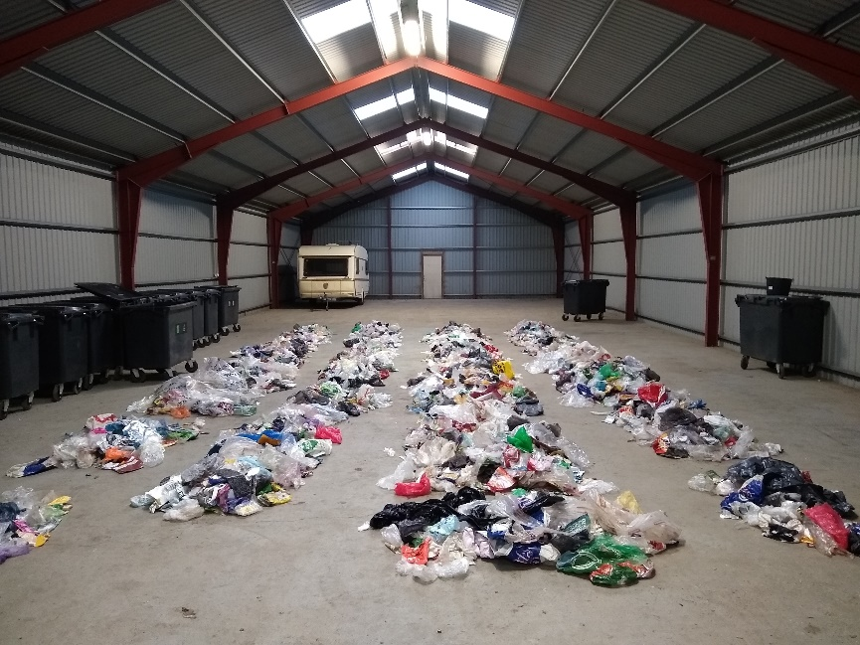
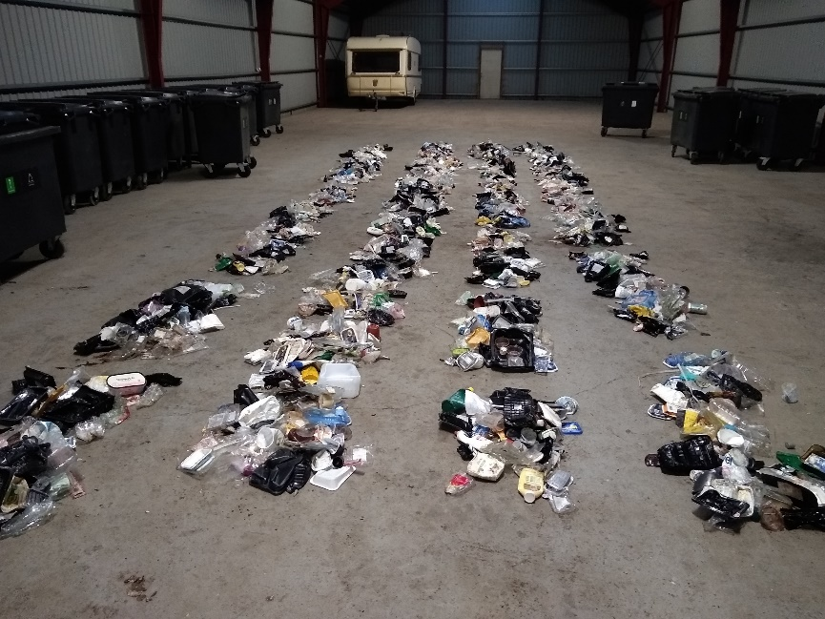
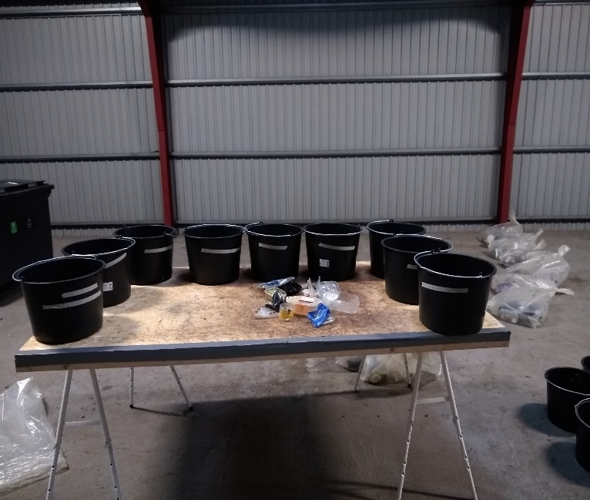
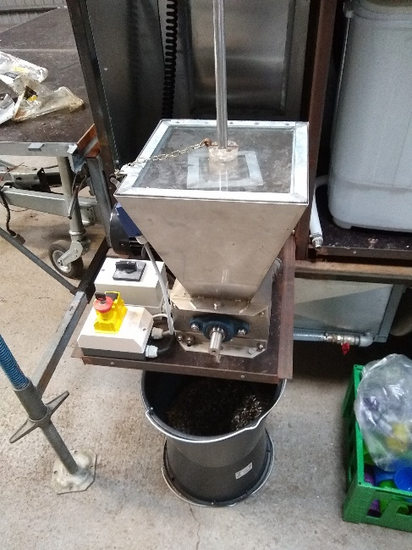
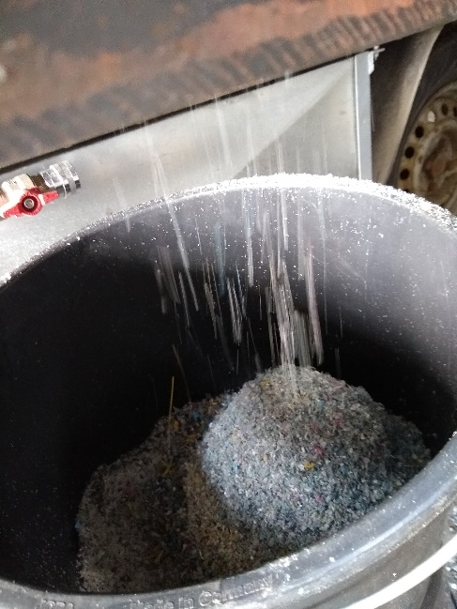
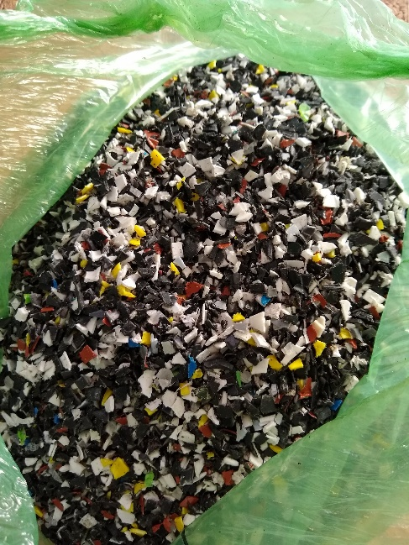
Recycled plastic quality
Ottesen og Petersen (2021)

Slide 8
Recycled plastic quality
Comparison before and after wash…
Ottesen og Petersen (2021)
Odense – foil plastic from residual waste
Copenhagen – foil plastic from source separated waste
Food LDPE
Technical LDPE
Food LDPE
Technical LDPE
Before wash
Food LDPE
Technical LDPE
Food LDPE
Technical LDPE
After wash

Slide 9
Gaschromatography
Recycled plastic quality
Chemical analysis of molecular contamination…
Ottesen og Petersen (2021)
LDPE foil plastic from residual waste Odense – after wash
LDPE foil plastic from source separated waste Copenmhagen after wash

Slide 10
Recycled plastic quality
- all known analytical comparisons
Plastic property | Plast type | Conclusion on quality | Year | Country | Reference
Polymer purity | Plastic in general | No difference | 2022 | Norway | Mepex Consult AS, 2022
 |  | In several cases best for post sorted plastic | 2021 | The Netherl. | van Velzen, Smeding, Brouwer & Maaskant-Reilink, 2021
 |  | No difference | 2014 | The Netherl. | Luijsterburg & Goossens, 2014
Particle contamination | PET bottles | Least contaminated for post sorted plastic | 2021 | The Netherl. | van Velzen, Smeding, Brouwer & Maaskant-Reilink, 2021
Chemical contamination - organic | LDPE bags | No significant difference | 2020 | The Netherl. | Maaskant-Reilink, van Velzen & Smeding, 2020
 | Plastic in genral | No significant difference | 2021 | Denmark | Ottesen & Petersen, 2021
Chemical contamin. - brom. flame retard. | Plastic in general | No significant difference | 2017 | Denmark | Pivnenko, Granby, Eriksson & Astrup, 2017
Chemical contamin. - heavy metals | PET, PE, PP and PS | Insignificant difference | 2018 | Denmark | Eriksen, Pivnenko, Olsson, & Astrup, 2018
Odor | LDPE bags | Difference in odor character No difference in odor intensity | 2020 | The Netherl. | Maaskant-Reilink, van Velzen & Smeding, 2020
 | Yellow bin vs. grey bin | The washing process means more than the collection method | 2020 | Spain | Cabanes, Strangl, Ortner, Fullana & Buettner, 2020
 | Plastic in general | Difference in odor character No difference in odor intensity | 2021 | Denmark | Ottesen & Petersen, 2021
Physical properties | HDPE, PP | No difference (smelteindeks, flydespænding, brudstyrke, brudforlængelse, elasticitet, slagsejhed) | 2020 | Denmark & Norway | Mortensen & Raussen, 2020
 | PE, film, PP, MP | No difference (trækstyrke, brudforlængelse) | 2014 | The Netherl. | Luijsterburg & Goossens, 2014

Slide 11
Climate benefits
Source separation
Post separation
Rambøll 2022 – comparative LCA

Slide 12
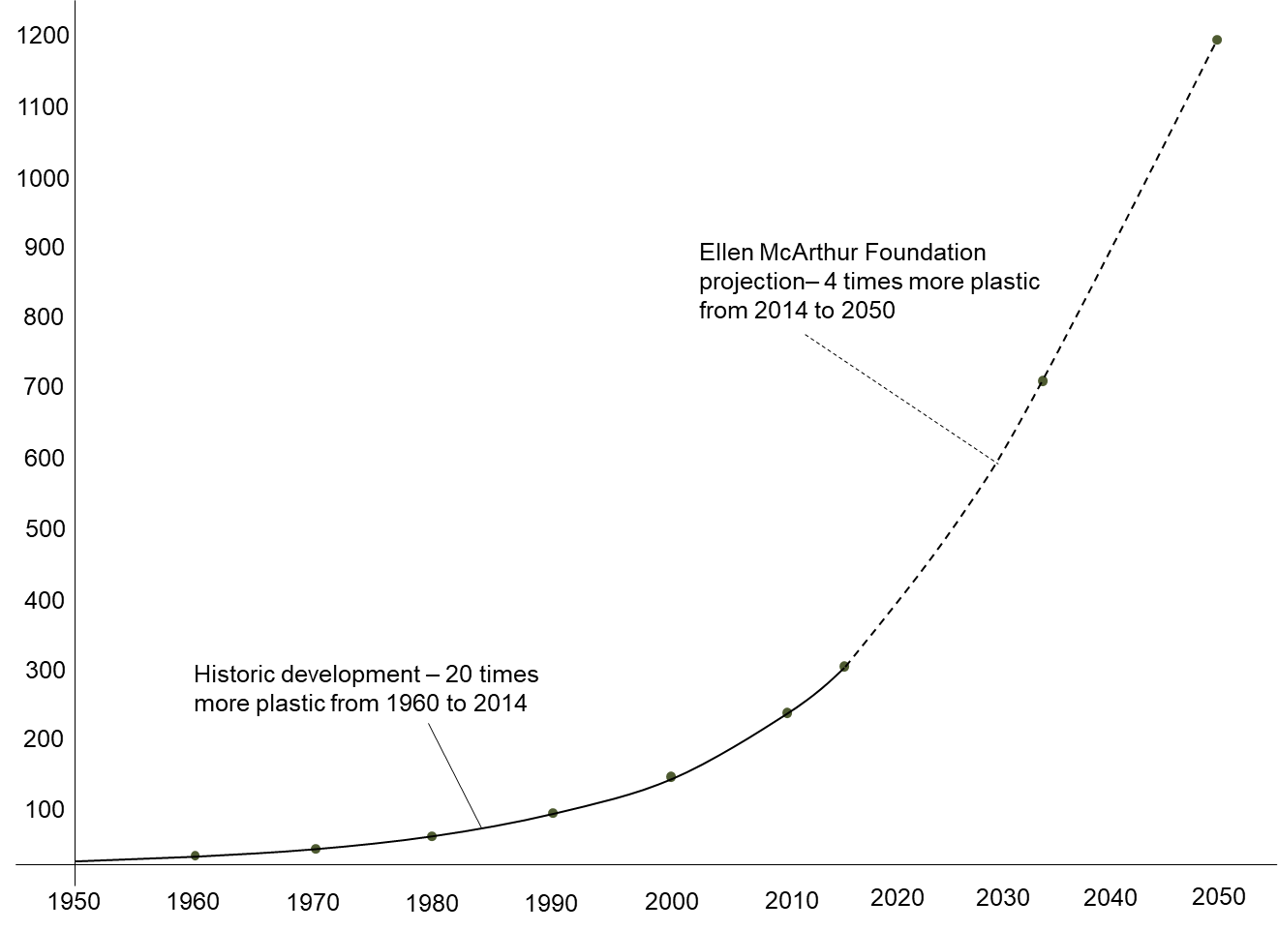
The nature of the plastic system
- material flows and plastic waste formation
Global plastic consumption
(Mt/year)

Slide 13
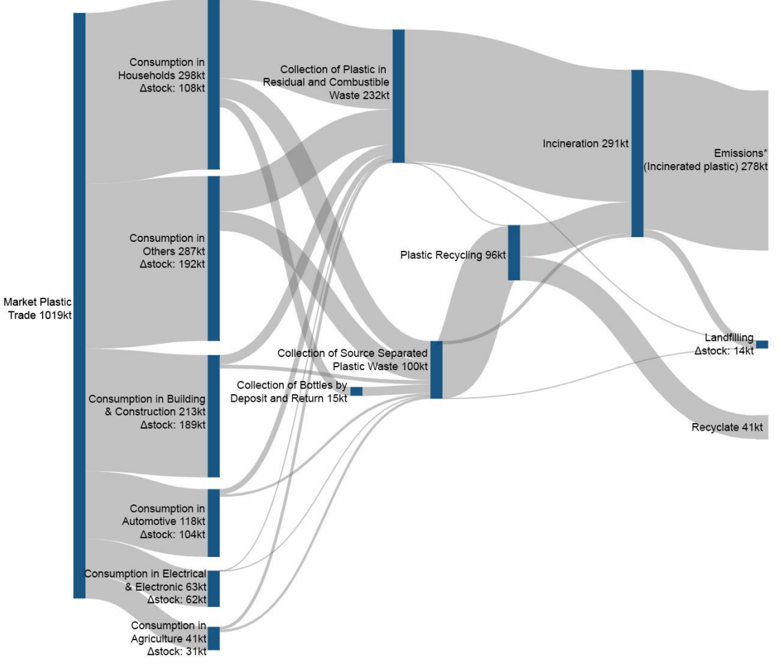
The nature of the plastic system
- material flows and plastic waste formation

Slide 14
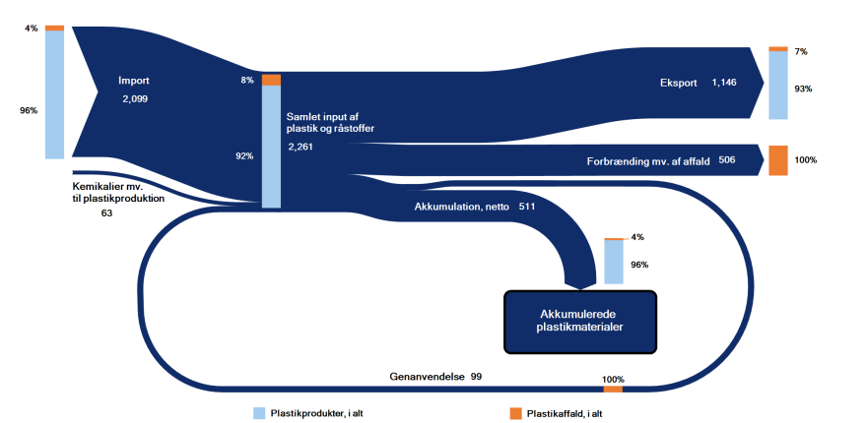
The nature of the plastic system
- material flows and plastic waste formation

Slide 15
The nature of the plastic system
- material flows and plastic waste formation
Global plastic consumption
(Mt/year)
Plastic waste formation
Plastic recycling

Slide 16
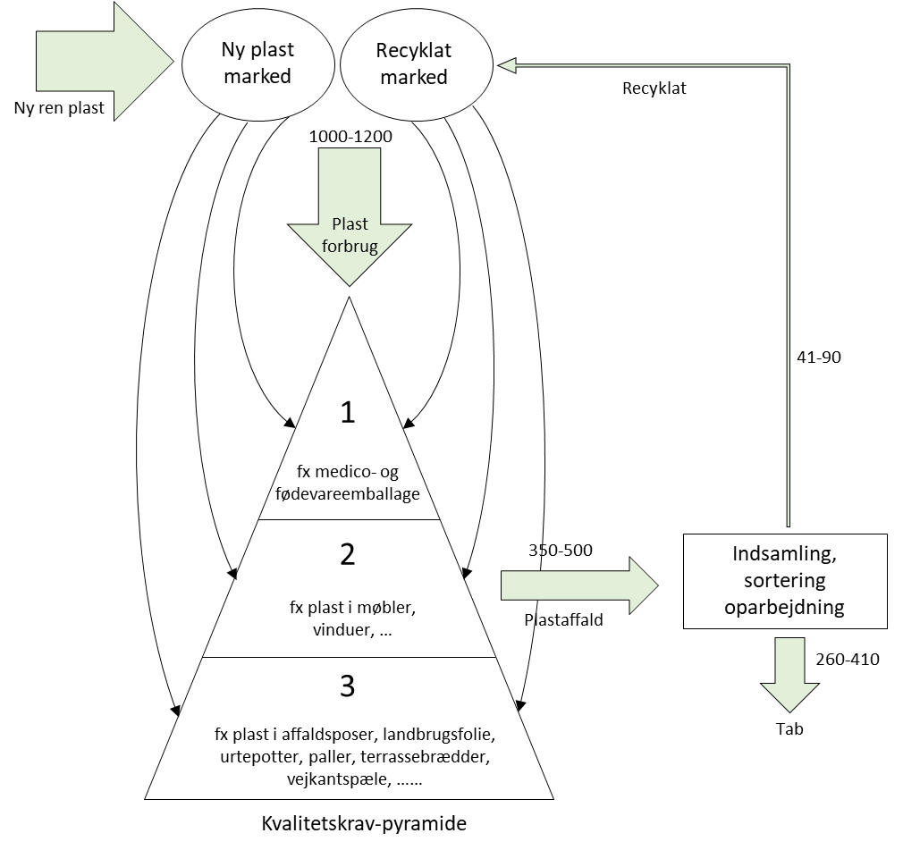
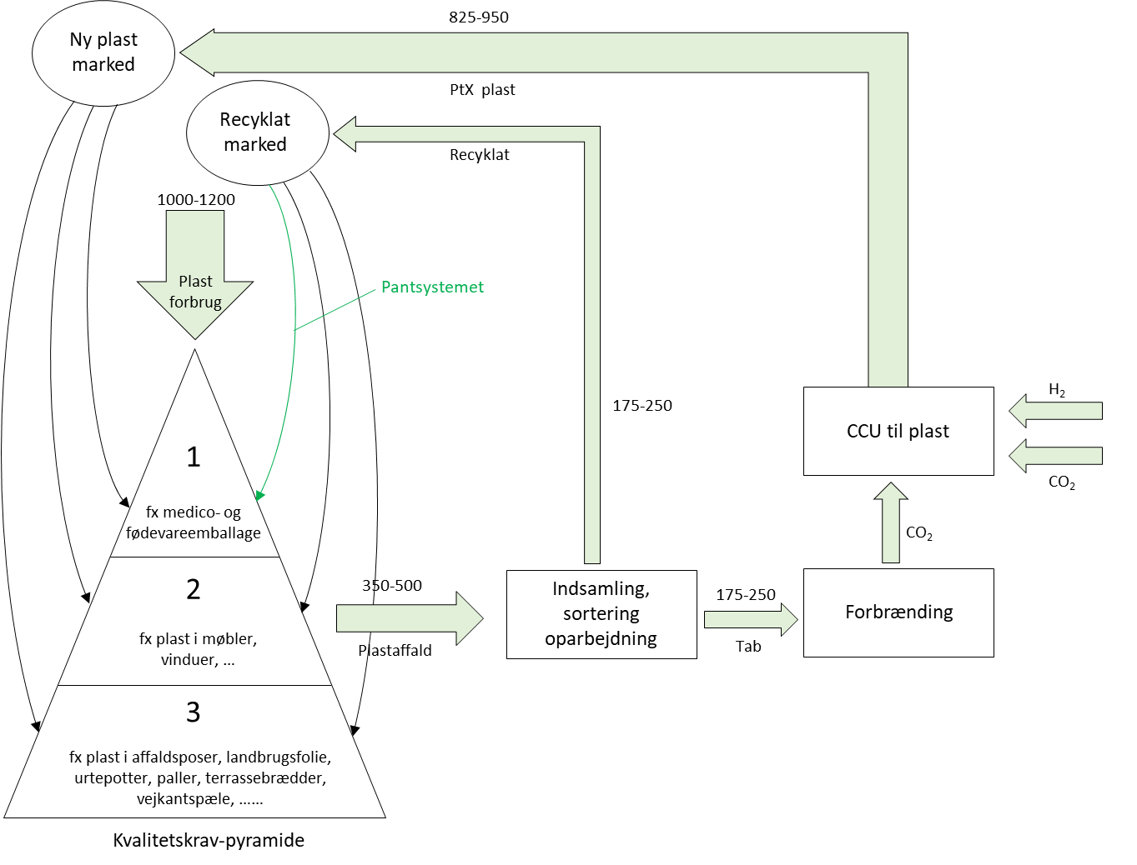
The nature of the plastic system
- material flows and plastic waste formation
Material flows in the plastic system with source separation (Pivnenko et al. 2019), (Ottesen og Petersen, 2021), (Urhammer et al., 2021)
Material flows in the plastic a fully circular system with post sorting and e-plastic made from CO2 and hydrogen
Numbers in kt/y

Slide 17
Experience from abroad
- post sorting replaces source separation in Norway and The Netherlands
From January 2019 to January 2021, 17 Dutch municipalities have left source separation of plastic and cartons after having established post sorting.
Municipality
Left source separation since
No. of Citizens
Later, Den Haag and other municipalities have followed

Slide 18



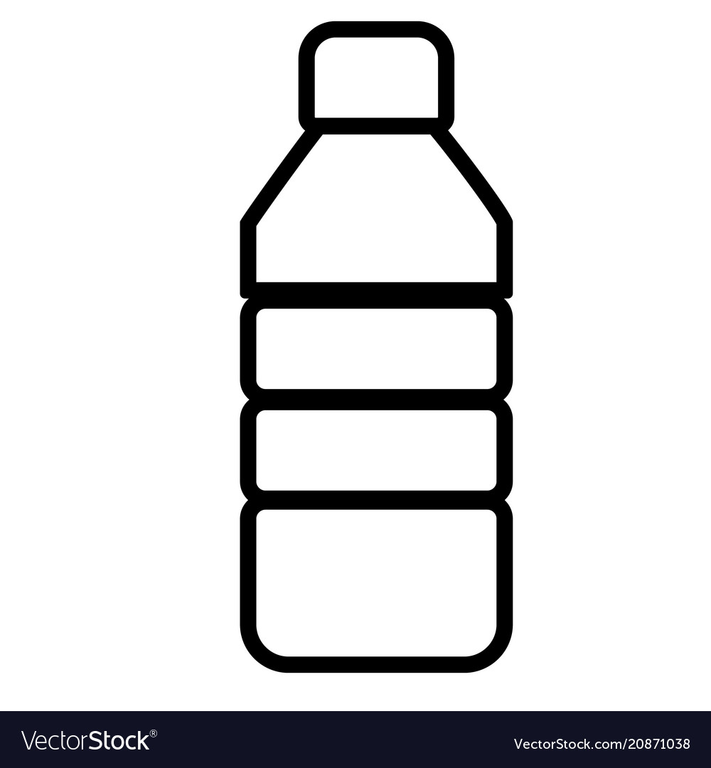





The vision for the future waste and plastic system
Paper & cardboard
Glass & metal
Plastic – medium quality
Mechanical recovery
Glass & metal
Residual waste
Storable fuel
Post sorting
Waste incineration
Plastic – only highest quality (food grade packaging) – e.g. via return system
Bio-waste
Bio-slurry
CO₂ + hydrogen
CO₂ + hydrogen
Plastic – highest quality
Source separation
Manure
Methane
Methane
Fuel
& plastic
Straw oa. residual
biomass
Biogas
GTL
Designer fertilizer
N, P, K, S, C
Gas grid
Agricultural soil

Slide 19

Q&A

