Slide 1
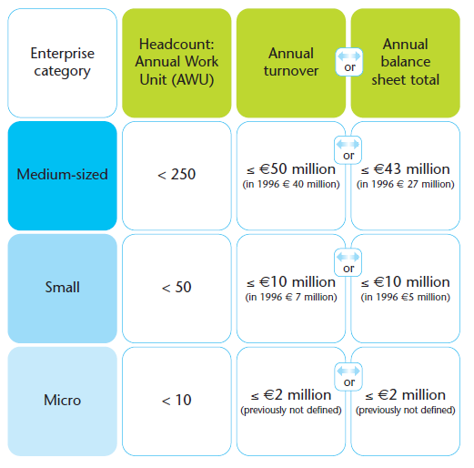
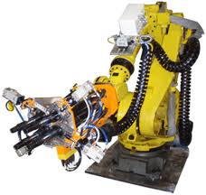
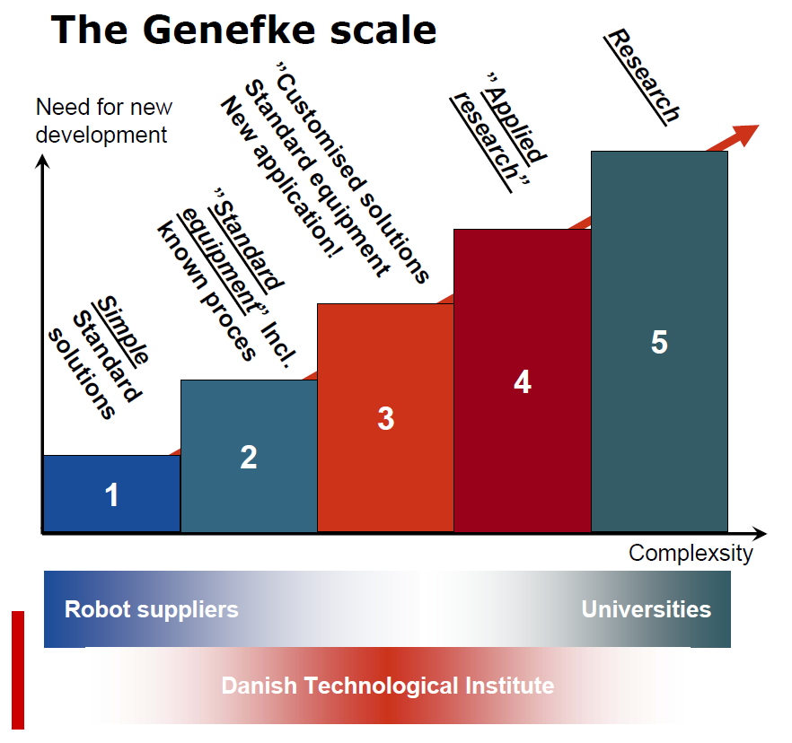
PhD Project
Technology in SME’s
SME’s has got a large impact on European economy (23 million SME’s provide 75 million jobs and represents 99% of all enterprises in the EU) and technology has been proclaimed to be one of the sources for the European SME’s to both survive and maintain jobs within the EU.
Henrik Blichfeldt| hbl@iti.sdu.dk
1
Investigation of SME’s in order to profile, categorize and create focus on what will built competitive advantage (CA) for manufacturing SME’s.
Manufacturing systems
SME’s
Reviewing and aligning known manufacturing systems with both manufacturing and technology outputs. Furthermore creating a conceptual profile of selected levers.
2
Framework
4
The aim of this PhD is to build a framework, supporting SME’s in selecting technologies and automation solutions, that can strengthen their competitive position, both currently and in future. Such decisions has to be built on the premises in which the SME operate, combined with the system in which they ‘value add’ their products.
Technology
3
Investigating the potential of building competitive advantage in SME’s through implementing technologies complementing the manufacturing system and SME profile.
The PhD is aligned with several of the work packages in the MADE initiative.
Cooperation's with SME’s are organized through the AutoSyd project and SAFIR project under the leadership of Region of Southern Denmark (Vækst forum).
Investigation of hard technologies and automation, from both a strategic and tactical perspective. Linking technology outputs to sources of competitive advantage.
Automation
SAFIR

