Slide 1
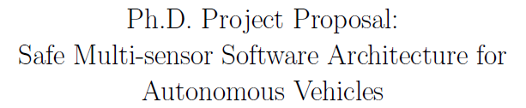


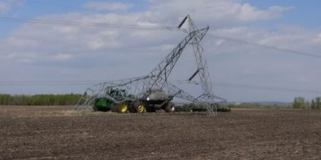
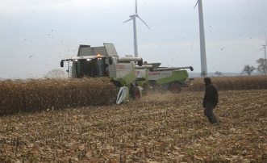
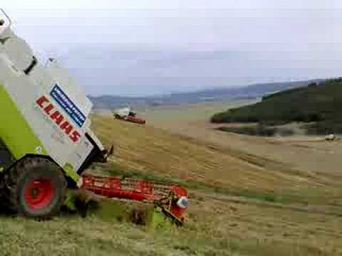
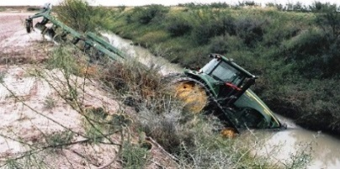
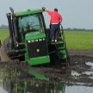
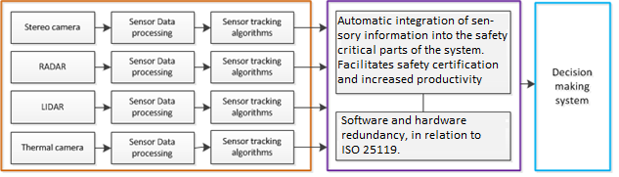
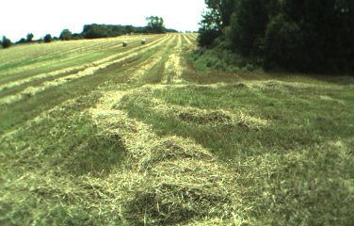

Project Requirements
Functional
Requirement
ISO Safety
Functional Safety
Johann Thor Ingibergsson Mogensen
Bandwidth
Processing Power
ISO 26262
Obstacle Detection and Handling
Interface
Optimal Configuration
Automatic generation and
Certification of new sensors.
Adhering to ISO25119, regarding development of HW and SW. Enabling safe communication between sensors and processing system.
Environmental Conditions
Latency
Real-Time
IEC 61508
Communication
ISO 13849
ISO 25119
Control
Fault Propagation
Distributed VS Centralized
Development Procedure
Fault Containment
Positive obstacles
Negative obstacles
Moving obstacles
Difficult Terrain
Obstacle Detection:
Design of safety-critical hardware for obstacle detection along with appropriate communication infrastructure.
Model-Driven Software Development will enable safe integration of sensors, and facilitate implementation of sensor fusion.
Perception:
Fusion of data from different sensors, to detect obstacles, enabling safe operation in the field.
Safety Critical
Zone
Design and development of hardware and software adhering to international safety standards.
Method for Automatic integration of sensory data into safety critical systems, using automatic program generation, thereby easing integration and verification of sensors and software.
Investigation of the ability of sensor-fusion to support safe operation of agricultural robots, by improving detection, handling and assessment of obstacles.
Project Proposal
Camera view

