Slide 1
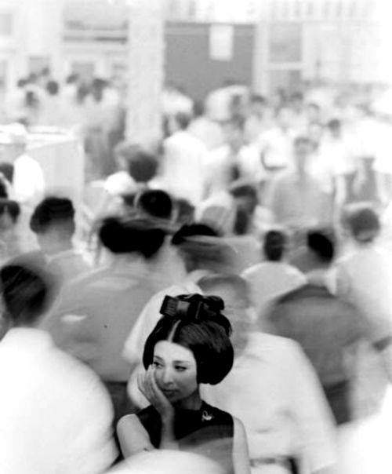
SDU International Club
OFFICIAL NEWSLETTER
No.77 – December 2013
December
Calendar
“An expert is a person who has made all the mistakes that can be made in a very narrow field.”
Niels Bohr, Danish physicist, 1885-1962
December 4th @ 19.oo
IC Dinner of the month
Meet new people and try excellent Italian cuisine at our monthly dinner at Simoncini Restaurant (Vestergade 70, 5000 Odense C). Simoncini's is centrally located in Odense and offers homemade Mediterranean cuisine using organic ingredients. Have dinner with your fellow internationals and make some new friends. Sign up as soon as possible to enjoy the dinner of the month at sgg@sdu.dk
Price: 150 kr.
(one course/one glass of wine)
December 7th @ 1o.45
The International Club invites you to a special Sport Event in the new SDU Fitness!
UNIQUE OPPORTUNITY for the SDU International Staff to get a special Introduction Day at the new SDU Fitness Center!!!
This is a great chance for you to be introduced to the basics of the fitness training. This could be the beginning of a new passion for some of you! And… Do not worry about your physical condition! You will be in the hands of real professionals. For the event will be engaged professional Fitness Instructors who will introduce you with care to the basics of the Fitness trainings. We will have also a Zumba Class for all of you! Men are also welcome to try it. This is your chance!
We meet at 10:00 at the SDU main entrance. Sign up at mrsa@sdu.dk , as soon as possible . The places are limited!
Please, note that you can sign up for one or both activities, so please remember to indicate your preferences in the sign up e-mail. Thank you!
Please note that places are limited.
by Evelina Kvartunaite
Each day brings something new to our lifes. It colours and brightens or sometimes, makes us stronger by throwing in challenges and lessons. And then there are those punctuations in our time line like holidays and ends of seasons which also brings reflections and determines our thoughts.
Now, as we are standing with pockets full of experiences 2013 brought us, it is nice to breathe in for a moment and smile and let it go. Become immortal in that moment. And… go on.
I would like to wish you all everything amazing and to remind you very simple thing in the words of M. Graham:
“There is a vitality, a life force, an energy, a quickening that is translated through you into action, and because there is only one of you in all of time, this expression is unique. And if you block it, it will never exist through any other medium and it will be lost. The world will not have it. It is not your business to determine how good it is nor how valuable nor how it compares with other expressions. It is your business to keep it yours clearly and directly, to keep the channel open. You do not even have to believe in yourself or your work. You have to keep yourself open and aware to the urges that motivate you. Keep the channel open. … No artist is pleased. [There is] no satisfaction whatever at any time. There is only a queer divine dissatisfaction, a blessed unrest that keeps us marching and makes us more alive than the others”
Stay happy! Stay merry! Stay curious! ☺
Page 1

Slide 2
December 10th @18.oo
Last SDU ladies night out of the year: Vegetarian Potluck
Would you like to help create an SDU women’s network?
Gloria has invited us to her house to discuss networking and work/life balance over dinner. Continuing in the scrumptious tradition of the past vegetarian evenings, please bring a dish to share for 4 people (and your own drinks).
More details later on.
December 11th @ 2o.oo
After dinner drinks and dancing to say goodbye to 2013!
Come join us for after dinner drinks at Nelle’s (Rosenbaek Torv 1, 5000 Odense. C.) Afterwards we will go for a dance in one of the known dancing floor in town.
Following the Danish tradition of the “Julefrokost” we meet to say goodbye to the old year that shortly gives entrance to 2014.
More details regarding the “International Julefrokost” very soon.
If you grow up the type of woman men want to look at, You can let them look at you. But do not mistake eyes for hands, Or windows for mirrors. Let them see what a woman looks like. They may not have ever seen one before. If you grow up the type of woman men want to touch, You can let them touch you. Sometimes it is not you they are reaching for. Sometimes it is a bottle, a door, a sandwich, a Pulitzer, another woman - But their hands found you first. Do not mistake yourself for a guardian, or a muse, or a promise, or a victim or a snack. You are a woman - Skin and bones, veins and nerves, hair and sweat You are not made of metaphors, Not apologies, not excuses. If you grow up the type of woman men want to hold, You can let them hold you. All day they practice keeping their bodies upright. Even after all this evolving it still feels unnatural, Still strains the muscles, holds firm the arms and spine. Only some men will want to learn what it feels like to curl themselves into a question mark around you, Admit they don’t have the answers they thought they would by now. Some men will want to hold you like the answer. You are not the answer. You are not the problem. You are not the poem, or the punch line, or the riddle, or the joke. Woman, if you grow up the type of woman men want to love, You can let them love you. Being loved is not the same thing as loving. When you fall in love, It is discovering the ocean after years of puddle jumping. It is realizing you have hands. It is reaching for the tightrope after the crowds have all gone home. Do not spend time wondering if you are the type of woman men will hurt. If he leaves you with a car alarm heart. You learn to sing along. It is hard to stop loving the ocean, Even after it’s left you gasping, salty. So forgive yourself for the decisions you’ve made, The ones you still call mistakes when you tuck them in at night, And know this. Know you are the type of woman who is searching for a place to call yours. Let the statues crumble. You have always been the place. You are a woman who can build it yourself. You are born to build.
- Sarah Kay
Announcement
Nice Christmas presents
The Odense-based scarf web shop www.besosscarves.com is opening every afternoon in week 51, Monday the 16th to Sunday the 22nd from 2pm until 4pm. We have a huge number of Danish designed scarves for both women and men - perfect for last minute Christmas presents! You can get your Christmas gift wrapped (for free) and take it home with you! We hope to see you in our Showroom, Vestergade 39, 4. sal., Odense C. All Christmas gifts can be exchanged until 15.1.13. --- Hannah West E: hannah.c.west@gmail.com
T: +45 2782 2757
Page 2
Contact us
For further information to:
icnewsletter_odense@yahoo.com
IC Newsletter’s Staff:, Evelina Kvartunaite,Editor and Design; Lorna Campbell, Proofreading.
Notes:
2

